Slide 1
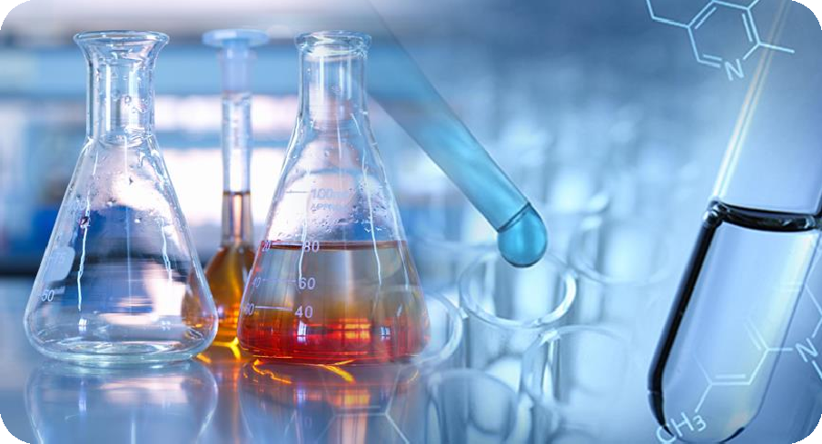


University of Hilla Vacuity of Nursing
Bio chemistry laboratory

Slide 2
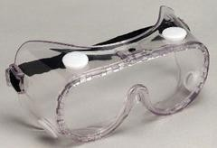
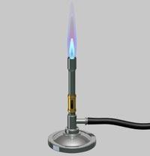
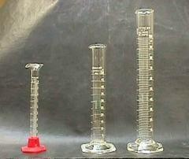
Lecture one
First stage
Instruments
  Instrument Name
Advantage
1) Goggles
protects eyes from chemical splashes.
2) Bunsen burner
used to heat substances.
3) Graduated cylinder
accurately measures liquid volumes

Slide 3
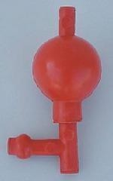
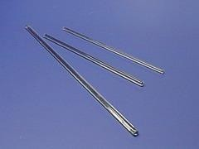
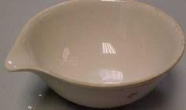
Lecture one
First stage
4) Pipet bulb
used to pull liquid up into a pipet
5) Stirring rod
used for stirring
6) Evaporating dish
liquids are heated over a flame so
that they evaporate, leaving
a solid residue

Slide 4
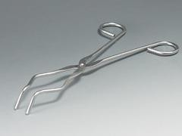
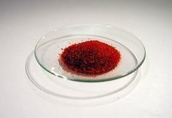
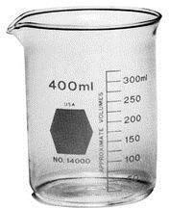
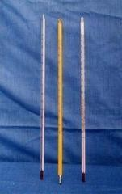
Lecture one
First stage
7) Crucible
to hold hot
8) watch glass
to hold solids while being weighed.
9) Beaker
used to hold liquids
10) Thermometer
measures temperature
(Science uses degrees in Celsius)

Slide 5
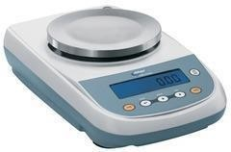
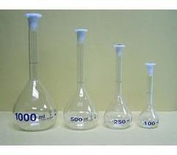
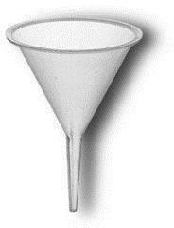
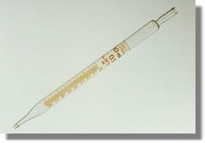
Lecture one
First stage
11) Balance
An Instrument for Determining Weight.
12) Volumetric flask
for making up solutions to a known volume
13) Funnel
for pouring liquid or other substance through a small opening
14) Volumetric pipet
measures small amounts of
liquids accurately

Slide 6
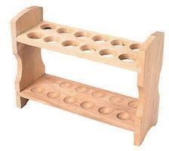
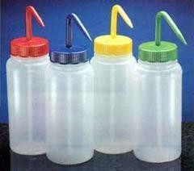
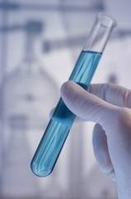
First stage
15) Test tube rack
holds test-tubes in a row
16) Wash bottle
used to rinse various pieces
of laboratory glassware
17) Test Tube
Open Tube Used To Hold Liquid

Slide 7
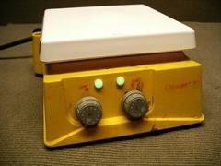
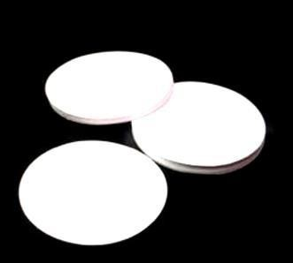
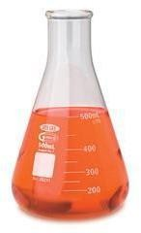
Lecture one
First stage
18) Hot plate
stir plate used to heat and stir
19) Filter paper
special paper used to separate solids from liquids
20) Conical flask
used to hold liquids,
has narrow neck to prevent splashes

