Slide 1
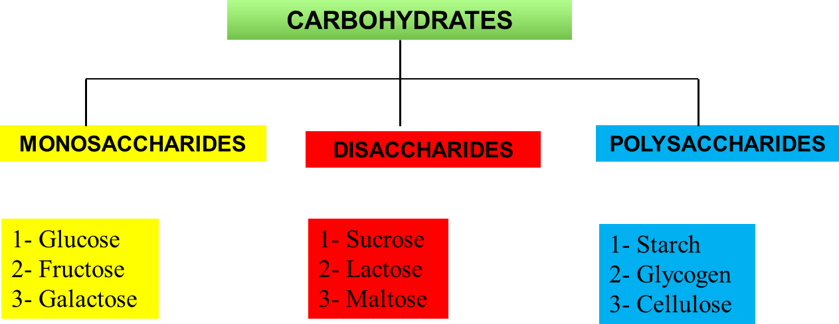
Carbohydrates is a biological compound containing carbon, hydrogen, and oxygen that is an important source of food and energy.
The body uses carbohydrates to make glucose which is fuel that gives your body energy. (glucose can be used immediately or stored).
Carbohydrates can be found in the following:
Fruits
Vegetables
Breads, cereals, and other grains
Milk & milk products
Foods containing added sugar
Photosynthesis chemical process which uses sunlight to turn carbon dioxide into sugars. It can happen in different ways, but there are some parts that are common
6 CO2(g) + 6 H2O + photons → C6H12O6(aq) + 6 O2(g)
carbon dioxide + water + light energy → glucose + oxygen
Classification of Carbohydrate
Monosaccharides are small organic molecules used as bulding blocks for more complex carbohydrates.
Many, but not all, carbohydrates have the empirical formula (CH2O)n
some also contain nitrogen, phosphorus, or sulfur

Slide 2
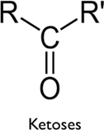
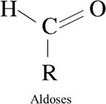
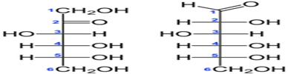
The two families of monosaccharides are aldoses and ketoses. we can be classifying according to the carboxyl group
If the carbonyl group is at an end of the carbon
chain (that is, in an aldehyde group), the monosaccharide is an aldose
if the carbonyl group is at any other position (in a ketone group), the monosaccharide is a ketose.
The simplest monosaccharides are the two three-carbon trioses:
glyceraldehyde, an Aldo triose, and dihydroxyacetone, a ketotriose

Slide 3
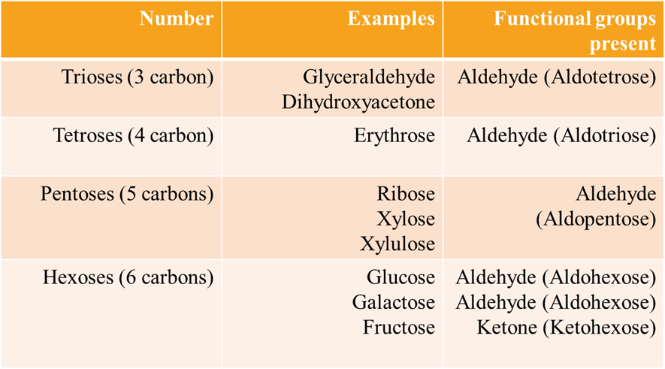
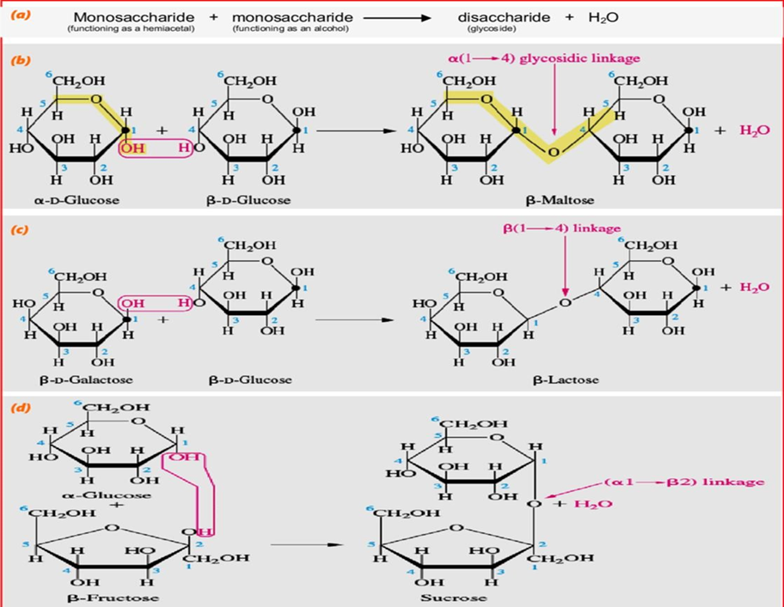
A disaccharide is a double sugar formed when two monosaccharides are joined via dehydration synthesis. In this type of synthesis reaction, one water molecule is lost as the bond is made. The formula of dehydration synthesis is as follows:
2 C 6 H 12 O 6 glucose + fructose → C 12 H 22 O 11 + H 2 O sucrose + water

Slide 4
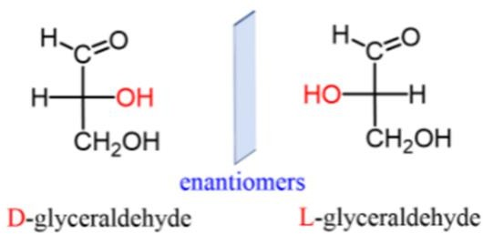
The compounds having asymmetric carbon atoms can rotate the beam of plane polarized light and are said to be optically active.
Enantiomer D dextrorotatory and L levorotatory-sugars

Slide 5
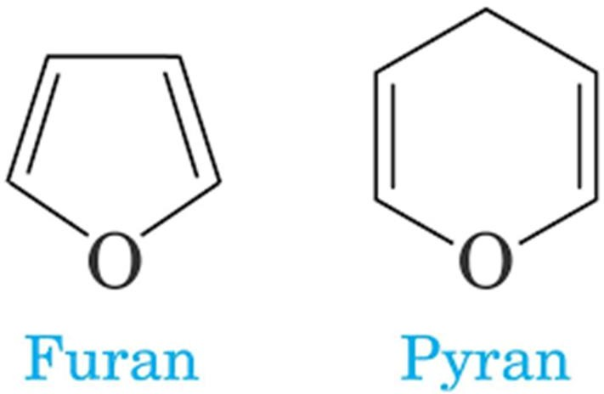
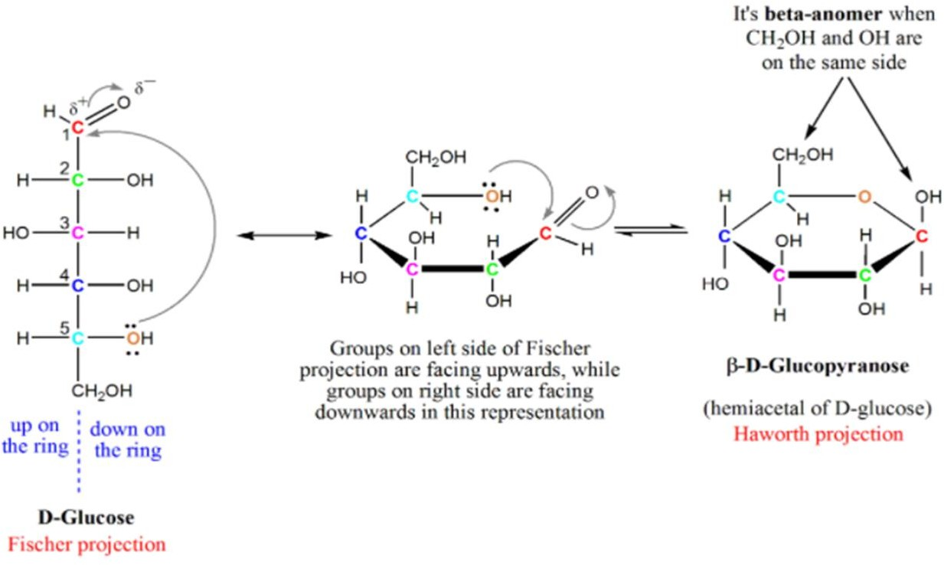
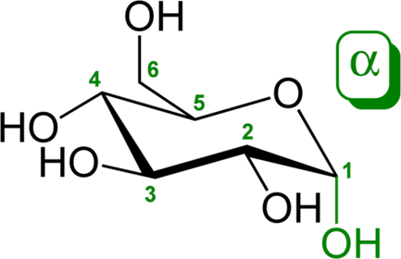
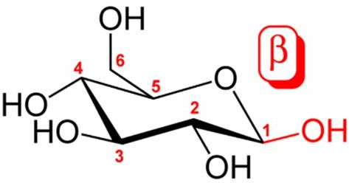
A glycosidic bond or glycosidic linkage is a type of covalent bond that joins a carbohydrate (sugar) molecule to another group, which may or may not be another carbohydrate to make compounds has more than one molecule.

Slide 6
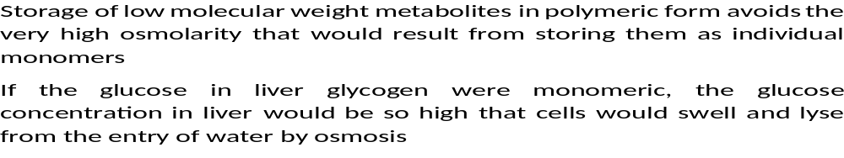
Poly saccharides
The polysaccharides are sugar polymers containing more than 10 monosaccharide units; some have hundreds or thousands of units
Some polysaccharides, such as cellulose, are linear chains; others, such as glycogen and amylopectin, are branched.
Starch is the most abundant polysaccharide after cellulose. It is a storage product and found in tubers, roots, seeds and other storage organs where it functions as a reserve nutrient for the growth and development of the plant.
Polysaccharides assume three-dimensional structures with the lowest-energy conformations, determined by :
covalent bonds, hydrogen bonds, charge interactions, and steric factors. Starch folds into a helical structure stabilized by internal hydrogen bonds
Cellulose assumes an extended structure which intermolecular hydrogen bonds are more important

Slide 7
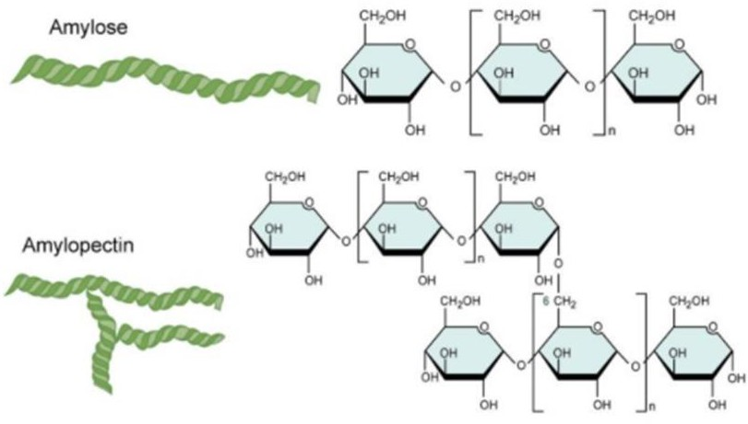
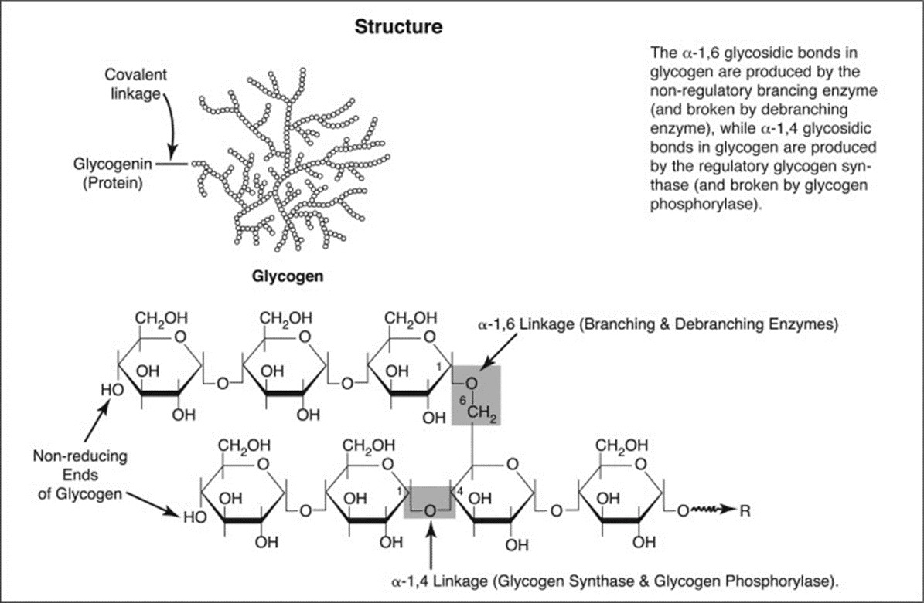
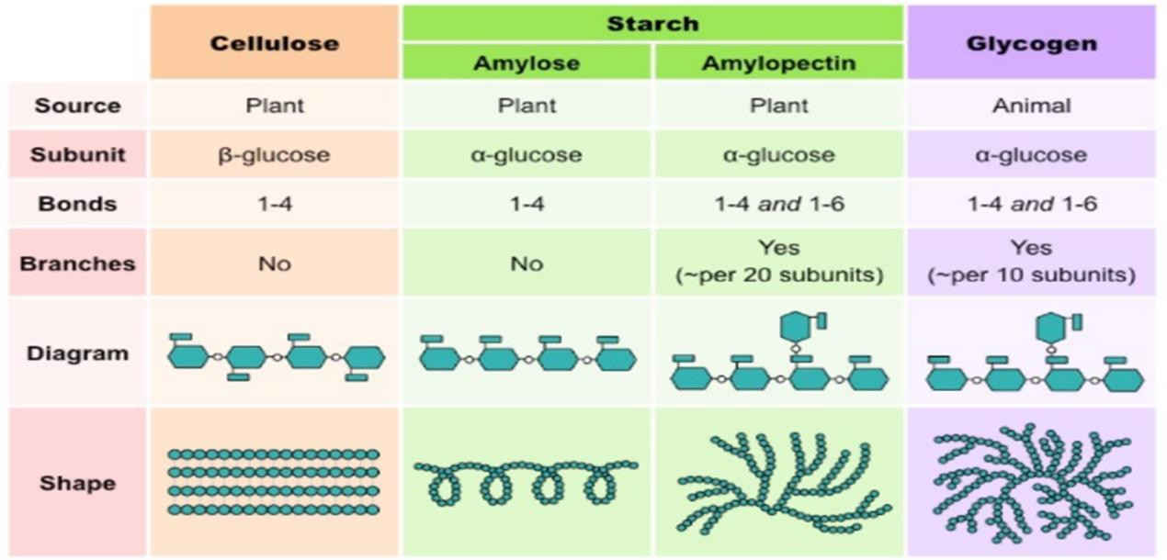
Glycogen

