Slide 1
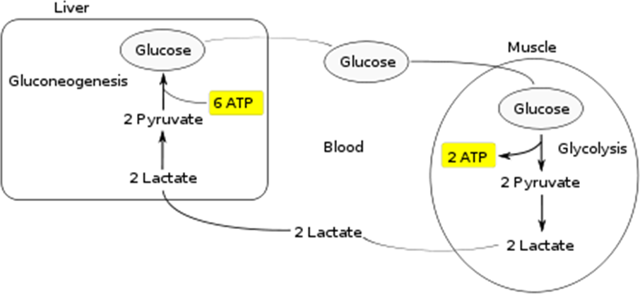
Carbohydrates metabolism Humans can consume a variety of carbohydrates, digestion breaks down complex carbohydrates into simple monomers (monosaccharides): glucose, fructose, mannose and galactose. After resorption in the gut, the monosaccharides are transported, through the portal vein, to the liver, where all non-glucose monosaccharides (fructose, galactose) are transformed into glucose as well.
Glucose (blood sugar) is distributed to cells in the tissues, where it is broken down via cellular respiration, or stored as glycogen. In cellular (aerobic) respiration, glucose and oxygen are metabolized to release energy, with carbon dioxide and water as end products.
Glycogenesis is the process of glycogen synthesis, in which glucose molecules are added to chains of glycogen for storage. This process is activated during rest periods following the Cori cycle (lactic acid cycle( in the liver, and also activated by insulin in response to high glucose levels.
Overall, the glycolysis steps of the cycle produce 2 ATP molecules at a cost of 6 ATP molecules consumed in the gluconeogenesis steps. Each iteration of the cycle must be maintained by a net consumption of 4 ATP molecules. As a result, the cycle cannot be sustained indefinitely. The intensive consumption of ATP molecules in the Cori cycle shifts the metabolic burden from the muscles to the liver.
Glycogenolysis is the breakdown of the molecule glycogen into glucose, a simple sugar that the body uses to produce energy. Glycogen is essentially stored energy in the form of a long chain of glucose, and glycogenolysis takes place in muscle and liver cells when more energy needs to be produced.

Slide 2
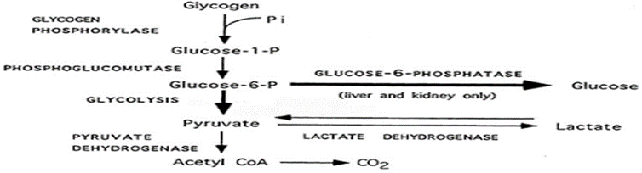

Slide 3
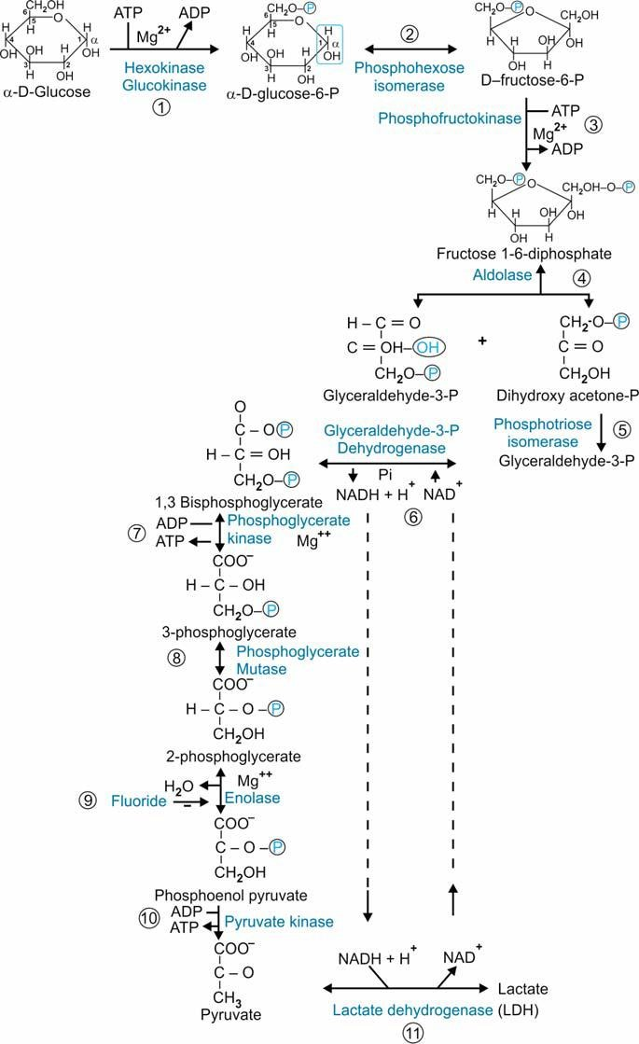
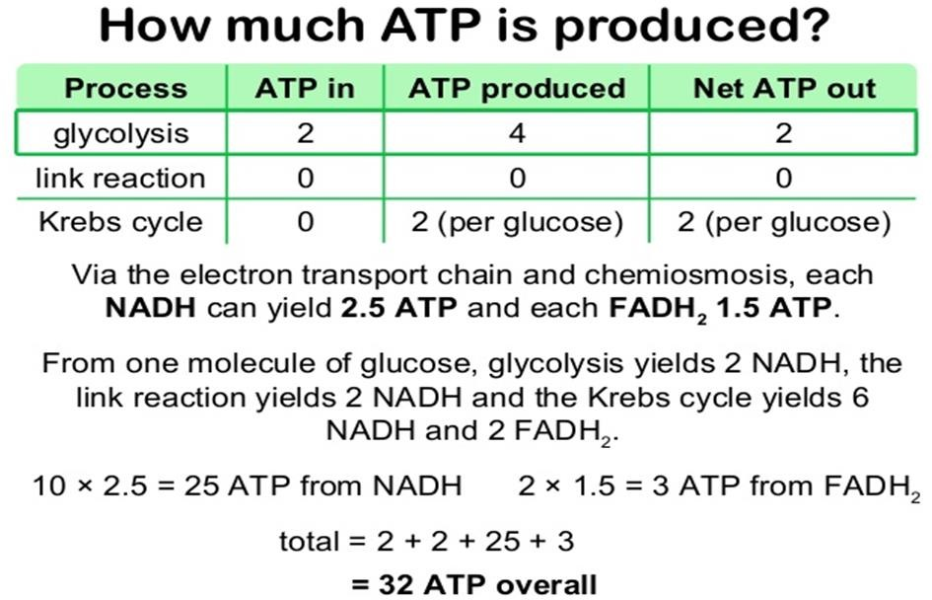
Glycolysis is the metabolic pathway that converts glucose C₆H₁₂O₆, into pyruvate, CH₃COCOO⁻, and a hydrogen ion, H⁺. The free energy released in this process is used to form the high-energy molecules ATP and NADH. Glycolysis is a sequence of ten enzyme-catalyzed reactions.

Slide 4
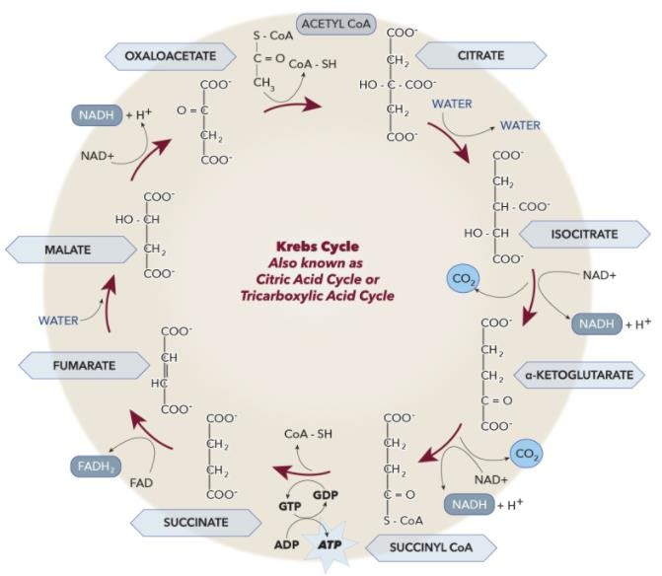
The citric acid cycle – also known as the TCA cycle (Tricarboxylic acid) or the Krebs cycle – is a series of chemical reactions used by all aerobic organisms to release stored energy through the oxidation of acetyl-CoA derived from carbohydrates, fats, and proteins.
Diabetes mellitus is a disorder in which the body does not produce enough or respond normally to insulin, causing blood sugar (glucose) levels to be abnormally high. Urination and thirst are increased, and people may lose weight even if they are not trying to.
Pathological events leading to type 1 and type 2 diabetes mellitus. The sequence of events leading to type 1 and type 2 diabetes mellitus is schematically shown together with relevant biomarkers. Development of type 2 diabetes is caused by constitutional factors and genetic predisposition. These factors favor insulin resistance which is accompanied by elevated insulin and C-peptide concentrations as counter regulatory mechanism in the early stage of disease progression. Consequently, this may lead to a dysregulation of the pancreatic beta cells characterized by an impaired glucose tolerance. Further exacerbation finally ends in the manifestation of type 2 diabetes due to beta cell

Slide 5
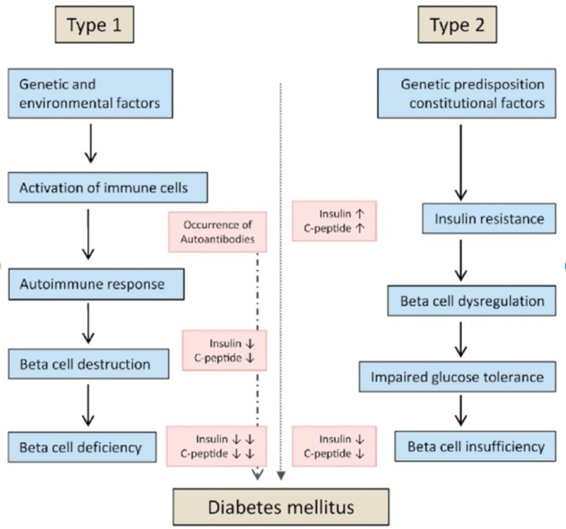
insufficiency accompanied by inadequately reduced insulin and C-peptide secretion and plasma concentrations. In contrast, the development of type
1 diabetes mellitus is assumed to be associated with genetic and environmental factors. The initial step in the progress of type 1 diabetes is not fully understood. It is presumed that activation of immune cells leads to an autoimmune response accompanied by the formation of high-affinity autoantibodies against antigens of the pancreatic beta cell. Subsequent beta cell destruction leads to insulin and C-peptide deficiency and finally to the manifestation of type 1 diabetes mellitus.

