Slide 1
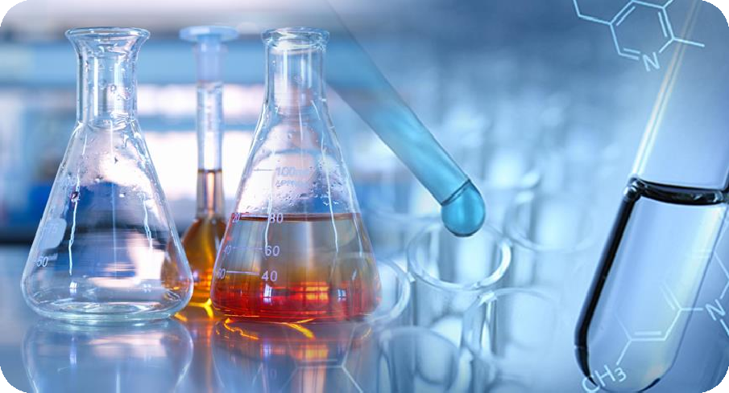

Lecture two
First stage
University of Hilla Faculty of Nursing
Biochemistry laboratory
f
First Stage

Slide 2
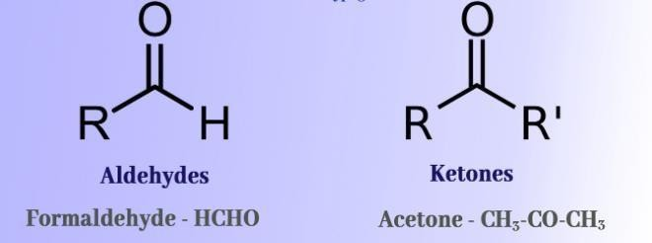
Lecture two
First stage
Introduction
Carbohydrates: organic compounds. has the general formula (C_{n}H_{2n}O_{n}). The simplest carbohydrates also contain either an aldehyde (these are termed (polyhydroxyaldehydes) or a ketone (polyhydroxy ketones)
Important of Carbohydrates
1-Glucose is a major fuel of the tissues of mammals and can be stored as glycogen for energy
2-Ribose and deoxyribose is a component of RNA and DNA, respectively
3-Galactose is the main component of milk
4- Many diseases associated with defects in CHO metabolism e.g. {diabetes mellitus (DM), glycogen storage diseases}.
5-Polysaccharides are structural elements in the cell wall of bacteria, plants.
6- CHO play a key role in cell-cell recognition process.

Slide 3
Lecture two First stage
Classifications of carbohydrate
1-Monosaccharides
2- Disaccharides
3-Oligosaccharides (from two to ten monosaccharide units, linked by glycosidic bonds)
4-Polysaccharides (hundreds of monosaccharide units).
Note: Carbohydrates can combine with lipid to form glycolipids or with protein to form glycoproteins.
General tests for carbohydrates
  Solubility test
  Molisch test
  Sulfur test
  Iodine test
Tests for reduced carbohydrates (sugars)
    fehling's test
    Benedict's test
    Parvo's test
    ozone's test
    Seliwanoffs test
    Tollen's test

