Slide 1
Biochemistry
Lipids
By: Maysam Ali Ameen Awadh
& Shaima Alsabty

Slide 2
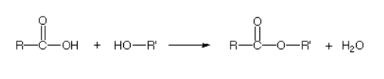
Lipids are heterogeneous group of naturally occurring compounds insoluble in water and soluble in nonpolar organic solvents.
They are Classification into:
Simple lipids: Fats and waxes.
Compound lipids: glycolipids and lipoproteins.
Derived lipids: Fatty acids and cholesterol
Notes:
the chemical reaction of a carboxylic acid with an alcohol.

Slide 3
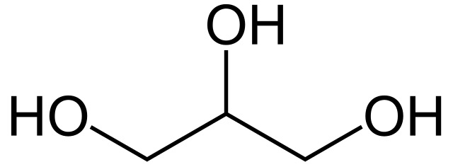
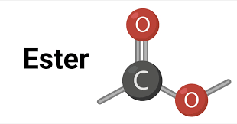
Fats is any of a group of natural esters of glycerol and various fatty acids, which are solid at room temperature and are the main constituents of animal and vegetable fat.
Oil is any of a group of natural esters of glycerol and various fatty acids,which are liquid at room temperature.
Glycerol

Slide 4
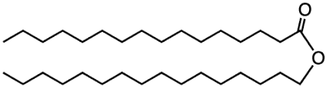
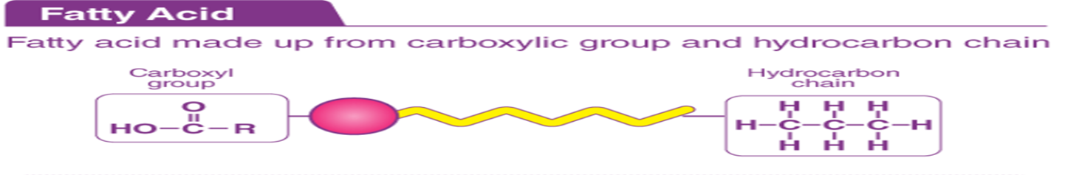
Waxes are organic compounds that characteristically consist of long aliphatic alkyl chains, although aromatic compounds may also be present. Natural waxes may contain unsaturated bonds.
Fatty acids are merely carboxylic acids with long hydrocarbon chains.The hydrocarbon chain length may vary from 10-30 carbons (most usual is 12-18).

Slide 5
FUNCTIONS OF LIPIDS
Storage of energy.
Absorption of vitamin.
synthesis of cholesterol and hence steroid hormones.
Help in blood coagulation.

Slide 6
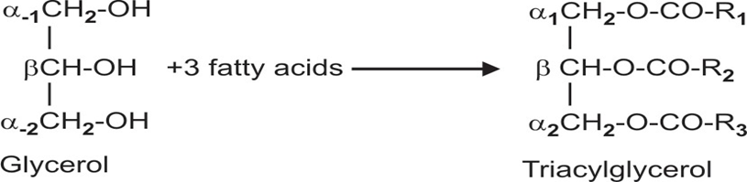
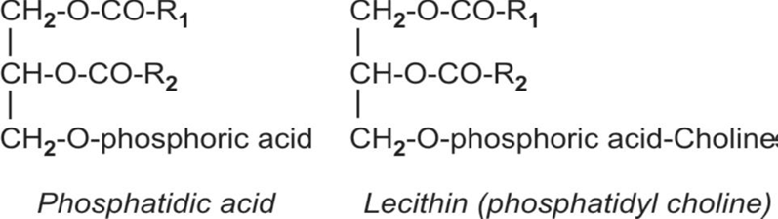
Simple Lipids
Triglyceride = glycerol attached with three fatty acid.
Compound Lipids
Glycerophospholipids

Slide 7
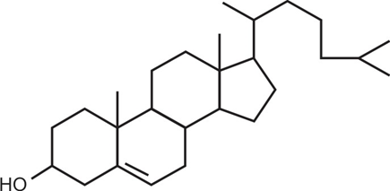
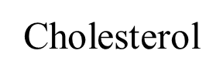
Derived lipids: fatty acids that can originate from the simple and compound lipids by means of hydrolysis, Such as cholesterol, bile acids.
Steroid: any of a class of natural or synthetic organic compounds characterized by a molecular structure of 17 carbon atoms arranged in four rings.

Slide 8
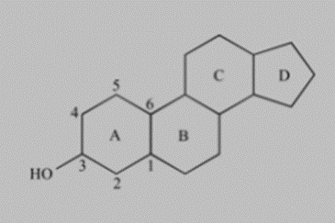
The steroid group includes all the sex hormones, adrenal cortical hormones, bile acids, and sterols of vertebrates, as well as the molting hormones of insects and many other physiologically active substances of animals and plants.
Sterols are a subgroup of steroids with a hydroxyl group at the 3-position of the A-ring.

Slide 9
Properties of lipids
Lipids may be either liquids or non-crystalline solids at room temperature.
Pure fats and oils are colorless, odorless, and tasteless.
They are energy-rich organic molecules
Insoluble in water
Soluble in organic solvents like alcohol, chloroform, acetone, benzene, etc.
No ionic charges
Solid triglycerols (Fats) have high proportions of saturated fatty acids.
Liquid triglycerols (Oils) have high proportions of unsaturated fatty acids.

Slide 10
Lipid Metabolism Overview
• Involves oxidation of fatty acids to generate energy or synthesize new lipids from small constituent molecules .
• Associated with carbohydrate metabolism as products of glucose (such as acetyl CoA) can be converted into lipids.
• Starts in the intestine where triglycerides are broken down into smaller chain fatty acids and monoglycerides by pancreatic lipases, enzymes that break down fats after they are emulsified by bile salts
• Cholecystokinin (CCK) is released when food reaches the small intestine.

Slide 11
Lipids may follow one of several pathways during metabolism. Glycerol and fatty acids follow different pathways.
Bile acids are steroid acids found predominantly in the bile of mammals and other vertebrates. Diverse bile acids are synthesized in the liver. Primary bile acids are synthesized by the liver.

Slide 12
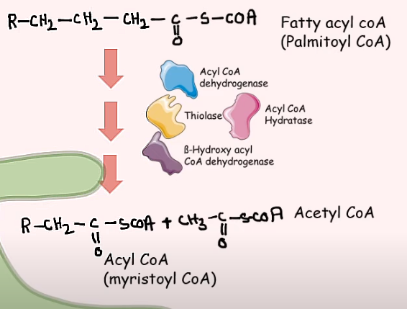
Fat oxidation refers to the process of breaking down fatty acids to generate Acetyl CoA which can then either enter the citric cycle or be used for the synthesis of fatty acids and cholesterol or in acetylation reactions.. To oxidize fat one needs: Healthy mitochondria, energy is generated for muscle contraction by burning fuel, using oxygen and producing carbon dioxide)

Slide 13
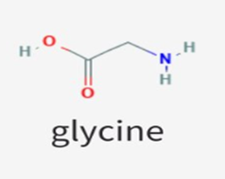
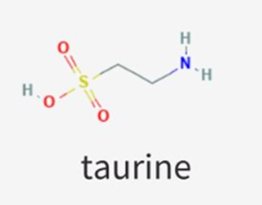
Bile acids are conjugated with taurine or glycine residues to give anions called bile salts.

Slide 14
Lipid metabolism disorders, such as Gaucher disease and Tay- Sachs disease, involve lipids. Lipids are fats or fat-like substances. They include oils, fatty acids, waxes, and cholesterol. If you have one of these disorders, you may not have enough enzymes to break down lipids

Slide 15
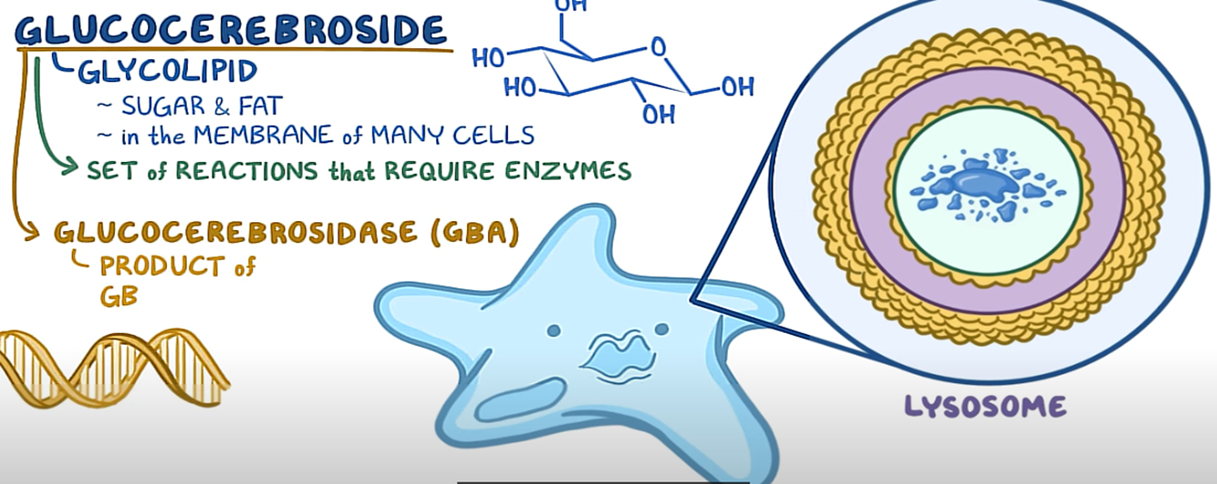
Gaucher disease caused by a deficiency of the lysosomal enzyme, glucocerebrosidase

Slide 16
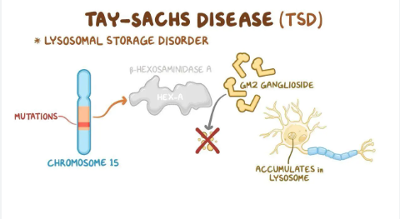
a deficiency of the enzyme beta-hexosaminidase A.

Slide 17
THANKE YOY

