Slide 1
Parasitology
Lec 1
Introduction & Amebae spp.
By Dr. MAYSAM ALI AMEEN

Slide 2
Definitions
Parasitology: is the science dealing with the study of protozoa & pathogenic effects.
Medical Parasitology: is the science that studies of parasites which infect human.
Parasite: an organism that live in or on anther organisms (host) and obtains its food from host.
Host: an organism which harbors parasite.
Reservoir: is the host that stores the parasite (usually animals).

Slide 3
Infection: is the process of living parasites in the hosts' body
Infestation: is the process of living parasites only on the surface of the hosts' body without penetrating the tissue. Example: Lice , ticks
Zoonosis: is defined as those diseases and infections, which are naturally transmitted from animals to human.
Pathogens: Are those organisms which causing diseases as bacteria, parasites, fungi, virus.

Slide 4
Pathogenesis: is defined as development of a disease (How disease starts, develops and resolves).
Pathogenicity: is defined as ability to cause disease
Pathogenic stage: is a stage of parasite life cycle that causing disease with in host.
Diagnostic stage: is a stage of parasite life cycle which use for diagnosis the parasitic infection and its disease
Infective stage: is a stage of the parasite life cycle which have ability to infect the host.

Slide 5
Some terms in Epidemiology
Endemic: constant presence of a disease or infectious agent within a given geographic area or population group
Epidemic: is (outbreak) or occurrence of one specific disease from a single source, in a group population, community, or geographical area, in excess of the usual level of expectancy
Pandemic: is an epidemic usually affecting a large number of populations, occurring over a wide geographic area such as the entire nation, a continent or the worldwide.

Slide 6
Sporadic: Sporadic means scattered of infected individual, occur from time to time, The infected individuals or cases are so few and separated widely in space and time, and no recognizable common source of infection
Incidence: number of new cases of specific disease during a given geographic area at a given period of time
Prevalence: Number of current case or infected person (old and new) with a disease at a given geographic area at a specified point or period of time

Slide 7
Different kinds of parasites
Microparasite: small, unicellular and multiplies within its vertebrate host, often inside cells. Protozoa are microparasites.
Macroparasite: large, multicellular and has no direct reproduction within its vertebrate It’s includes helminths. On the basis of their location.
Ectoparasites: a parasitic organism that lives on the outer surface of its host, e.g. lice, ticks, mites
Endoparasites: parasites that live inside the body of their host, e.g. Entamoeba histolytica.

Slide 8
Endoparasites can be further subdivided into the following types:
Obligate parasites: This parasite is completely dependent on the host during a segment or all of its life cycle, e.g.(Plasmodium and Toxoplasma gondii).
Facultative parasites: an organism that exhibits both parasitic and non-parasitic modes of living and hence does not absolutely depend on the parasitic way of life, but is capable of adapting to it if placed on a host. Facultative parasite as a commensal, but may become parasitic. E.g. Naegleria.
Accidental parasites: organisms that attack an unusual host e.g. Echinococcus

Slide 9
Aberrant parasites: organisms that attack a host where they cannot live or develop further e.g. Toxocara canis in man.
opportunistic parasite: that particularly those take advantage of certain situations.
Free-living: it describes the nonparasitic stages of existence which are live independently of a host, e.g. hookworms have active free-living stages in the soil.

Slide 10
The Vector
Vector: is an agent usually arthropod (insect) that transmits the parasite to the host and may be
Mechanical vector refers to a vector that facilitates the transfer of parasitic forms between hosts but is not essential in the life cycle of the parasite, such as houseflies and cockroaches in the case of Entamoeba, by transferring the parasite's cysts from infected feces to food consumed by humans.
The biological vector is crucial in the parasite's life cycle, as it aids in the pathogen's development and reproduction before being transmitted to the next host. Intermediate host existence is essential for some parts of the life cycle, including asexual reproduction.

Slide 11
Three essential characteristics that are examined to study the causes for disease in epidemiological study are:
1- Host
2- Agent
3- Environment

Slide 12
Epidemiology is identify:
1-source of infection,
2-mode of infection and spread
3-Susceptible host
4-Etiological factor
5-recommend control measures

Slide 13
Different kinds of hosts
1• Definitive host: a host that harbors a parasite in the adult stage or where the parasite undergoes a sexual method of reproduction.
2• Intermediate host: harbors the larval stages of the parasite or an asexual cycle of development takes place. In some cases, larval development is completed in two different intermediate hosts, referred to as first and second intermediate hosts.
3.Reservoir host: a host that makes the parasite available for the transmission to another host and is usually not affected by the infection.

Slide 14
4.Natural host: a host that is naturally infected with certain species of parasite.
5• Accidental host: a host that is under normal circumstances not infected with the parasite.
6. Compromised host: it is the one in whom normal defense mechanisms are impaired e.g. AIDS
7.Paratenic host: it is a host in which the larval stage of a parasite survives but does not develop further. It is often not a necessary part of the life cycle.

Slide 15
Types of parasite- host relationships are:
Phoresis: the parasite transport through the host with mechanism. E. histolytica
Commensalism: this relation positive for parasite while neutralized for host.
Mutualism: positive for parasite and host.
Parasitism: positive for parasite and negative for host.
Symbiosis: “living together“; a close association between two organisms.

Slide 16
Source of the infection
Patient: persons who have parasites in their body and show clinical symptoms.
Carrier: persons who have parasites in their body, not show symptoms.
Reservoir host: animals that harbor the same species of parasites as man, the parasites in animals sometimes can be transmitted into human.

Slide 17
Transmission of infection
modes or portals of entry the host: ingestion, inoculation, inhalation, congenital, venereal, and other.
portals of exit from host: respiratory tract, gastrointestinal tract, genital tract, biting insect, and allergy.

Slide 18
Types of transmission
Congenital transmission: from mother to infant , e.g., toxoplasmosis
Contact transmission: direct contact or indirect contact with patients or infected animals, e.g., Trichomonas vaginalis
Food transmission: the infectious stage of parasites contaminated food / the meat of the intermediate hosts containing infectious stage of parasites , e.g., Clonorchiasis
Water transmission: drink or contact the water contaminated the infectious stage of parasites, e.g., schistosome, Entamoeba histolytica

Slide 19
Soil transmission: soil contaminated by feces containing the certain stage of parasites which can develop into infective stage, e.g., Ascaris lumbricoides .
Arthropod transmission: vectors of certain parasitic diseases, e.g., plasmodium

Slide 20
Prevention measures of parasitic diseases
Controlling the source of the infection: treatment of the patients, carriers and reservoir hosts
Blocking the routes of transmission: managing feces and water resource, controlling or eliminating vectors and intermediate hosts
Protecting the susceptible hosts: paying attention to health education/ personal hygiene, changing bad working/ eating habit, etc.

Slide 21
The infected phases of parasites:
ovum.
larva.
cyst.
adult phase (worm).
The parasites of medical importance fall into kingdom:
Protista
animalia.

Slide 22
The parasites are classified as four phyla which are:
Protozoa is single organism microscopic (belong to Protista)
platyhelminthus (cestoda)
nematoda
trematoda
Helminthes are macroscopic multicellular organisms or worms, belonging to Animalia, with well-differentiated tissues and organ systems, ranging in length from less than millimeter to over meter.

Slide 23
Classes of Protozoa:(singular, protozoan), from the Greek ‘protos’ and ‘zoon’meaning first animal
According to their organelle of locomotion have been divided into four major classes:
Rhizopods (Sarcodina): they have pseudopodia and the mode of reproduce by binary fission. Such as E. histolytica
Ciliaphora: they have cilia and the mode of reproduce by binary fission. Such as Blantidium coli
Mastigophora or flagellated : they have flagella and the mode of reproduce by binary fission.
Sporozoa or Apicomplexa : is non motile and reproduce by sporogony\schizogony. Such as Plasmodium species.

Slide 24
Morphology of protozoa: They are made up of Protoplasm which consist from :
The cytoplasm :divided
A\ into outer layer of hyaline ectoplasm .The ectoplasm functions in protection, locomotion, and ingestion of food, excretion, and respiration.
and an inner granular endoplasm.
B\ In the endoplasm there which contain Nucleus
2. The Nucleuses (nuclear membrane and chromatin).has important roles in reproduction and maintaining life.
Chromatin may be condensed in a single mass (karyosome)

Slide 25
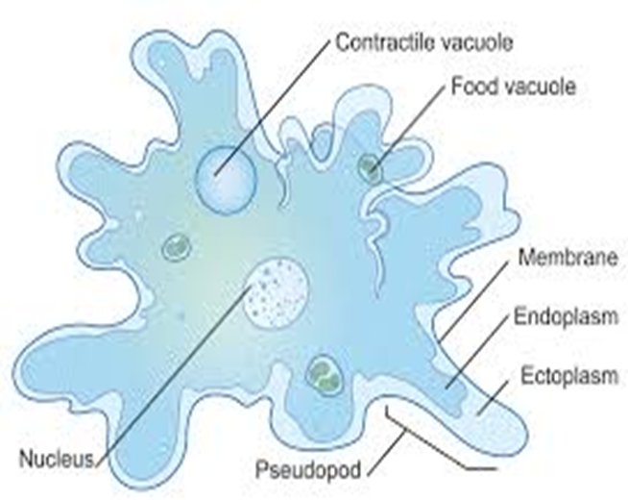

Slide 26
Features of most intestinal protozoa:
A-Trophozoite Stage nourishment
• Active, motile, feeding and reproducing stage of parasite.
• Derives nutrition from environment via diffusion, pinocytosis, and phagocytosis.
• Pathogenic stage, diagnostic for acute infection if the parasite has only trophzoit stage .

Slide 27
B-cyst stage:
• Non-motile, non-feeding, non-active stage.
• Infective, survives adverse conditions.
• Low nutrient supply.
• Anaerobic, enclosed in cyst coat.
• Importance in environment-medical infection.

Slide 28
Notes :
1.Protozoa may secrete Toxin. Lytic enzymes. Digestive enzymes. Antigenic substances.
2 .Transmitted to the human by food and water contamination.
Medical Protozoa Reproduction
• Binary fission: Common asexual reproduction.
• Multiple asexual division in some forms.
• Sexual reproduction: Takes place within the host, usually results in azygote formation.
Both sexual and asexual reproduction occur in the Apicomplexa.

Slide 29
Rhizopods (amoebae): Entamoeba histolytica & E. coli
• Protozoa infects predominantly humans and other mammals as dogs and cats
• Live cycle consists of two stages: trophozoite and cyst.
• Cysts survive outside the host in water, soils, and foods especially under moist conditions
.The active (trophozoite) stage exists only in the host and in fresh feces;
After ingest contaminated food with cyst cause infections by excysting (to the trophozoite stage) in the digestive tract. encysting (trophozoite To cyst stage)

Slide 30
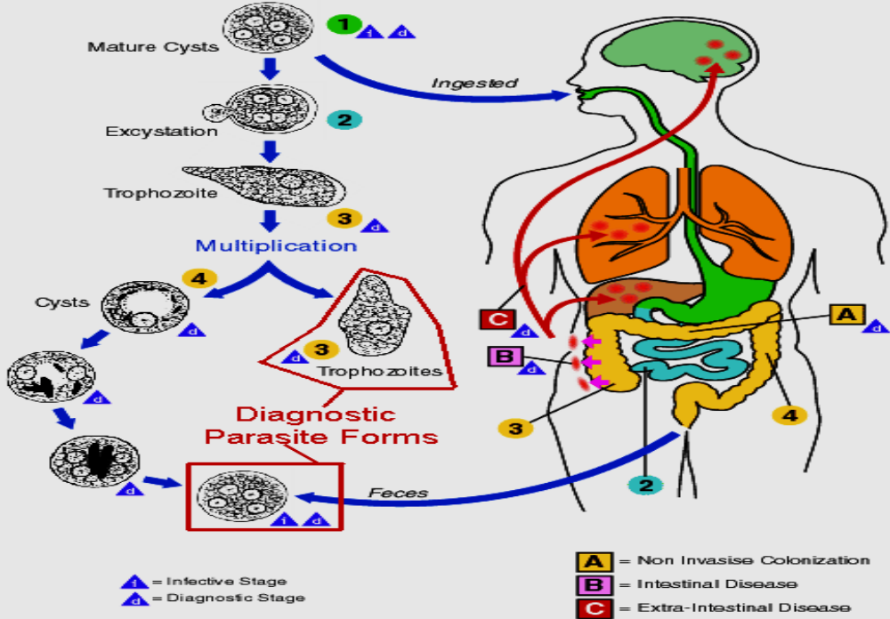

Slide 31
Life Cycle of Infective Cysts
• Infective stage ingested leads to excystation in small intestine.
•nuclear division and Single cyst produces eight motile trophozoites.
• These trophozoites replicate by binary fission in large intestine lumen, feeding on host cells.
• Occasionally, trophzoites migrate to liver, causing abscess formation.
• Encystation occurs in intestinal lumen, cyst formation completes with four nuclei passed out into the environment in human feces
• Infective cysts are resistant to various physical conditions, often survival in feces contaminated environment for up to a month.

Slide 32
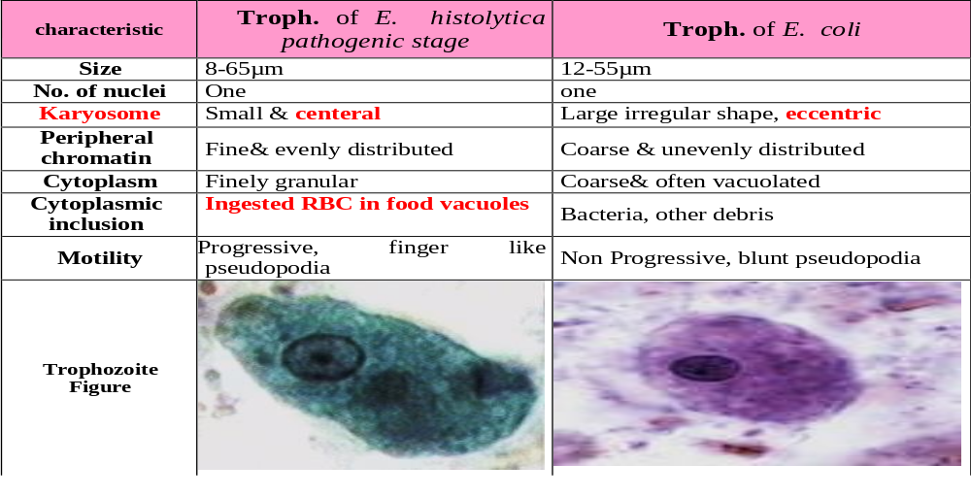
Table showing the comparison between troph. of E. Histolytica & E. coli

Slide 33
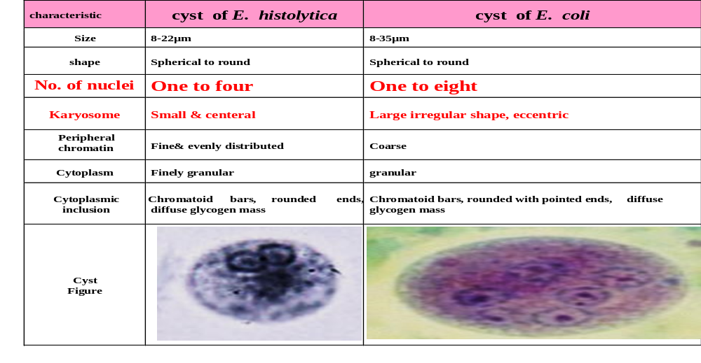
Table showing the comparison between cyst. of E. Histolytica & E. coli

Slide 34
Amebiasis:
• Infection caused by E. histolytica, affecting the large intestine and other internal organs such as the lung , liver, skin and brain.
• Pathogenicity determines the development of the disease.
• Severe cases cause sores Flasks shape ulcer appears when the host infected with bloody diarrhea , abdominal cramps, vomiting, chills, and high fevers.
• Acute cases may cause complications like appendix inflammation, intestinal wall tear, or colon inflammation (fulminating colitis).a

Slide 35
Extraintestinal Amoebiasis
• 5-10% of individuals with intestinal amoebiasis develop hepatic amoebiasis after 1-3 months of dysentery disappearance.
• Tropozoites from the large intestine ulcer multiply in the liver, leading to cytolytic action.
• Small abscesses merge to form large liver abscesses, causing liver dysfunction.
• Abscesses can grow in various locations if the parasite enters general circulation.
• Causes include pulmonary amebiasis, pneumonitis, encephalitis, spleen, heart, joints, bones, muscles, urogenital system, and skin.

Slide 36
Nonpathogenic Amoebae
A number of species of the genus Entamoeba are of worldwide distribution but do not appear to cause disease.
Entamoeba coli: Its life cycle is similar to that of E. histolytica but it does not have an invasive stage and does not ingest red blood cells. the large intestine is the normal habitat of E.coli. The relationship between the host and E. coli is Commensalism.

Slide 37
2. Entamoeba gingivalis
It is a parasite of the mouth of man and other mammals, (monkeys, dogs and cats). It commensal, commonly found in the tartar and debris associated with the gingival tissues of the mouth. It lives in/on the teeth, gum and sometimes tonsils, particularly if there is suppuration (purulence), as in pyorrhoea alveolaris
3. Entamoeba hartmanni
4. Endolimax nana
5.Entamoeba dispar
6. Iodamoeba butschlii

Slide 38
Laboratory diagnosis of amebiasis
• Labrytory diagnosis through stool examination.
• Infective stage: cyst of E. histolytica & E. coli.
• Diagnostic stages: troph & cyst of E. histolytica & E. Coli or both in diarrhea stool.
• Other serological methods include ELISA.

Slide 39
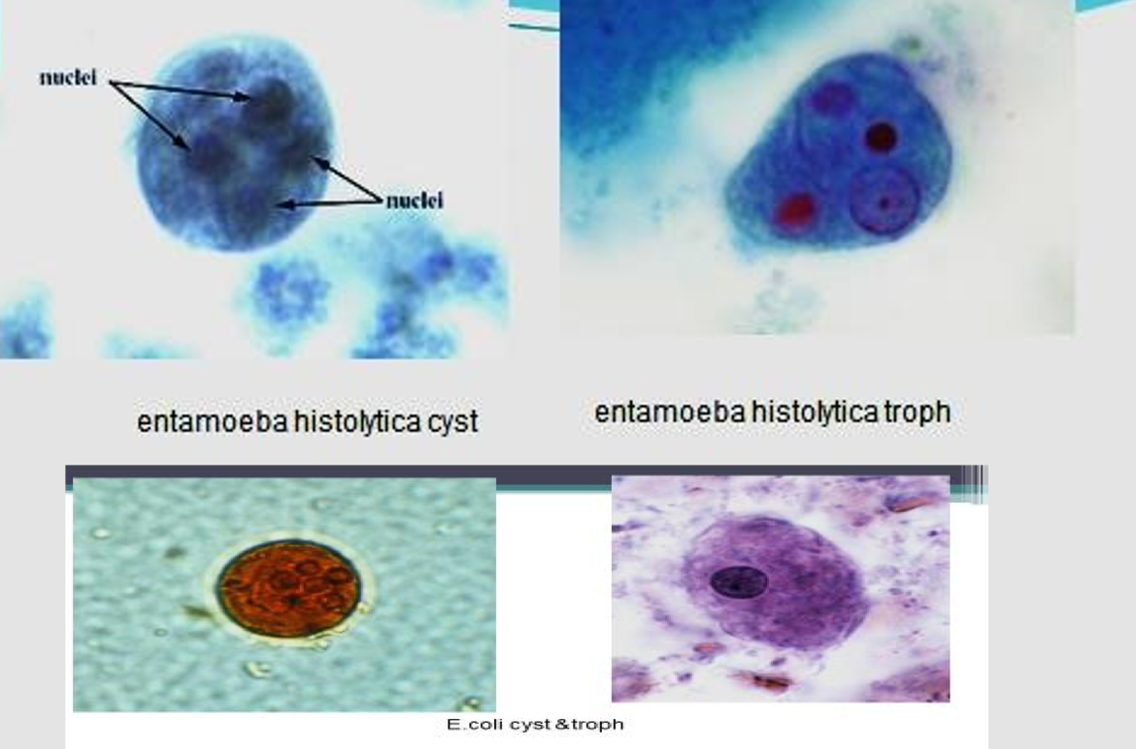

Slide 40
Prevention and Control of E. histolytica
Good hygiene, Avoid taken contaminated food and water Improvement of water supply and sewage and Good health education.
Treatment of E. histolytica = Metronidazole

Slide 41
Opportunistic free-living amoebae
Naegleria, Acanthamoeba, and Balamuthia Parasites
• Facultative parasites of humans.
• Commonly found in soil and water. swimming pools, tap water, and heating and air-conditioning units
• Feed on bacteria.
• Opportunistic amoebae.
• Can cause serious central nervous system and eye infections.

Slide 42
Naegleria fowleri
• Infection acquired through nasal contamination during swimming in freshwater lakes or dust inhalation.
• Infective cysts can enter the nose.
• Amoeboid forms invade nasal mucosa, cribriform plate, and travel along olfactory nerves to the brain.
• Invades olfactory bulbs and spreads to posterior brain regions, leading to primary amoebic meningoencephalitis (PAM).

Slide 43
Symptoms
Severe Frontal Headache Symptoms
• Severe fever (39°-40°C).
• Anorexia.
• Nausea, vomiting.
• Meningeal irritation.
• Disturbances in smell or taste.
• Visual disturbances.

