Slide 1
Parasitology
Lec 2
Ciliaphora:
By Dr. MAYSAM ALI AMEEN

Slide 2
: Class (Ciliaphora) Blantidium coli
• Lives in digestive system and causes blantidiasis.
• Different from E. histolytica that invades liver.
• Has two phases: Troph. and Cyst.
• Troph.: Largest (largest protozoa parasite), ovule shape, covered with cilia have two nuclei macronucleus (kidney shape) responsible for all activities of parasite except the reproduction & micronucleus (vascular shape) responsible for the reproduction only. .
• Cyst: Spherical shape with thick cell wall, difficult to diagnose nuclei.

Slide 3
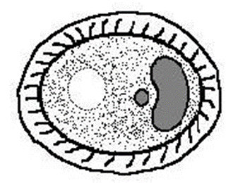
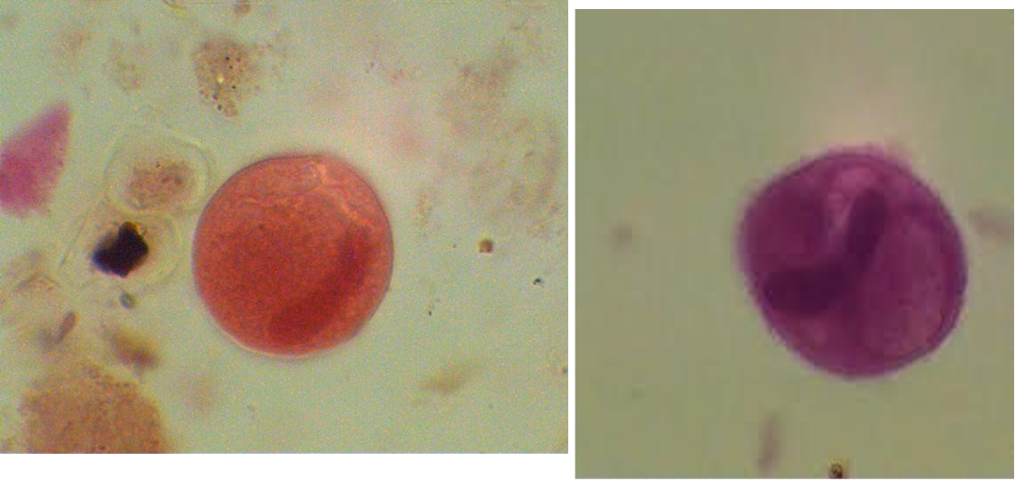
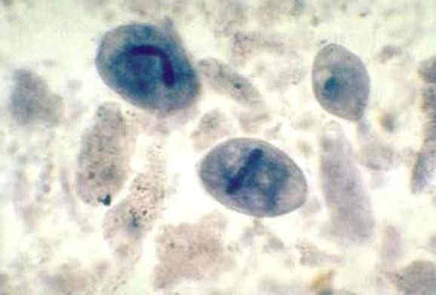
Troph
Cyst

Slide 4
Balantidiasis Symptoms
• Symptoms range from mild colitis to full-blown clinical balantidiasis.
• Abscesses and ulcers may form in mucosa and submucosa of large intestine.
• Secondary bacterial infection followed by abscesses and ulcers.
Acute infections present with up to 15 liquid stools per day.
• Chronic Infections in Patients include Tender colon, anemia, cachexia occasional diarrhea constipation.
• Balantidium coli invades liver, lungs, pleura, mesenteric nodes, urogenital tract.

Slide 5
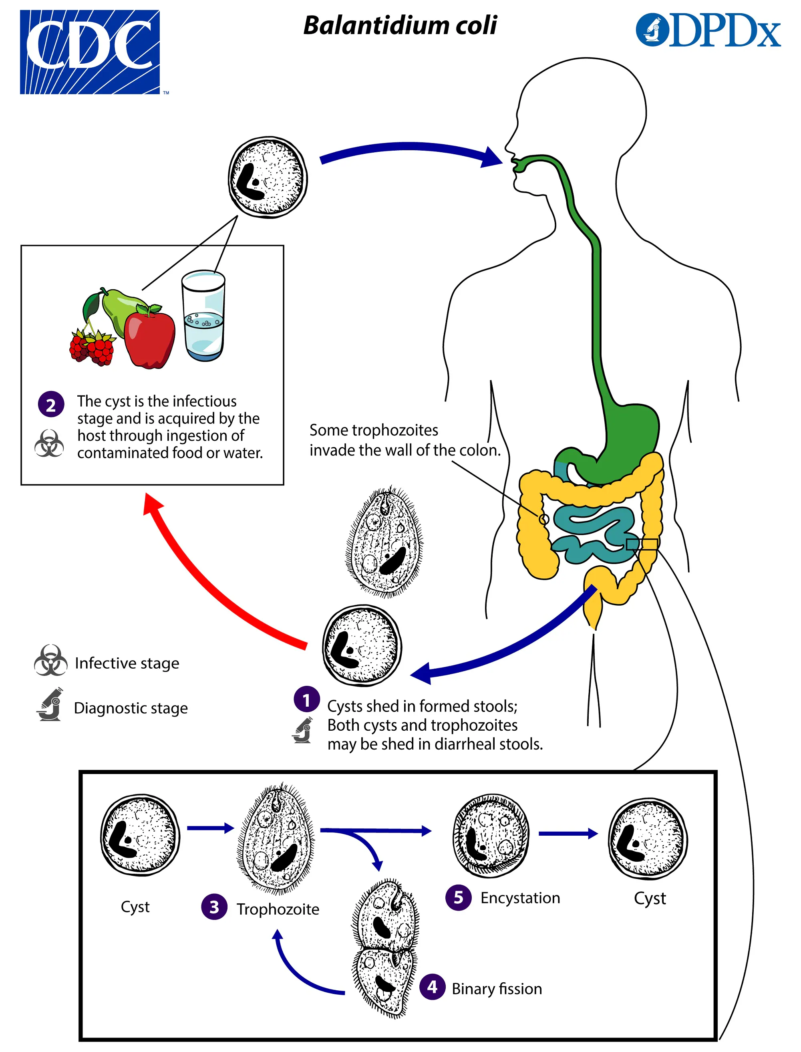
B. coli Life Cycle
• Initiated through ingestion of infective cysts in contaminated food or water.
• Nuclei multiplication doesn't occur in cyst phase.
• After excystation in small intestine, trophozoites reside and feed primarily in cecal region, ileum, lumen, mucosa, and submucosa of large intestine.

Slide 6
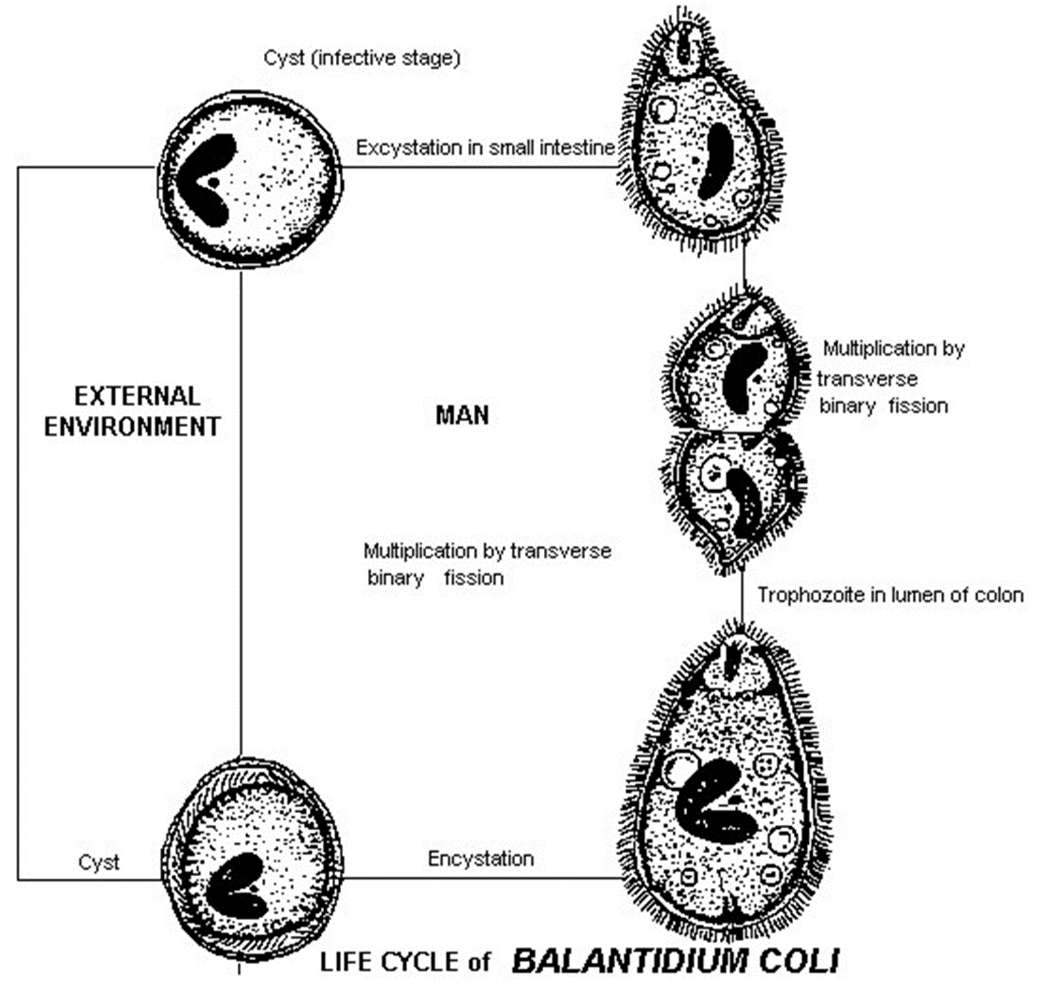
• Transverse binary fission results in the multiplication of trophozoites, resulting in two young trophozoites.
• These delicate trophozoites do not survive outside the environment.
• Encystation occurs in the lumen, resulting in mature cysts.

Slide 7
• These cysts can survive for weeks in the outside environment.
•The natural host of Balantidium coli is pigs.
• Balantidium coli is the only ciliate known to parasitize humans and inhabits the Large intestine.
• Pigs most common , rats, and monkeys are main reservoirs for B. coli cysts.

Slide 8
B. Coli Control and Prevention
• Control through hygiene, improved water supply, sewage, and health education.
Treatment via Metronidazol.
Diagnosis via visualization of trophozoites in fresh or preserved samples.

Slide 9
Class: Mastigophara (Flagellates)
1\Giardia lamblia: Causes of Giardiasis
• Lives in the duodenum.
• Live cycle consists of two stages: trophozoite and cyste.
• Trophozoite: Pear-shaped, 9-21µ long, with two nuclei, four flagella pairs, two axostylels, The broad anterior end of the organism tapers off at the posterior end. motility that resembles a falling leaf and a suction disk attached to the intestinal wall.
• troph. Bilaterally symmetrical with two ovoid to spherical nuclei with a large karyosome .Supported by an axostyle.
• Features two curved rod-like structures, known as median bodies.

Slide 10
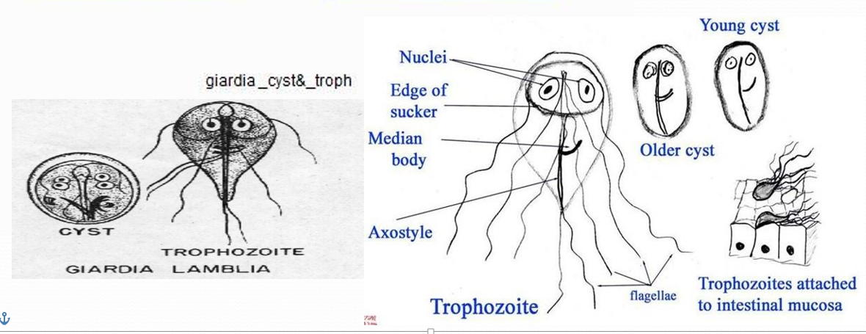
The G. lamblia trophozoite is equipped with a sucking disc. Covering one half to three quarters of the ventral surface, the sucking disc serves as the nourishment point of entry by attaching to the intestinal villi of an infected human
• Cyst: Ellipsoid or oval cyst, 8-12µ long, thick walled with four
nuclei, gives rise to two trophies during excystation.cyct is the dormant stage of Giardia lamblia remain viable for 3 months in water

Slide 11
Pathogenesis :
• Transmission via ingestion of contaminated food and water.
• Excystation in duodenumThe digestive juices, particularly gastric acid, stimulate the cysts to excyst in the duodenum .
• Troph established and multiply approximately every 8 hours via longitudinal binary fission ,it attaches to gut wall of gut but doesn't invade.it may also infect the common bile duct and the gallbladder
• Causes inflammation of the duodenum mucosa, , leading to malabsorption of protein and fat.

Slide 12
Clinical finding Giardiasis: Traveller's Diarrhea"
• Symptoms include mild diarrhea (watery, non bloody, foul smelling diarrhea (semi solid: and greasy or fatty), , abdominal cramps, anorexia, flatulence.
• Symptoms can escalate to epigastric tenderness, steatorrhea, and malabsorption syndrome.

Slide 13
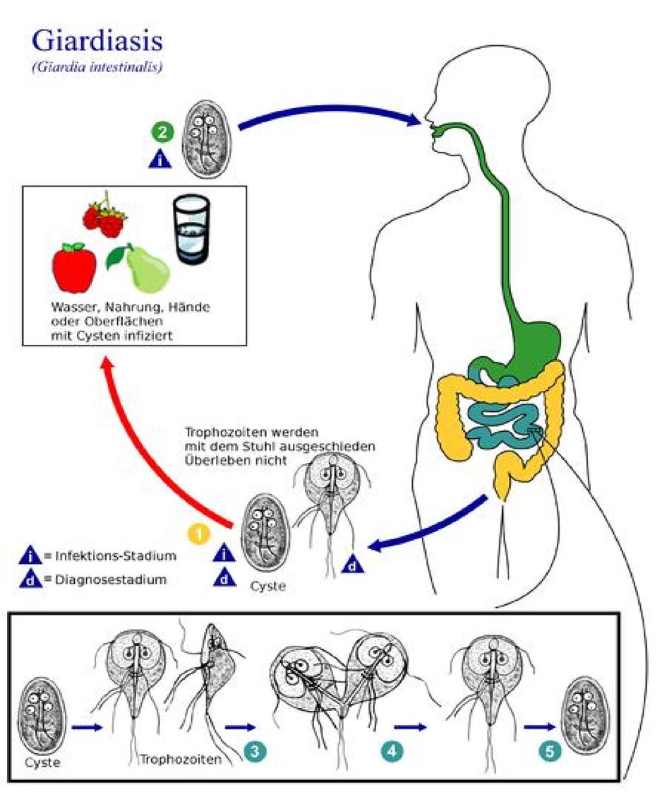
Severe Giardiasis Cases
• Light-colored stools with light fat content.
• Possible secretions from irritated mucosal lining.
• Fat-soluble vitamin deficiencies, folic acid deficiencies.
• Hypoproteinemia with hypogammaglobulinemia.
• Structural changes of intestinal villa.

Slide 14
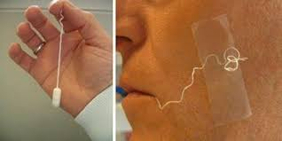
Diagnosis :
1. by finding troph. Or cyst or both in diarrhea stool
2. using ELISA test
3.string test
- diagnostic stages are troph. Or cyst or both in diarrhea stool. The infective stage is cyst.

Slide 15
Giardia Lamblia Control and Prevention
• Control through hygiene, water supply, sewage improvement, and health education.
• Treatment via Metronidazole or Tinidazol.

Slide 16
2. Trichomonas ,
a\Trichomonas vaginalis: Rapid, jerky motility is accomplished with the aid of the organism’s four to six flagella,
Pathogenic to human &causes vaginitis (trichomoniasis).
2. troph. Is round or pear like in shape, contains 4-6 flagella, all originating from anterior end & only one extend posteriorly. The motility is rapid & jerky.
• Undulating Membrane is short Extends half body length.
• Prominent axostyle often curves around nucleus.
• Granules visible along axostyle.Oval, single nucleus.
• No visible cyst.

Slide 17
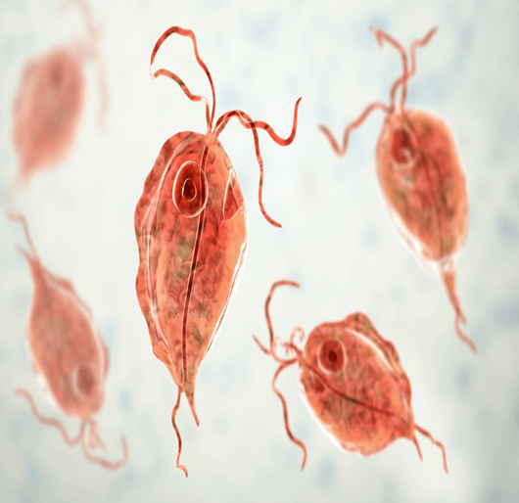
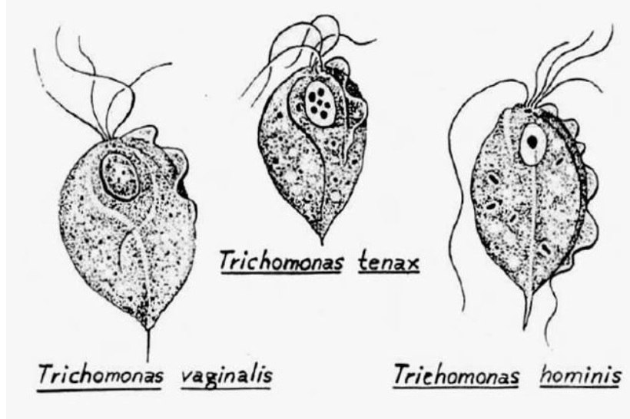

Slide 18
T. vaginalis Clinical Symptoms
• T. vaginalis resides on the mucosal surface of the vagina.
• Common sites in males are the prostate gland region and urethra epithelium.
• Vaginitis, characterized by foul smelling, greenish-yellow discharge, burning, and itching, may occur in infected women.
• Common symptoms include urethral involvement, dysuria, and increased urination frequency.
• Pathogenicity is primarily through cell-to-cell adherence, hemolysis, and secretion of soluble proteinases.

Slide 19
Trichomonas vaginalis Life Cycle
• Trichomonas vaginalis trophozoites live on mucosal vagina surface.
• They multiply by longitudinal binary fission and feed on local bacteria and leukocytes.
• They thrive in slightly alkaline or slightly acid PH environments.
• Most common infection site in males is prostate gland region and urethra epithelium.
• Life cycle in males is unknown.
Infective and diagnostic stage is trophozoites

Slide 20
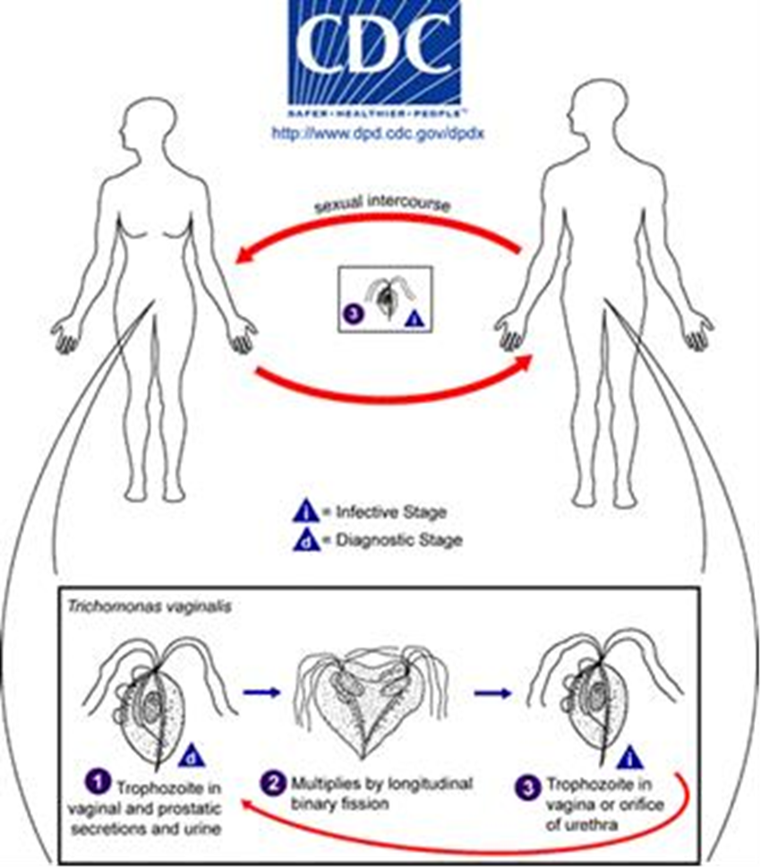
Trichomonas vaginalis Control
• Condom use is the best protection against STIs.
• Limited use due to religious or cultural reasons, especially in developing countries.
• Concurrent treatment recommended to prevent reinfection.
• Systemic chemotherapy administration increases nitroimidazole-refractory strains.

Slide 21
diagnoses: trophozoites may be recovered in spun urine, vaginal discharges, uretheral discharges and prostatic secretions.
Treatment = Metronidazole

Slide 22
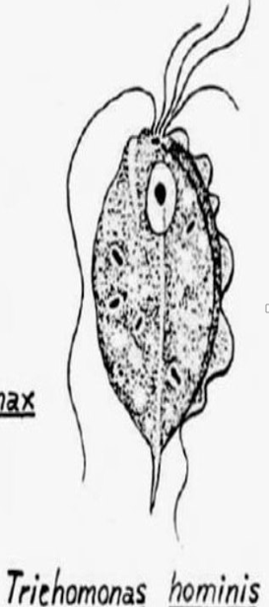
Trichomonas hominis
Pathogenicity
• Pyriform, nonpathogenic inhabitant in man's caecum and larg intestine and other primate species.
• Observed in fresh fecal samples.
• Feeds on enteric bacteria.
• Doesn't invade intestinal mucosa.
• Pathogenicity not established in diarrhoeic stools.
• Observed in freshly passed specimens, especially unformed stools.
• Observed in wet preparation for flagellar movement, undulating membrane, and axostyle presence.

Slide 23
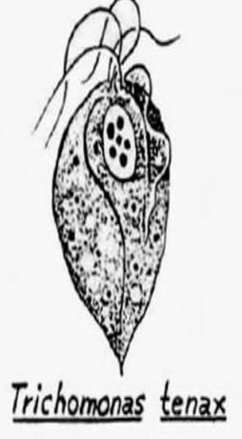
Trichomonas Tenax
• Oval to pear shape with one nuclei filled with chromatin granules.
• Five flagella originating anteriorly, four extend anteriorly, one extends posteriorly.
• Undulating membrane extending 2/3 body length.
• Thick axostyle and small anterior cytosome opposite membrane.
• Exists a known cyst.

Slide 24
Trichomonas Tenax Life Cycle
• Survives as mouth scavengers.
• Feeds on local microorganisms.
• Located in tartar, tonsillar crypts, pyorrheal pockets, gums.
• Multiplies through longitudinal binary fission.
• Cannot survive digestive process.
Clinical Symptoms
• No notable symptoms typical of T. tenax infection.
• Rarely invades respiratory tract in patients with underlying pleural exudate abscesses.

Slide 25
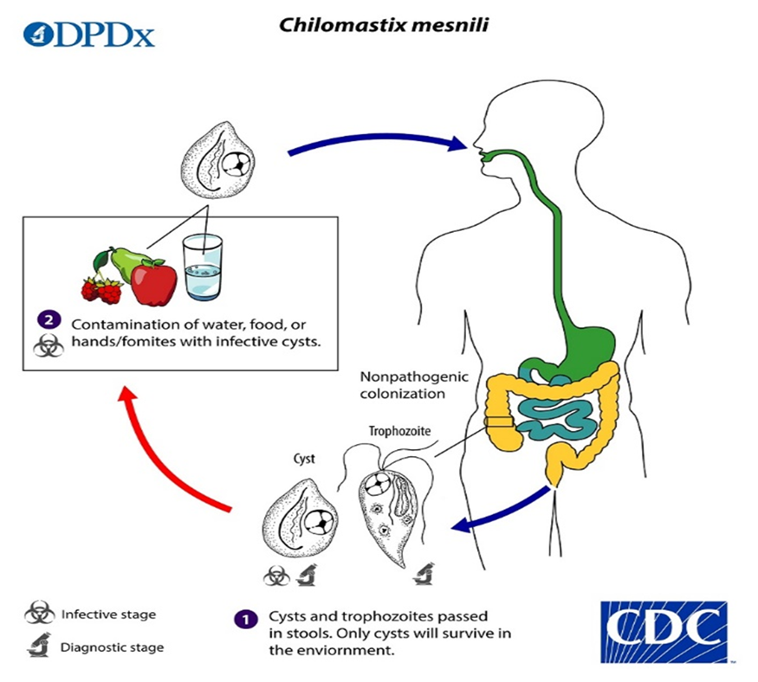
"Chilomastix mesnili:
• Common flagellate living as a harmless commensal in human caecum and colon.
• More prevalent in warm climates.
• Well-defined trophozoite and cystic stages.

Slide 26
Thank you

