Slide 2
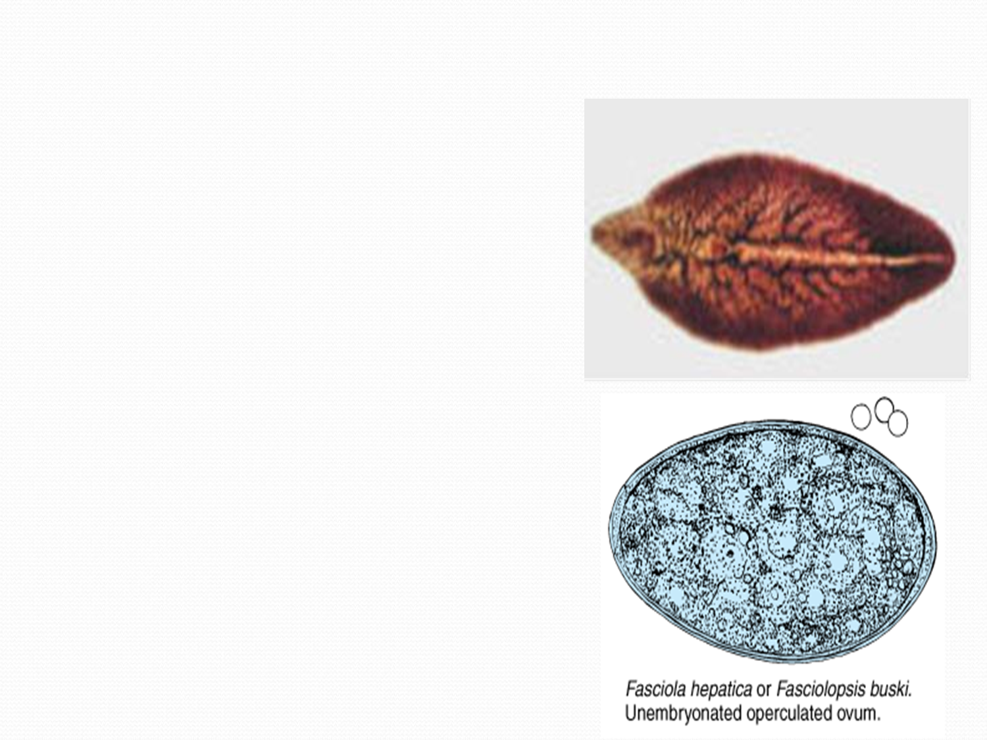
2.Fasciola hepatica (sheep liver fluke)
Adult Fasciola Hepatica Worm
• Flattened, leaf-like shape with shoulders.
• Size: 3cm by 1cm, grayish.
• Two suckers: oral and ventral. they located in cephalic zone.
• Branching intestine.
• Short, coiled uterus with grayish eggs.

Slide 3
Life cycl Fasciola Hepatica: Sheep Liver Fluke
• Primarily affects sheep and domestic animals in Latin America, Africa, Europe, and China.
• Humans infected by contaminated watercress or aquatic plants.contaminated by larvae (metacercariae)
• Larvae excyst in duodenum, penetrate gut wall, reach liver where they mature into adults.
• in Bile Ducts Hermaphroditic Adults Hermaphroditic adults produce eggs(unembryonated operculated ovum) excreted in feces.

Slide 4
• Eggs hatch in fresh water, miracidia enter snails.
• Miracidia develop into cercariae, encyst on aquatic vegetation.
• Sheep and humans eat plants, completing life cycle.
Life cycle of Fasciola hepatica &Fasciolopsis buski The life cycle stage of the digenetic trematodes that cause "swimmer's itch" is aRedia

Slide 5
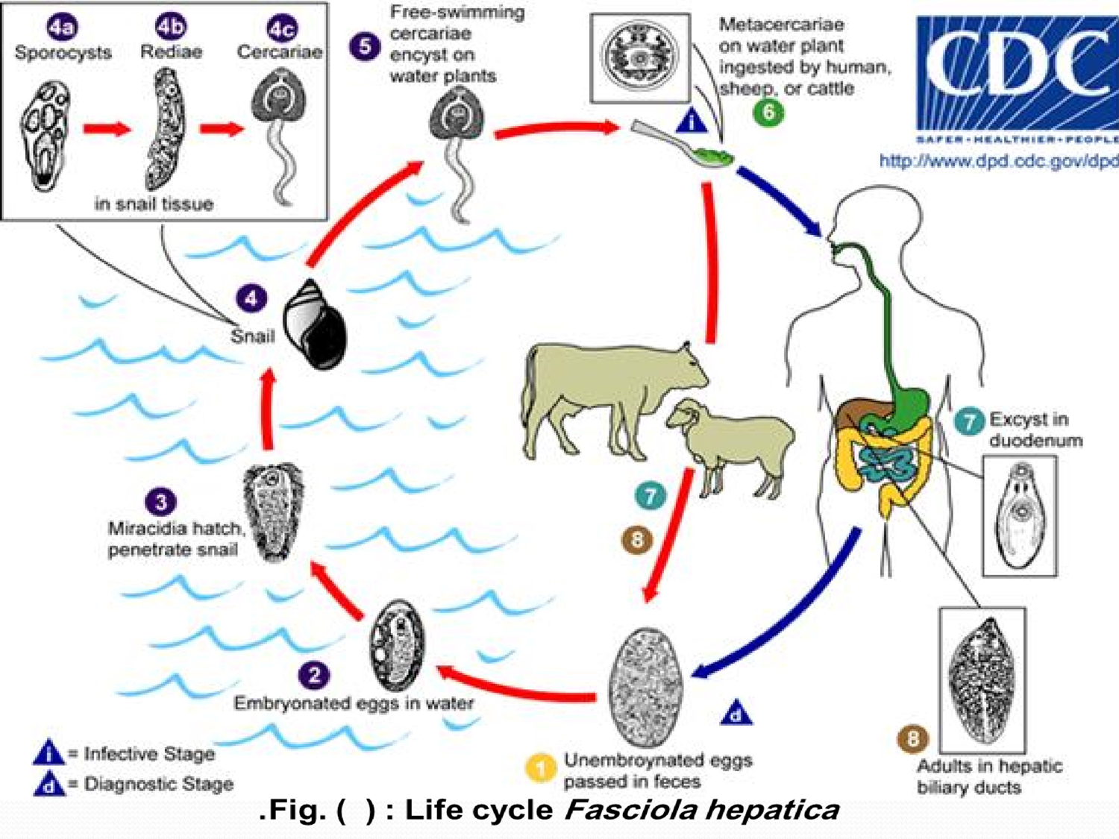

Slide 6
Clinical symptoms :
Fascioliasis: Liver Fluke Infection
• Symptoms include stomach and bowel pain, fever, liver disease (jaundice), and diarrhea.
• Early infection can cause right-upper-quadrant pain and hepatomegaly.
• Most infections are asymptomatic.
• Later, obstructive jaundice can occur.
• Halzoun Painful pharyngitis caused by adult flukes on posterior pharyngeal wall.
• Adult flukes acquired through raw sheep liver or raw watercress by swallowing metacercariae of the fluke.

Slide 7
1\ Acute Fascioliasis :
Severe Hepatitis in Sheep
• Typically occurs in sheep, rarely in humans.
• Requires large numbers of parasites.
• Migrating larvae invade liver, causing traumatic hepatitis.that is frequently fatal.
• Liver capsule may rupture, causing death from peritonitis.
• Invasive phase lasts weeks, causing intermittent fever, hepatomegaly, and abdominal pain.

Slide 8
2\Chronic Fascioliasis
• Latent Fluke Infection Phases
lasting months to years.
• Possible obstructive phase causing hepatitis, cholangitis, or pancreatitis.
• Ectopic infections, especially in lungs and subcutaneous tissues.

Slide 9
Fasciola Hepatica Diagnosis and Treatment
• Diagnosis: is made by identification of eggs in the
feces. Adult flukes in the pharynx and larynx can be removed surgically. There is no serologic test.
• Treatment: Surgical removal of adult flukes in pharynx and larynx. : Albendazole, sulphoxide, Praziquantel, bithionol
• Control: Avoid contaminated aquatic vegetables, water, and raw liver sheep.

Slide 10
Fasciolopsis buski ( intestinal fluke)
Cause Fasciolopsis
• Caused by eating aquatic vegetation carrying metacercariae.
•After excysting in the small intestine
Parasites attach to mucosa and differentiate into adults.
• Eggs pass in feces, on reaching fresh water
differentiate into miracidia.
• Miracidia penetrate snails, develop into cercariae.
• Cycle completes when plants carrying cysts are eaten.

Slide 11
Fasciolopsis Buski Pathology
• Adult fluke damages intestinal mucosa.
• Infections are usually asymptomatic, but can cause ulceration, abscess formation, and diarrhea.
• Diagnosis based on eggs found in feces.
• Prevention involves proper sewage disposal.
• Control measures include avoiding contaminated food and water.
• Treatment involves praziquantel.

