Slide 1
Lecture-1-
Introduction & History development of microbiology
Dr. MAYSAM ALI AMEEN

Slide 2
Microbiology:
Microbiology: is the study of microorganism.
M.O. their is large and diveres kind of them
a single cell
cell cluster
viruses which are microscopic but not cellular.

Slide 3
These MO are present in vast numbers in nearly every environment known.
Also more than 90% of the cells in human's bodies are microbes. Some of these microorganisms (M.O.) are harmful (disease causing microorganisms), others benefit by association with biological activity of the host.

Slide 4
Microbial Divisions
The field of microbiology includes :
Bacteriology: is the science dealing with the study of bacteria.
Mycology: is the science dealing with the study of fungi.
Protozology: is the science dealing with the study of protozoa.
Virology: is the science dealing with the study of viruses.
Immunology: is the study of host's defense mechanisms against disease, also study the interaction between human and disease agents (pathogenic microbes).

Slide 5
The size M.Os. were variable :
viruses are smallest MO,
bacteria (prokaryots),
fungi, protozoa and worms (euokaryotes).
In genera prokaryotic cells are smaller than eukaryotic cells.

Slide 6
History development of microbiology
Microbiology has its origin deeply rooted in curiously. At first MOs were thought to be of little practical importance,
Leeuwenhoek (1673) :
designed and constructed simple microscope,
he made the first accurate descriptions of most major types of single cell MO known today: algae, bacteria, protozoa, and yeasts.
Edward Jenner (1796) discovered the vaccine against cowpox (Vaccinia).

Slide 7
Louis Pasteur (1850)
demonstrated the biological functions of MO (fermentation theory)
method of sterilization (pasteurization)
development of vaccines against microbial diseases such as anthrax and rabies.
control of disease of silk warm

Slide 8
Joseph Lister
showed the role of MO in the wound contamination
developed Lister system which came to be known as Antiseptic Surgery, which includes the heat sterilization of instruments and the application of phenol to wound by means of dressings.

Slide 9
Koch postulates in 1876.
The suspected causative agent must be found in every case of disease.
This MO must be isolated from the infected individual and grown in a culture with no other types of MO.
When inoculation into normal healthy susceptible animal a pure culture of the agent must be produce the specific disease.
The same MO must be isolated from the experimentally infected host.

Slide 10
Paul Ehrlich:
The modern era of control treatment in 1900 began with the use of chemicals that would kill or interfere with the growth of the disease agent without damaging the infected individual. This approach, known as chemotherapy was introduced by Paul Ehrlich .

Slide 11
In 1929, Alexander Fleming isolated a mold produced substance that inhibited bacteria but was non toxic to lab animal. He named this antibacterial material Penicillin, which is one type of antibiotics.
Up to data, many new approaches and techniques are developing that aid in the isolation, treatment, controlling, and prevention of infectious disease.

Slide 12
Eukaryotes & Prokaryotes
The main differences between Eukaryotic cells & Prokaryotic cells can be illustrates in the following table:
Table (1) illustrates the main differences between Eukaryotic cells & Prokaryotic cells
Prokaryotic cells | Eukaryotic cells | Structure
No | Yes | Definite Nucleus
No | Yes | Nuclear membrane
Single | Multiple | Chromosome
Yeas, have rigid cell wall that contain peptidoglycan | Yeas, have flexible cell mem. Except fungi have rigid cell wall with chitin | Cell envelope
No | Yes | Nucleolus
No | Yes | Organelles.(mitocondria, Golgi apparatus,
Small 70 S ribosome | Large 80 S ribosome | ribosome
By binary fission | By mitosis | Replication
Bacteria | Animals, plant, protozoa, fungi | Representative organisms

Slide 13
Scientific name:
The binomial system of published by C. Linnaeus. The genus and species are significant taxonomic uses in binomial nomenclature for each organism. First name for genus and second name for species. First letter of genus should be written in capital letter, whereas first letter of species, must be write in small. Name of genus and species for any organism must be write in Italic from or place line under each genus and species.

Slide 14
Ex:
Staphylococcus aureus.
Staphylococcus aureus

Slide 15
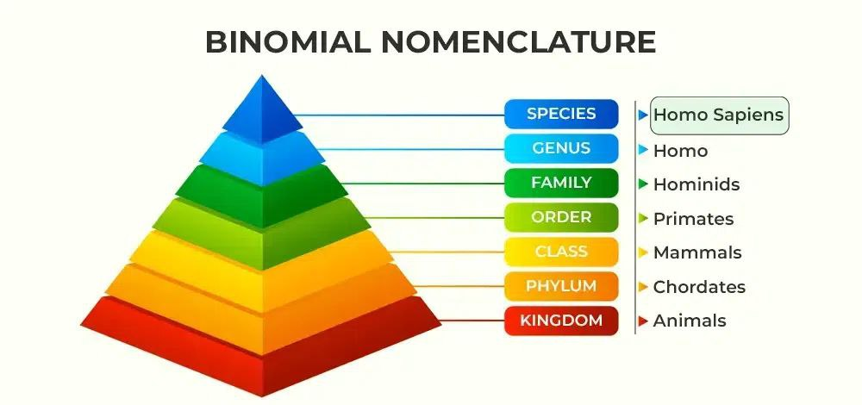

Slide 16
Name of bacteria are derived from
The name of disease that caused by bacteria. Ex: Vibrio cholerae = causes cholerae.
The locality where the bacteria was first isolated. Ex: Escherichia coli = from colon.
The scientists responsible for isolating bacteria. Listeria = Lister.
Properties of bacterial morphology and physiology. Staphylococcus aureus = cluster.

Slide 17
All types of organisms classified in to five kingdom; monera, protista, fungi, plantae, and animalia. The following table illustrates the kingdom.
Table (2) illustrates the kingdom of All types of organisms
Organism | Types of cell | Kingdom
Bacteria | Prokaryotes | monera
Protozoa | Eukaryotes | protista
fungi | Eukaryotes | fungi
plant | Eukaryotes | plantae
Man, animals | Eukaryotes | animalia

Slide 18
Table (3) illustrates the comparison of medical important organism
characteristic | Viruses | Bacteria | Fungi | Protozoa | Helminthes
Cells | No cell (particle) | Yes | Yes | Yes | Yes
Diameter(μm) | 0.02-0.3 smallest MO | 1-0.5 | 3-10 (yeast) | 15-25 trophozoite | multicellular Largest organism
Nucleic acid | Either DNA or RNA | Both | Both | Both | Both
Nature of outer surface proteins | Capsid and lipoprotein envelope | rigid cell wall that contain peptidoglycan | rigid cell wall with chitin | Flexible cell mem. | May be cuticle
ribosome | absent | 70 S | 80 S | 80 S | 80 S
Methods of Replication | Produce many copies of Nucleic acid and protein, then, reassemble into multiple progeny viruses. They are replicate only within living cell | By binary fission | Budding or mitosis | mitosis | mitosis
Motility | none | some | none | most | motile

Slide 19
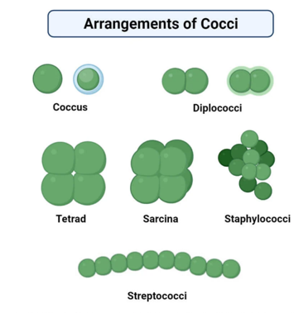
Shapes and size of bacteria and patterns of arrangement
1.Spherical (cocci);

Slide 20
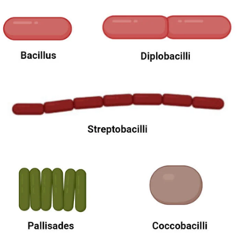
2. Bacilli (rod like);

Slide 21
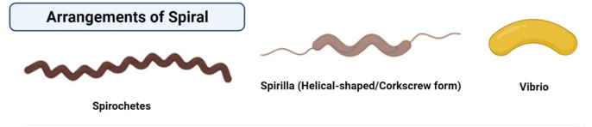
3.Spirochetes: spirilium (spiral). F vibrio (comma).
4.pleomorphic (appear in many shape).

Slide 22
  Bacterial size
Most disease causing by bacteria range in size from 0.2 -5 μm in diameter and 0.4-14 μm in length approximately. The bacterial cells are about the size of mitochonderia.

Slide 23
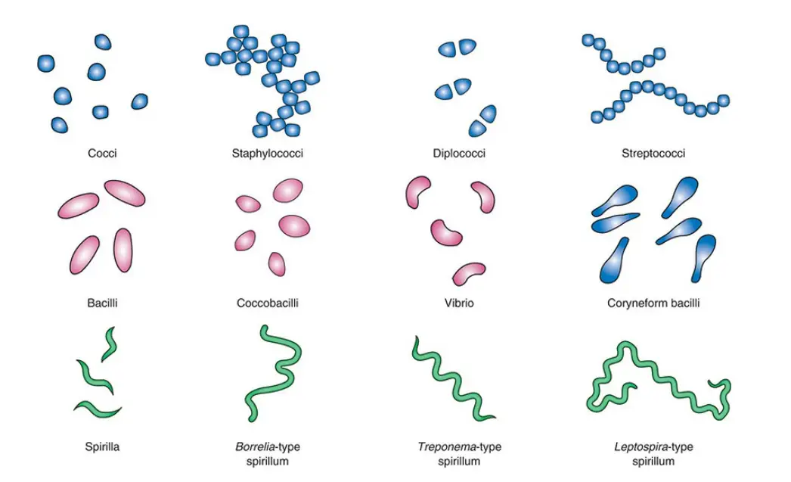

Slide 24
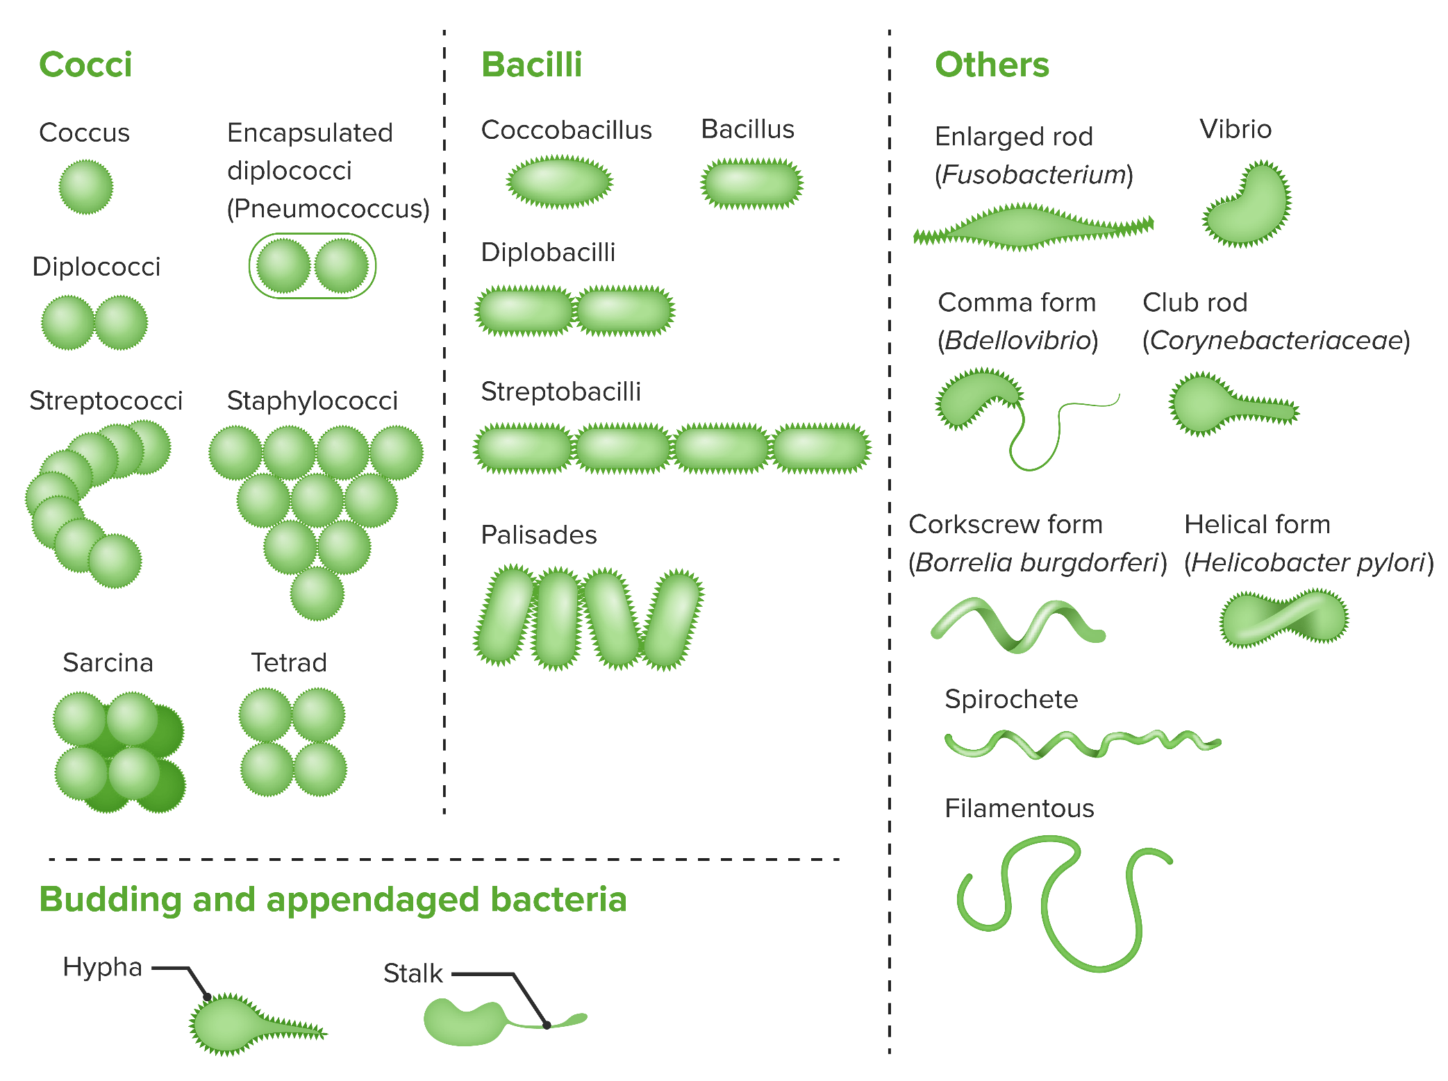

Slide 25
THANK YOU
766555TR555T6YYYH76Y6YY7KIKKK,MN FBV BVBVV BVGB

