Slide 1
Lecture-3-
Physiology of Bacteria:
Dr.Maysam Ali Ameen

Slide 2
Bacterial growth
Growth: is the orderly increase in the sum of all the components of an organism.
Cell multiplication: is a consequence of growth, in unicellular organism, leads to an increase in the number of individuals making up a population.
The bacterial growth can be measured by:
A: cell concentration: viable cell count.
B: Bio mass density: by determining the dry weight of a microbial culture.

Slide 3
Phases of the bacteria growth:
The phases of the bacterial growth curve :
1:lag phase: represents the period of adaptation to the new environment, enzymes. And intermediates are formed.
2: log (exponential) phase:the number of cell increase exponentially (one becomes 2, 2 →4, 4 →8…..) , the time required for this doubling is called as generation time or doubling time.

Slide 4
3:stationary phase: the exhaustion of nutrients or the accumulation of toxic products
4:death phase: after the period of time in the stationary phase, and completely exhausted of nutrients and accumulation of high level of toxic substances, the death increase until it reach a steady level.

Slide 5
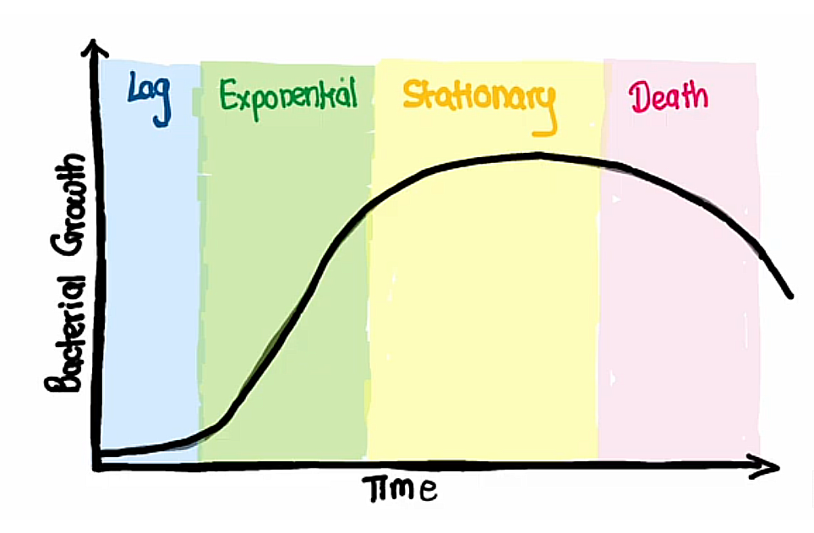

Slide 6
Table (3) Phase & Growth rate of the bacterial growth
Growth rate | Phase
Zero | Lag
Positive constant | Exponential
Zero | Stationary
Negative (death) | Death

Slide 7
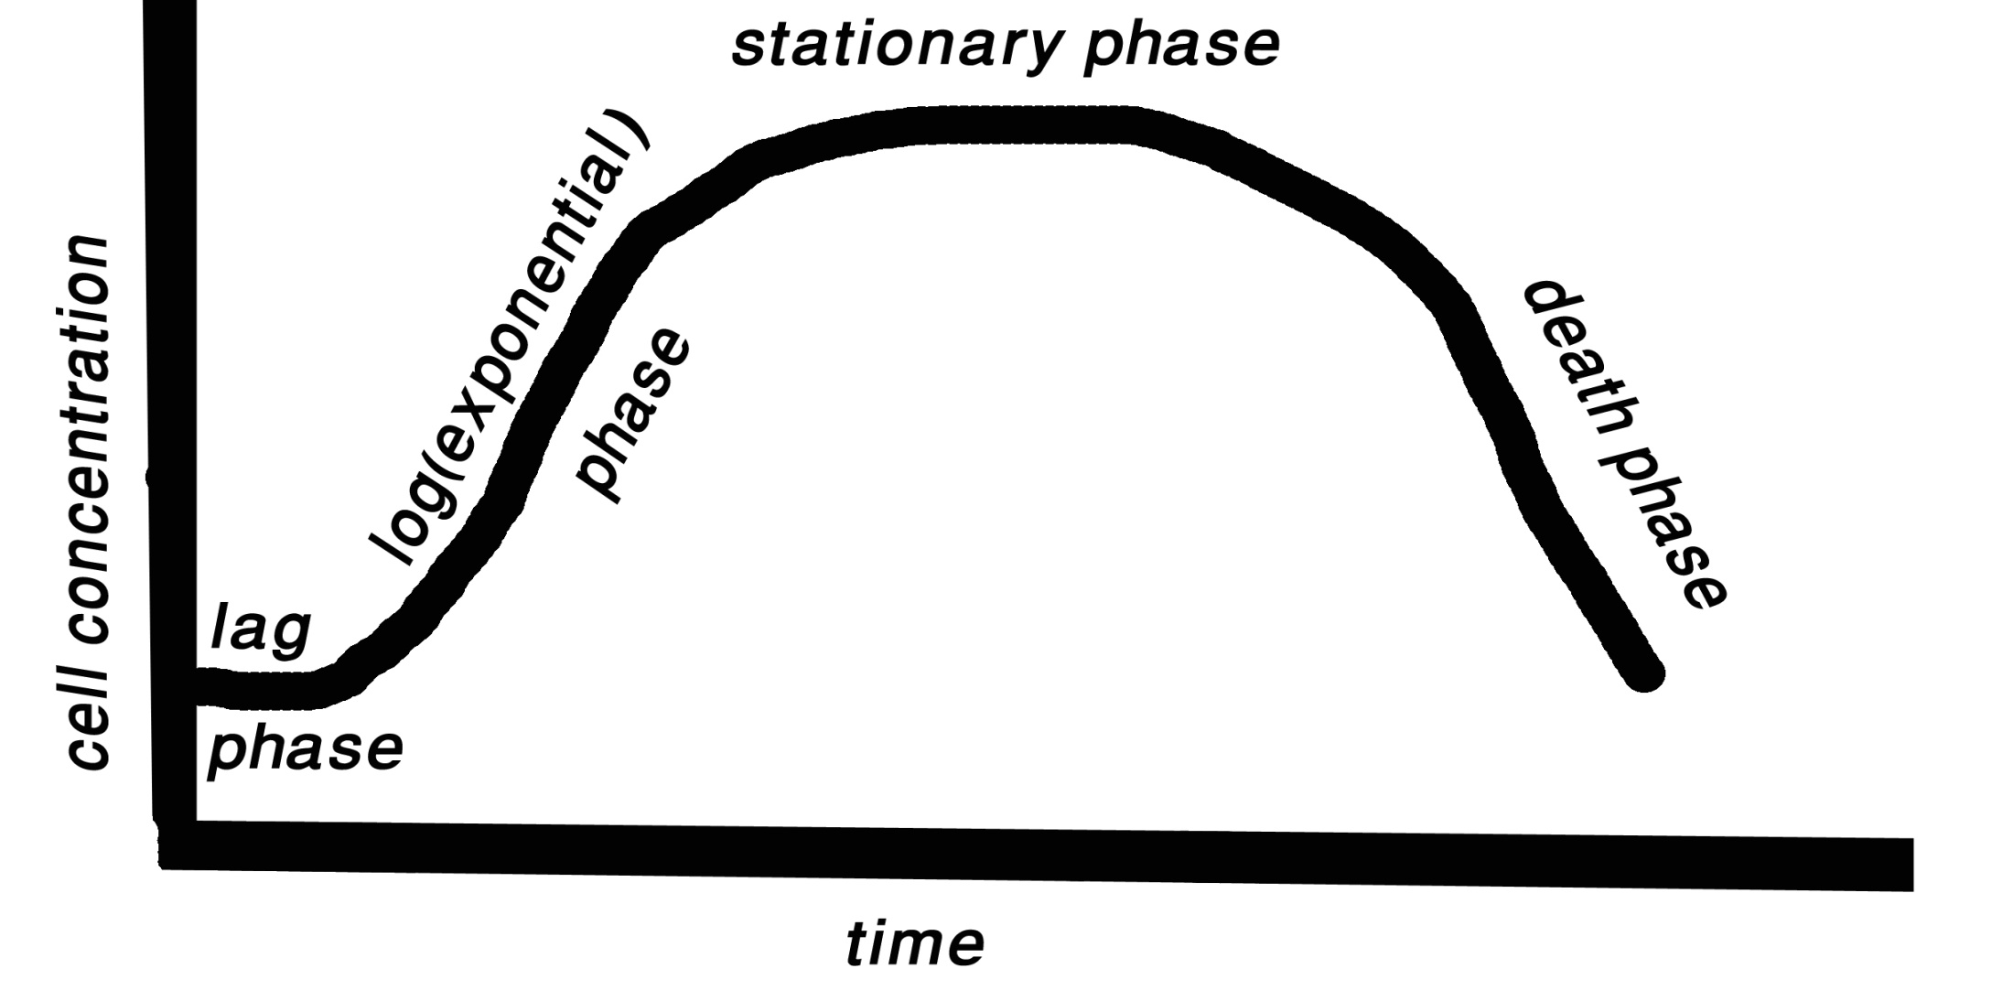
Figure (3) the phases of the bacterial growth curve

Slide 8
Environmental growth factors
A-Nutrients
The following nutrients must be provided for any bacterial culture:
Hydrogen donors and accepters.
Carbon source.
Minerals elements (sulfur and phosphorus).
Growth factors (amino acid, pyrimidines and purin).

Slide 9
B-pH:
bacteria can be classified according to pH rang:
Neutrophiles: pH=6-8. most pathogenic bacteria.
Acidophiles: pH=3. can grow at pH as low as 3.
Alkaliphiles: pH=10.5. can grow at pH as high as 10.5.

Slide 10
C- Temperature: bacteria can be classified according to temperature:
Mesophiles: grow best at 30-37°C. most pathogenic bacteria.
Psychophiles: grow best at15-20°C.
Thermophiles: grow best at 50-60°C.
D- Oxygen:
Obligate aerobes: need O2 as hydrogen accepter.
Obligate anaerobes:- need substance other than O2 , and being sensitive to O2 inhibition
Facultative:- able to live aerobically or an aerobically.

Slide 11
aerobic bacteria +O2 → H2O2 (toxic for bacteria ) →produce enzyme by bacteria (catalase) → H2O+ O2 (gas bubbles)
Non aerobic bacteria +O2 → H2O2 (toxic for bacteria ) →bacteria is not produce enzyme) → H2O2

Slide 12
E-salt & osmotic pressure:
Halophiles: requiring high salt concentrations (marine bacteria).
Osmophiles: requiring high osmotic pressure.

Slide 13
Microbiological culture media
The growth of MO depends on available nutrients and favorable growth environment. The cultures media differ depend on MO needing to nutrition. The media divided depending on their contents into:
1.Natural media.
2. Synthetic media.
3. Semi synthetic media.

Slide 14
While the media can be divided depending physical state in to:
1.Liquid media (broth).
2. Solid media (agar).
3. Semisolid media.
Type of inoculation of media:
1.Streaking plate.
2. Spreading methods.
3. Pour plate technique.
4. stapping methods.

Slide 15
Types of laboratory media:
Acording to the physiological requirements. Various types of liquid and solid media have been developed for the diagnostic microbiology laboratory.
Simple media
Many bacteria will grow in or on simple media, e.g. nutrient broth/nutrient agar that contains ‘peptone’ (polypeptides and amino acids) and ‘meat extract’ (water-soluble components of meat containing mineral salts and vitamins).

Slide 16
Enriched media
These contain additional nutrients for the isolation of more fastidious bacteria that require special conditions for growth, e.g. agar containing whole blood (blood agar) or agar containing lysed blood (chocolate agar).

Slide 17
Selective media
These are designed to facilitate growth of some bacteria, while suppressing the growth of others, and include:
• mannitol salt agar which contains increased NaCl (salt) concentration for the recovery of staphylococci;
• MacConkey agar, which contains bile salts and allows the growth of bile-tolerant bacteria only;
antibiotics, which are frequently added to media to allow only certain bacteria to grow while suppressing or killing others.

Slide 18
stains:
are chemical compounds with colored ions which react with the different constituents of the living cell to stain the transparent and minute cells of bacteria which are difficult to see by naked eyes.
The stain may be classified into
simple:stain colored all parts of the cell e.g. methylene blue
differential: selected that react with specific groups of the different parts of the cell or of different genera and species of bacteria for example Gram stain

Slide 19
Gram stain G+ ve G-ve
1.crystal violet
Washing after 1 mint purple purple
2.Iodine
Washing after 1 mint purple purple
3.alcohol
Washing after 15 sec purple colorless
4.Safranin
Washing after 1 mint purple pink

Slide 20
Many theories have been proposed to explain the observed difference in Gram staining:
one of the most common theory is that based on variation in the chemical composition of bacterial cell wall .
G+ve bacteria contain magnesium- RNA-protein – carbohydrate complex which form an insoluble substance with the crystal violet and iodine , this complex is not washed with alcohol ,

Slide 21
while the lipid content of the cell wall being 10 times in G-ve as much as in G+ve ones , this lead to the solubility of lipids in alcohol and increase of cell wall porosity in G-ve and crystal violet iodine –complex can be extracted , so , G-ve cells become colorless after alcohol washing and take the another color safranin (cell turn pink) as shown in the below figure .

Slide 22
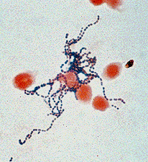
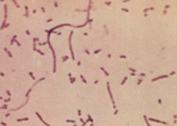

Slide 23
Source of metabolic energy:_
The three major mechanisms for generating metabolic energy are :
Aerobic respiration:- is the metabolic process in which (O2) serves as the final electron acceptor for the electron transport chain. In this process O2 is reduced to water. This is the energy-generating used by all aerobic bacteria.
Anaerobic respiration: - is the metabolic process in which inorganic compounds rather than O2 serve as the final acceptors, these acceptors can be nitrate or sulfate.

Slide 24
3. Fermentation: is an alternative aerobic process, by which an organic metabolic intermediate serves as the final electron transport, such as pyruvate, lactate, or ethanol which is released from glucose fermentation.
In all pathways the energy represented by ATP is released and used in the biosynthesis of bacterial cell component (cell wall, capsule,…) the ATP yielded is much higher in respiration than fermentation.

Slide 25
THANK YOU

