Slide 1
Oncology and advanced therapeutic modalities
Prepared
By
Mayada omar

Slide 2
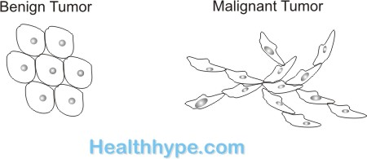
Outline:
Introduction.
Definitions.
Pathophysiology.
Etiology.
Classifications of cancer
Staging of Cancer.
Diagnosis of patient with cancer.
  Signs & Symptoms.
  Diagnostic Findings.

Slide 3
Cont..,
Advanced modalities in medical and surgical treatment.
    Surgery.
    Radiation therapy.
    Chemotherapy.
    Bone marrow transplantation
    Stem cell transplantation

Slide 4
Cont..,
Nursing Care for Patient with Cancer.
Summary.

Slide 5
General objectives:
At the end of this lecture every participant should be able to acquire knowledge, skills and attitude regarding care of patient with oncology problem.

Slide 6
Specific objectives:
Mention key definitions related to oncology.
Describe Pathophysiology.
Enumerate the Etiology of cancer.
State the Classifications of cancer
Identify Stages of Cancer.

Slide 7
Cont..,
Enumerate the diagnostic measures for patient with cancer.
Discuss the advanced modalities in medical and surgical treatment.
Apply nursing Care for Patient with Cancer.

Slide 8
Introduction:
Cancer continues to be one of the leading causes of morbidity and mortality worldwide. According to the WHO, cancer was the second leading cause of death in 2020, responsible for 8.8 million deaths globally. While the global burden of cancer continues to be high, therapeutic innovation based on improved understanding of disease biology.

Slide 9
Oncology:
The word oncology comes from the Greek word meaning "mass" or "bulk," referring to tumors. A doctor who specializes in oncology is called an oncologist.

Slide 10
Tumors :
An abnormal mass of tissue that results from excessive cell division (mitotic activity). Tumors perform no useful body function. They may be either benign or malignant.

Slide 11
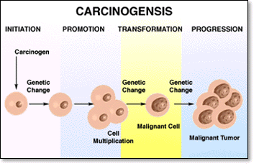
Cancer:
A disease resulting from the uncontrolled growth of cells, which causes malignant cellular tumors.

Slide 12
Benign tumors:
Benign tumors are not cancers. They can usually be removed and, in most cases, they do not come back. Most important, cells from benign tumors do not spread to other parts of the body. Benign tumors are rarely a threat to life.

Slide 13
Malignant tumors:
Malignant tumors are cancers. Cancer cells can invade and damage nearby tissues and organs. Also, cancer cells can break away from a malignant tumor and enter the blood stream or the lymphatic system. This is how cancer spreads from the original (primary) tumor to form new tumors in other parts .

Slide 14
Carcinogenesis:
Process of transforming normal cells into malignant cells.
Metastasis:
Spread of cancer cells from the primary tumor to distant sites.

Slide 15
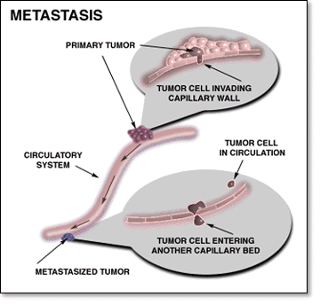

Slide 16
Pathophysiology:
The cell is the basic structural unit in human. Differentiated cells work together to perform specific functions. Cell regeneration occurs through cell division and reproduction. Abnormal changes in cells develop for many reasons.

Slide 17
Cont..,
These abnormal cells reproduce in the same way as normal cells, but they do not have the regulatory mechanisms to control growth. Thus, abnormal cell growth proliferates in an uncontrolled and unrestricted way.

Slide 18
Cont..,
The second step to becoming a cancer cell is the tumor suppressor genes get turned off. Tumor suppressor genes are a part of a healthy cells DNA that help stop cancer from forming in healthy cells

Slide 19
Cont..,
The last step to becoming a Cancer cell is the DNA repair genes gets turned off. DNA repair genes help your healthy cells know if something is wrong with its DNA and how to fix it. When these genes get turned off the cell doesn’t know if it is sick, and it can’t fix any problems with its DNA.

Slide 20
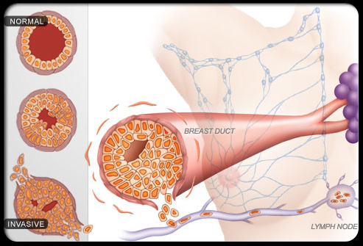

Slide 21
Signs and Symptoms:
Local symptoms :Unusual lumps or swelling (tumor), hemorrhage (bleeding), pain and/or ulceration. Compression of surrounding tissues
Systemic symptoms Weight loss, poor appetite, fatigue and excessive sweating
Symptoms of metastasis (spreading) Enlarged lymph nodes, cough and hemoptysis, hepatomegaly (enlarged liver), bone pain .

Slide 22
Early Warning Signals of Cancer
CAUTION
Seven warning signals of cancer should be familiar to all:
  Change in bowel habits or bladder function.
  A Sores that do not heal.
  Unusual bleeding or discharge.
  Thickening or lump in breast or other body parts.
  Indigestion or difficulty swallowing.
  Obvious weight loss, sweating at night.
  Nagging cough or hoarseness.

Slide 23
Diagnosis :
1-Tumor Marker Tests
Tumor markers (also known as biomarkers) are substances found at higher than normal levels in the blood, urine, or body tissue of some people with cancer.

Slide 24
ONCOGENES:
Some tumor markers are the product of oncogenes.
Examples: Ph1 (Philadelphia chromosome).
HORMONES:
Examples:
Some hormones associated with malignancy are: Calcitonin

Slide 25
Other laboratory tests:
The complete blood count (CBC) may indicate anemia in a client with possible colon cancer.
Occult blood in the stool may indicate colorectal cancer.

Slide 26
Cont..,
Specific organ function (e.g. liver function tests, renal function tests, pancreatic enzyme levels, thyroid hormone levels) may be used to evaluate organ function and provide information about the effects of potential metastasis.

Slide 27
Radiologic and imaging tests:
X-Ray Studies
Computed Tomography
Magnetic Resonance Imaging
Fluoroscopy
Tissue Biopsy
Endoscopy

Slide 28
Advanced modalities in medical and surgical cancer treatment
    Surgery.
    Radiation therapy.
    Chemotherapy.
    Bone marrow transplantation (Stem cell transplantation)

Slide 29
Radiation therapy
Radiation therapy uses high-energy radiation to shrink tumors and kill cancer cells. X-rays, gamma rays, and charged particles are types of radiation used for cancer treatment.
The radiation may be delivered by a machine outside the body (external-beam radiation therapy), or it may come from radioactive material placed in the body near cancer cells (internal radiation therapy, also called brachytherapy).

Slide 30
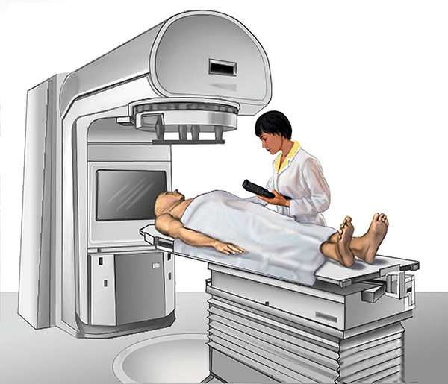

Slide 31
To reduce exposure, clients are asked to:
  Wash hands carefully after going to the bathroom.
  Flush toilet several times after each use.
  Use separate eating utensils and towels.
  Wash laundry separately.
  Drink plenty of fluid to help flush radioactive substances away.
  Avoid kissing and sexual contact.

Slide 32
Chemotherapy Therapy:
Chemotherapy uses antineoplastic agents to treat cancer cells locally and systemically. These agents may be used alone or combined with other therapies to cure cancer, prevent it from metastasizing, slow its growth, destroy tumor cells that have metastasized, or relieve symptoms.

Slide 33
How is Chemotherapy Given?
intravenous (IV) ,
oral (PO),
intramuscular (IM),
intraperitoneal (IP)

Slide 34
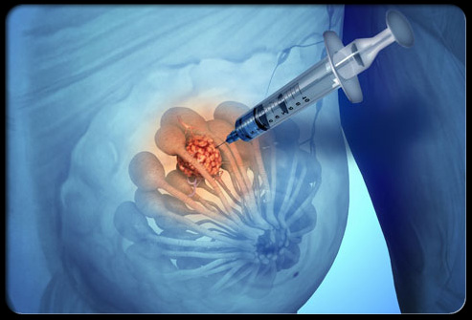

Slide 35
Side effects of Chemotherapy therapy:
Nausea and vomiting are common during the first 24 hours after chemotherapy administration.
Stomatitis and mouth soreness or ulceration may result from destruction to the epithelial layer.
Alopecia develops because chemotherapy affects rapidly growing cells of hair follicles.
Fatigue

Slide 36
Administer antiemetics before and during administration of chemotherapy, or as indicated.
Encourage the following dietary modifications:
  Eat small, frequent meals.
  Eat slowly.
  Eat cool, bland foods and liquids.
  Avoid hot or very cold liquids, food with fat and fiber, spicy foods, and caffeine.
Assess oral mucosa for dryness, swelling, lesions, ulcerations, viscous (sticky) saliva, or white patches

Slide 37
Prevention of cancer :
1_Increase consumption of fresh vegetables (especially those of the cabbage family) because studies indicate that roughage and vitamin-rich foods help to prevent certain kinds of cancer.
2. Increase fiber intake because high-fiber diets
may reduce the risk for certain cancers (e.g., breast, prostate, and colon).
3. Increase intake of vitamin A, which reduces the risk for esophageal, laryngeal, and lung cancers.

Slide 38
4. Practice weight control because obesity is linked to cancers of the uterus, gallbladder, breast, and colon.
5. Reduce intake of dietary fat because a high-fat diet increases the risk for breast, colon, and prostate cancers.
6. Stop smoking cigarettes and cigars, which are carcinogens.
7- Reduce alcohol intake because drinking large amounts of alcohol increases the risk of liver cancer.

Slide 39
  8. (Note: People who heavily smoke are at greater risk for cancers of the mouth, throat, larynx, and esophagus.)
  9. Avoid overexposure to the sun, wear protective clothing, and use a sunscreen to prevent skin damage from ultraviolet rays that increase the risk of skin cancer.
  10. Increase intake of foods rich in vitamin C, such as citrus fruits and broccoli, which are thought to protect against stomach and esophageal cancers .

Slide 40


