Slide 1
infectious disease
Prepared
By
Mayada omar

Slide 2
Definition of Infectious Diseases
Infectious diseases are diseases caused by pathogenic microorganisms, such as bacteria, viruses, parasites or fungi; the diseases can be spread, directly or indirectly, from one person or host to another.
Symptoms of infectious diseases
Symptoms of infectious diseases depend on the type of illness. Fever.
Chills.
Congestion.
Cough.
Fatigue.
Muscle aches and headache.
Gastrointestinal symptoms (diarrhea, nausea, vomiting)

Slide 3
Diagnosis and Tests
Swabbing nose or throat.
Getting blood, (urine), (stool) or (saliva) samples.
Taking a biopsy or scraping a small sample of skin or other tissue.
Getting imaging (X-rays, CT scans or MRIs) of affected parts of your body.

Slide 4
Serious and life-threatening complications of various infectious diseases include:
Dehydration: Fever, vomiting, diarrhea.
Pneumonia: Respiratory illness (viral or bacterial).
Sepsis: Bacterial infections.
Meningitis (swelling of the brain): Multiple causes, including bacterial, viral, fungal and parasitic infections.
AIDS: HIV.
Liver cancer: Hepatitis B, hepatitis C.
Cervical cancer: Human papillomavirus (HPV).

Slide 5
Spread of infectious diseases
Source: Places where infectious agents (germs) live (e.g., sinks, surfaces, human skin)
Susceptible Person with a way for germs to enter the body
Transmission: a way germs are moved to the susceptible person
mouth, nose and cuts in skin are common places for pathogens to enter your body. Diseases can spread:
From person to person when you cough or sneeze. In some cases, droplets from coughing or sneezing can linger in the air.
From close contact with another person, like kissing or oral, anal or vaginal sex.
By sharing utensils or cups with other people.
On surfaces like doorknobs, phones and countertops.

Slide 6
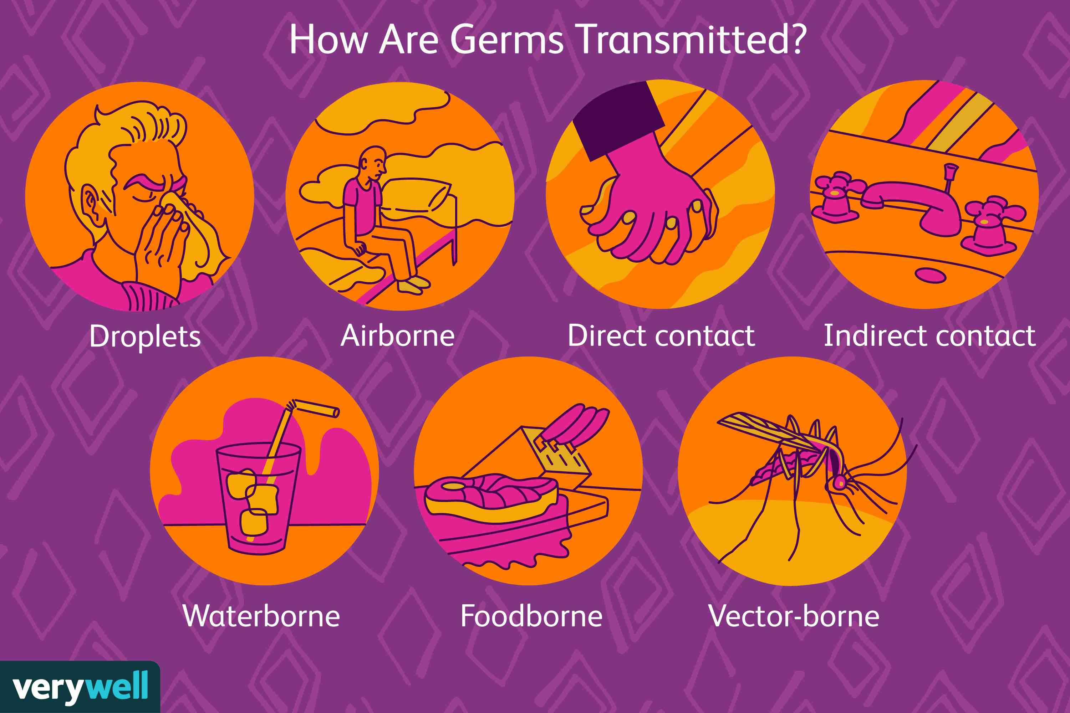

Slide 7
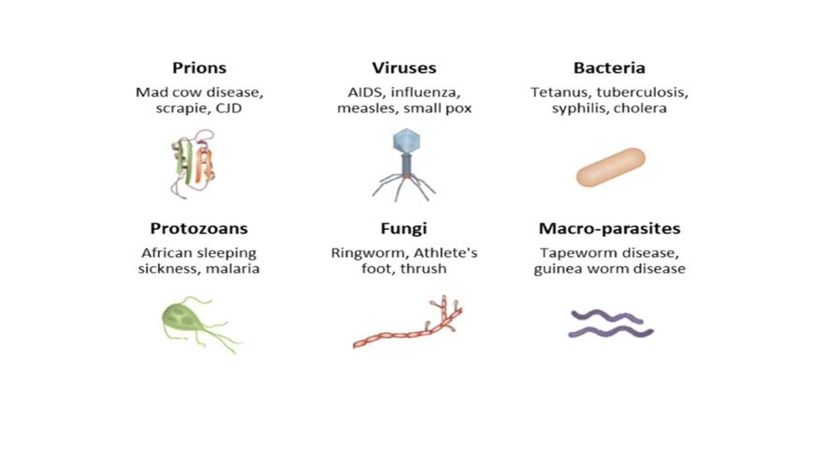
Types of infectious diseases

Slide 8
Common infectious diseases caused by viruses:
Common cold.
The flu (influenza)
COVID-19.
Stomach flu (gastroenteritis)0
Hepatitis.
Respiratory syncytial virus (RSV)

Slide 9
Common infectious diseases caused by bacteria:
Strep throat.
Salmonella.
Tuberculosis.
Whooping cough (pertussis)
Urinary tract infections (UTIs)
E. coli.

Slide 10
Common infectious diseases caused by fungi:
Ringworm (like athlete’s foot)
Fungal nail infections.
Vaginal candidiasis (vaginal yeast infection)
Common infectious diseases caused by parasites:
Giardiasis.
Toxoplasmosis.
Hookworms.
Pinworms.

Slide 11
Standard infection prevention and control precautions include:-
Hand hygiene
Respiratory and cough hygiene
Personal Protective Equipment (PPE)
Waste management
Use and disposal of sharps
Management of Laundry
Cleaning and decontamination of re-useable medical equipment
Management of blood/body fluids spills
Maintenance of a clean environment
Occupational safety & Exposure

Slide 12
•Nosocomial infection:
The infection occurring in a patient in a hospital or other health care facility in whom the infection was not present or incubating at the time of admission. This includes infections acquired in the hospital but appearing after discharge, and also occupational infections among staff of the facility

Slide 13
Sources and transmission of nosocomial infection
Skin
Nasal tract
Air
Stool
Clothes
Workers and staff
Pathogenic discharges and clinical sample of patients
Water cycle of hospital
All used instrument
Operating room environment

Slide 14
Nosocomial infection sites
Nosocomial pneumonia.
Urinary infection
Surgical site infections-
Nosocomial bacteraemia.
Other nosocomial infections-.
Gastroenteritis s.
Sinusitis and other enteric infections,

Slide 15
Duration of transmission
  If the infection appeared with in 7 days of operation and deep, this mean the contamination occur inside the operation period.
  If the infection appeared after 7 days of operation and superficial, this mean the contamination occur out the operation period.

Slide 16


