Slide 1
Parasitology
Lec 6
Helminths or Worm (Metazoa) part II
By Dr. MAYSAM ALI AMEEN

Slide 2
3.Hymenolepis nana =Dwarf TW : tiny intestinal tapeworm
Adult worm is smallest tape worm of man it has length about 25-40 mm. Scolex contain 4 sucker with short rostellum armed with circle of hook. Eggs are oval in shape with hexanth embryo, 3 pairs of hooklet and has polar thinking protect the embryo. H. nana causes Hymenolepiasis
-Life cycle: is direct no intermediate host.
-Infective stage to human: egg by food and water.
-Diagnostic stage to human by egg and gravid segment in stool

Slide 3
Hymenolepidid Infection and Life Cycle
• Infection is primarily acquired from eggs in the feces of another infected individual.
• Eggs hatch in the duodenum, releasing oncospheres that penetrate the mucosa and lie in the lymph channels of the villi.
• An oncosphere develops into a cysticercoid, which has a tail and a well-formed scolex.
• In five to six days, cysticercoids emerge into the lumen of the small intestine, attaching and maturing.

Slide 4
• The direct life cycle is a recent modification of the ancestral two-host life cycle found in other hymenolepidid species.
• Direct contaminative infection by eggs is the most common route in human cases, but accidental ingestion of an infected grain beetle or flea is also possible.
• The direct infectiousness of the eggs allows for rapid infection and person-to-person spread.

Slide 5
Mode of infection
1-Contaminated food and water with ova or
2- Auto infection, ova remains and hatches in the intestine.
• Habitat: Adult worm in the small intestine of human.
Symptoms: Rare symptoms include anorexia, vomiting nausea and behavioral disturbances

Slide 6
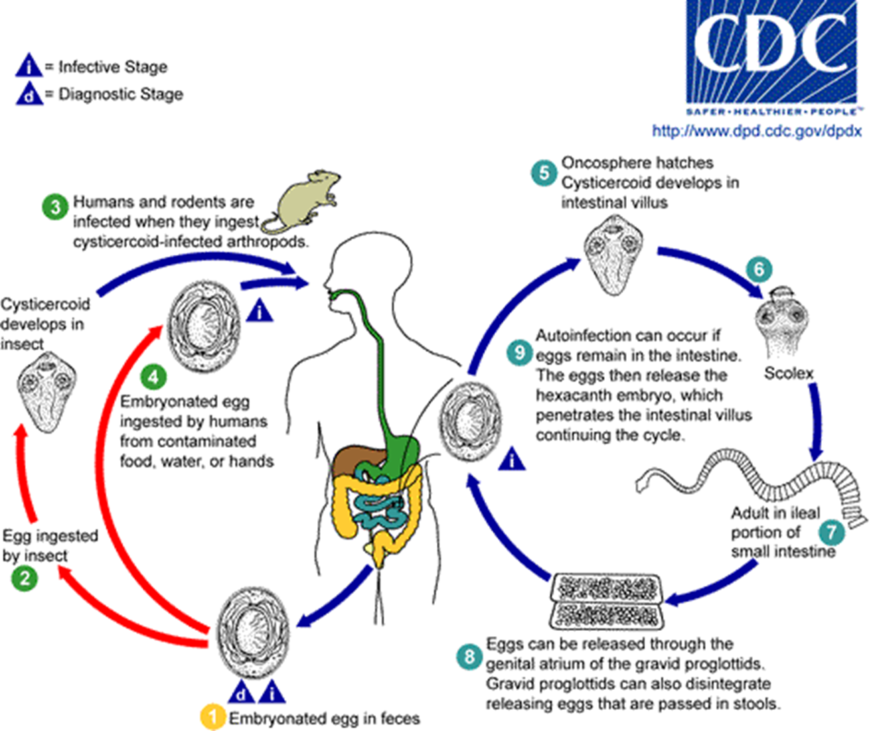

Slide 7
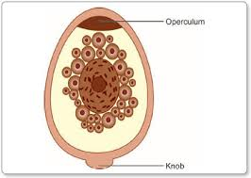
4.Diphyllobotherium latum =Broad fish TW
The length of D.latum about 10m-15m . scolex is spatulate shape ,it have contain 2 long sucking groove.
eggs of D.latum are oval shape & have opericulum at anterior end & have knob in posterior end.
D.latum causes Diphyllobotheriasis, that transmitted by larvae in undercooked or raw fish.
-Infective stage is larva
-Diagnostic stage is eggs or gravid segment in stool
-Pathogenic stage is Adult Worm

Slide 8
5.Echinococcus granulosis=Dog TW
E. granulosis causes Echinococcosis, infection produce large hydatid cysts in in the liver, lung, ovary, brain. This disease follows ingestion of egg in dog feces.
The human is a dead-end life cycle.
• Infective stage to human is : eggs by ingestion food & water.
• Mode of infection: contaminated food and water with eggs.
Egg is the infected stage comes from:
I. Ingested of water or vegetable Contaminated by infected dog feces.
II. handling or caressing infected dog where the hairs contaminated with eggs.

Slide 9
Intermediate host: human, sheep cattle, camels all carry hydatid cyst.
• Habitat: adult worm in the small intestine of dogs.
• Final host: is only the dogs
Larval stage (hydatid cyst) in intermediate host.
• Hydatid cyst is found in Humans and animals. Anaphylactic reaction to worm antigens can occur if the cyst ruptures.
Echinococcosis is diagnosed by X ray, CT scan or ultrasound scan or biopsy of infected tissue.
Casoni test for diagnosis of Echinococcus granulosus eggs
• It is world wide specially in dogs regions.

Slide 10
E. Granulosus Parasite Life Cycle
• E. granulosus requires two host types: definitive hosts (dogs) and intermediate hosts (sheep, cattle, horses, pigs, goats, camels).
• The dog is the main definitive host, with eggs shed in its scat.
• The parasite attaches to the mucosa of the intestines in the definitive host, growing into adult stages.
• The parasite can be transmitted from the intermediate host to the definitive host by frequent feeding of offal.
• The larval form of E. granulosus can cause in human cystic echinococcus, causing abnormal organ function, spontaneous fracture of bones, and neurological effects.

Slide 11
• Factors affecting infection pressure within the definitive host include frequency of offal feedings, parasite prevalence, and the age of the intermediate host.
• The life expectancy of the parasite and frequency of anthelminthic treatments also influence infection rate.
• The temperature and humidity of the environment can affect the survival of E. granulosus.

Slide 12
Pathogenesis of Parasite Infections
• Eggs hatch in duodenum or small intestine, causing extra intestinal infections.
• Embryos migrate via portal veins to lungs, liver, and brain.
• Larvae develop into hydatid cysts in these organs.
• Cysts may be large, filled with clear fluid, and contain proto-scolices. (immature forms of the head of the parasite).
• These mature into developed scolices.
•Echinococcus forms one large fluid-filled cyst that contains thousands of individual scoleces as well as many daughter cysts within the large cyst.

Slide 13
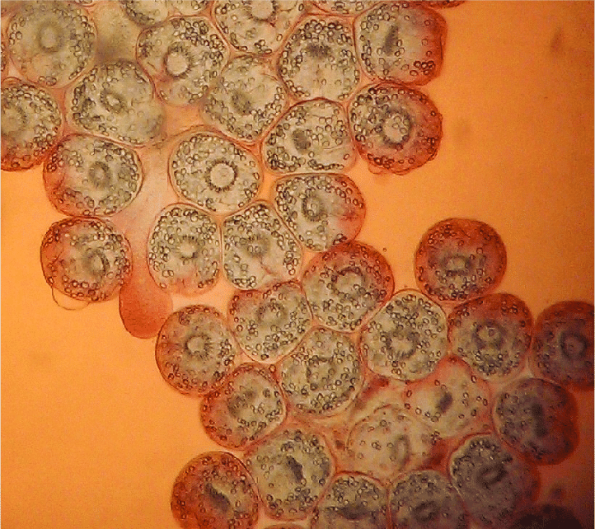
•Individual scoleces lying at the bottom of the large cyst are called “hydatid sand”.

Slide 14
• The outer layer of the cyst is thick, fibrous tissue produced by the host.
• The cyst fluid contains parasite antigens, which can sensitize the host.
• If the cyst ruptures spontaneously or during trauma or surgical removal, life-threatening anaphylactic shock can occur.
• Rupture of a cyst can also spread protoscoleces widely.
Symptoms
• Rare symptoms because the cyst grow slowly unless it rupture causing
Anaphylactic shock due to release of protoscolices and toxins of hydatid cyst.

Slide 15
Prevention and Control
control of Cestodaes = Avoid taken uncooked meat containing infective stage in the muscles.
control of Taenia saginata= Avoid taken uncooked beef meat containing infective stage in the muscles.
control of Taenia solium= Avoid taken uncooked pig meat containing infective stage in the muscles. hygiene, Improvement of water supply and sewage and Good health education.
control of Diphyllobotherium latum = Avoid taken uncooked fish meat containing infective stage in the muscles.
control of Echinococcus granulosis= Avoid taken contaminated food and water. keep the dogs away with human contact

Slide 16
Treatment of Cestodaes = Praziquantel, Albendazole
Treatment of Taenia saginata= Albendazole Alternatively, niclosamide
Treatment of Taenia solium= Albendazole
Treatment of Diphyllobotherium latum = Albendazole
Treatment of Echinococcus granulosis= Albendazole and surgical excision of cysts.

Slide 17
Trematodes (flukes)
Trematodes are small (about 1 cm), flat, leaf-like worms or flatfish that, depending on the species, infect various organs of the human host (intestinal veins, urinary bladder, liver, or lung). All trematodes use freshwater snails (Biomphalaria) as an intermediate host, human as final host
The sexual stages or adult stages in the (definitive host) and asexual or larval stages in the (intermediate host).
The life cycle stage of the digenetic trematodes that cause "swimmer's itch" is a Miracidium. it is the larval stage of a fluke that is covered with cilia and swims about seeking out a snail to serve as an intermediate host

Slide 18
All are hermaphrodite (monoecious) except Schistosoma in which sexes are separated (dioecious).
The alimentary canal of flukes like an inverted Y. There are three types :
Schistosomes (Blood flukes)
Fasciolopsis buski (giant intestinal fluke) causes Fasciolopsis. Live in Small intestine
Fasciola hepatica (sheep liver fluke ) causes Fasciolosis. live in Liver.
Cause Liver rot (bile ducts, after migration through parenchyma)

Slide 19
1. Schistosomes (Blood flukes) The disease is transmitted by direct skin penetration (cercaria is infective stage). has three sp.
A: S. haematobium: Shape of egg: oval, contain terminal or polar spine. Resident the vein surrounds the urinary bladder & Present in veins of the vesical and pelvic plexuses. causes urinary bilhariziasis. the main symptoms are hematuria, fibrosis, granulomas. The loss of blood can lead to iron deficiency anemia blocking of urinary tract & bladder cancer.
(egg in urine is diagnostic stage).

Slide 20
S. msnsoni & S. japonicum causes intestinal bilhariziasis or Schistosomiasis. Resident in the mesenteric or rectal vein surround small intestine. The eggs causes damage in intestine, liver, gastrointestinal tract causes bleeding diarrhea. Damage to the intestinal wall is caused by the host's inflammatory response to eggs deposited at that site. The eggs also secrete proteolytic enzymes that further damage the tissue. Diagnosis (egg in stool is diagnostic stage).

Slide 21
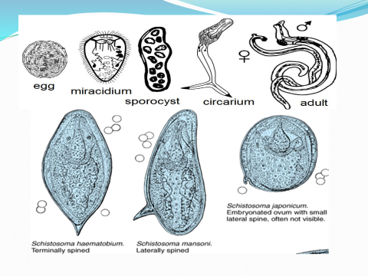
B. S. msnsoni: Shape of egg large oval, contain lateral spine.
C. S. japonicum (Oriental schistosomiasis or Katayama disease): The egg: oval contain lateral knob & blunt projection spine.

Slide 22
Schistosome Life Cycle Overview
• Schistosomes have one intermediate host, the snail, schistosome cercaria acquire by penetrating swimmers' skin in contaminated rivers and lakes.
• After dissemination and development in the human host, Adult schistosomes reside in various abdominal veins, depending on the species.
• Schistosomes have distinct sexes, with a male in which the smaller female resides and continuously mates with the male (Female of Schistosoma settled with male in place Gynecophoric canal.

Slide 23

• Fertilized eggs penetrate the human host's vascular walls enter the human host's intestine or bladder, emerging in feces or urine.
• In fresh water, schistosomes infect snails, multiply, and produce cercaria, which are released into the fresh water.
Egg miracidia sporosyst cercariae Adult worm
larva
miracidia enter the snails (mollusks) develop into cercariae
Life cycle of schistosomes

Slide 24
Egg miracidia sporosyst rediae cercariae metacercariae
larva
Adult worm
miracidia enter the snails develop into metacercariae
Life cycle of Fasciola hepatica & Fasciolopsis buski

Slide 25
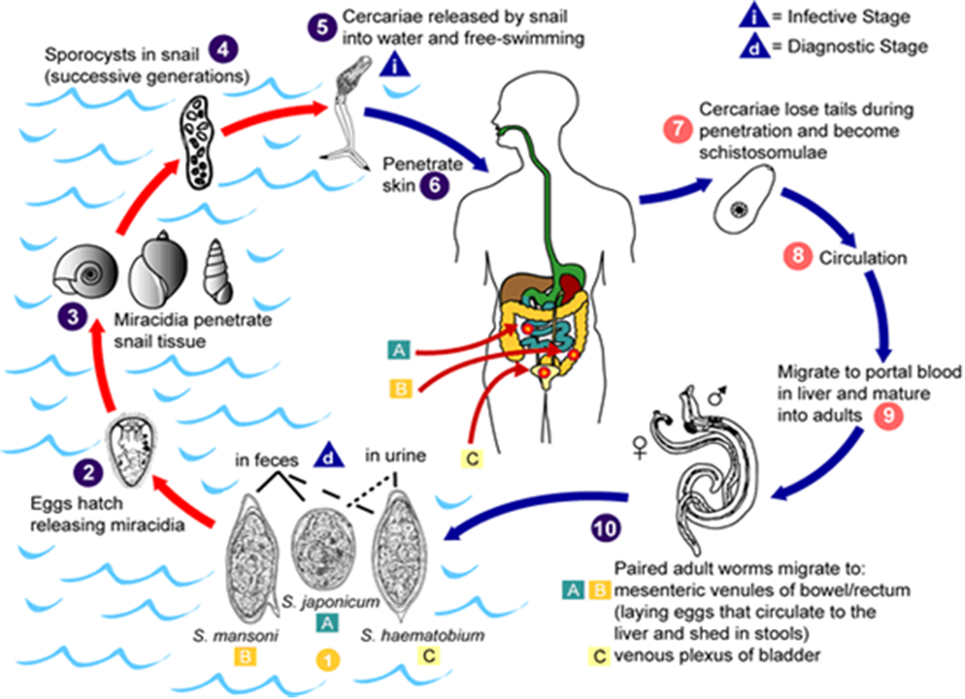

Slide 26
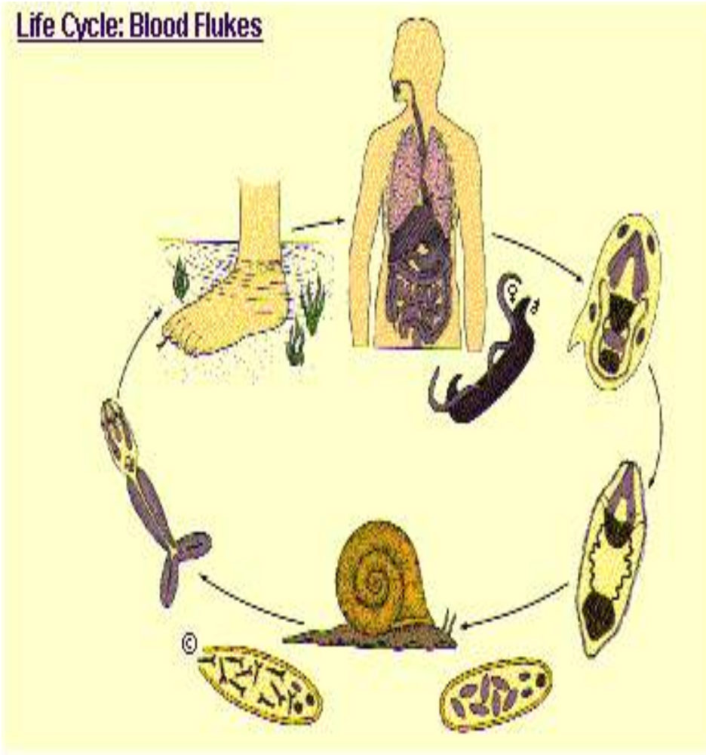
control &Preventionof Schistosomes = Prevention of pollution of water in rivers by humanUrine, Eradication of Mollusks (snail), Avoiding swimming or washing, or bathing in or contact with infected or polluted water.
Treatment of Schistosomes = praziquantel

Slide 27
Thank you

