Slide 1
Parasitology
Lec 4
Sporozoa apicomplqaxia
By Dr. MAYSAM ALI AMEEN

Slide 2
Sporozoans reproduce asexually in human cells by a process called schizogony, in which multiple nuclear divisions are followed by envelopment of the nuclei by cell walls producing merozoites (ring stage). These, in turn, become trophozoites. Sexual reproduction occurs in the Anopheles, where new spores (sporozoites) are formed process called sporogony.
Plasmodium : intermediated host= human
definitive host = mosquitoof Anopheles
Toxoplasma : intermediated host= human
definitive host = cat

Slide 3
A:Malariaor water fever (Plasmodium species):
Malaria is an acute infectious disease of the blood
P. falciparum causes malignant tertian malaria incubation period 7-10d. It accounts for some 50 % of all malaria cases.
P. malariae: causes Quartan malaria, incubation period 18-40d and represent 18 %of malarial cases
P. vivax: causes benign tertian malaria, incubation period 10-17 days. P. ovale: causes benign tertian malaria, incubation period 10-17 days

Slide 4
Mode of infection of plasmodial parasite
1- Insect bite of a female Anopheles mosquito
2-Blood transfusion from infected donors.
3-Organ transplantation.
4-Congenitally and trasplacentally.
5-Needle stick injury: In case of drugs addiction.

Slide 5
Important properties
There are two cycles in the life cycle:
Schizogony (asexually in human; intermediated host),
Sporogony (Sexual reproduction in the Anopheles; definitive host) Sporozoites (infective stage) pathogenic stage: all liver and RBCS stages.
•Diagnostic stage: All intracellular RBCS STAGES (ring,macrogamete and microgamete).
Habitat: 1-intra-Liver cells 2- Intra-RBCS

Slide 6
Life cycle :
• Malaria Transmission by Anopheles Mosquitoes
• Malaria transmitted via blood meal.
• Transfers malarial sporozoites from salivary gland into wound.
• Sporozoites carried to liver parenchymal cells for schizogony to form schizont .
• Exoerythrocytic cycle of growth and reproduction lasts 8-25 days, depending on Plasmodium species.
• Infected liver cells rupture, introducing merozoites into blood.
• Host reaction with parasite products from erythrocytes schizogony.
• Trophozoite forms of plasmodium present inside liver cells.

Slide 7
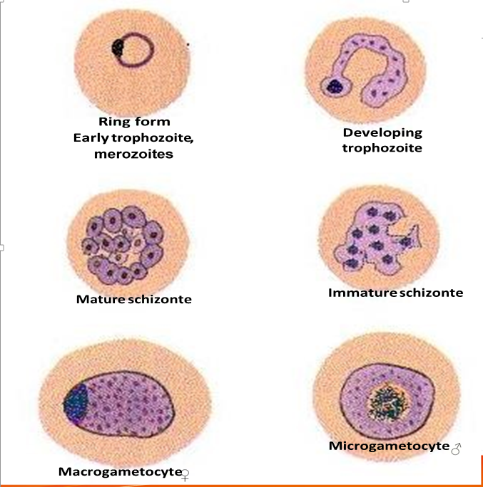
Merozoite Migration and Growth
• Migrating merozoites target age and size-specific RBCs.
• Initiate erythrocytic cycle of growth.
• Asexual phase: plasmodia feeds on hemoglobin.
• Passes through six morphologic forms.

Slide 8
Table ( 1) : Plasmodium vivax :Typical characteristics ( based on Giemsa stain ).
Appearance of infected RBCs | Enlarged , distorted
Ring form (merozoites) | Delicate cytoplasmic ring measuring 1/3 RBC diameter Single chromatin dot, Ring surrounds a vacuole
Developing trophozoite | Irregular ameboid appearance .Ring remnants common .Brown pigment
Immature schizout | Multiple chromatin bodies Brown pigment
Mature schizont | 12 to 24 merozoites occupying majority of the RBCs .Merozoites surrounded by cytoplasmic material Brown pigment may be present
Microgametocyte | Large pink to purple chromatin mass surrounded by colorless to pale halo
Macrogametocyte | Round to oval cytoplasm , Eccentric chromatin mass Delicate light – brown pigment present throughout cell

Slide 9
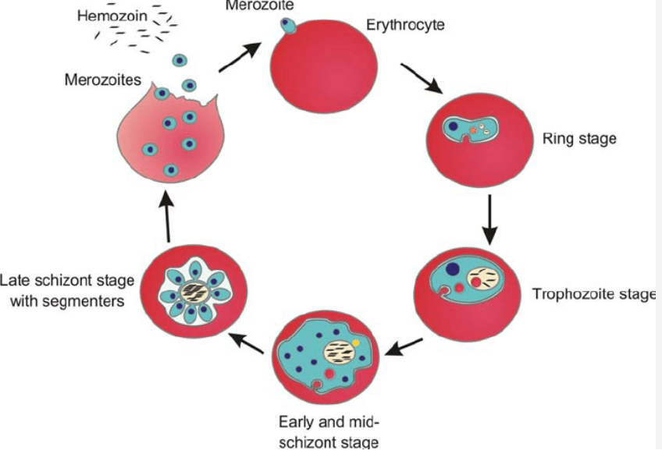

Slide 10
Merozoite Formation and Erythrocytic Cycles
1• Merozoites can rupture RBCs, releasing them to target new RBCs.This cycle repeats, leading to numerous erythrocytic cycles.
2• Infected RBCs can develop into microgametocytes male and macrogametocytes female .
3• Some are destroyed by healthy individuals' immune systems.
Transmission of malaria back into the vector occur when the mosquito ingests mature male (micro) and female (macro) gametocytes during a blood meal, thus initiating the sexual cycle of growth

Slide 11
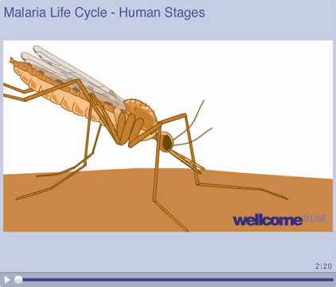

Slide 12
Mosquito Infection Process
• Male and female gametocytes unite in mosquito's stomach.
• Forms zygote, elongated and active and is called Ookinete, which matures into oocyst.
• Oocyst ruptures, releasing sporozoites.
• Sporozoites migrate into mosquito's salivary gland, ready to infect humans.

Slide 13
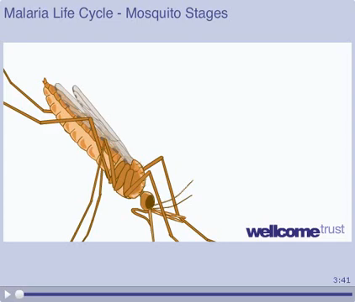

Slide 14
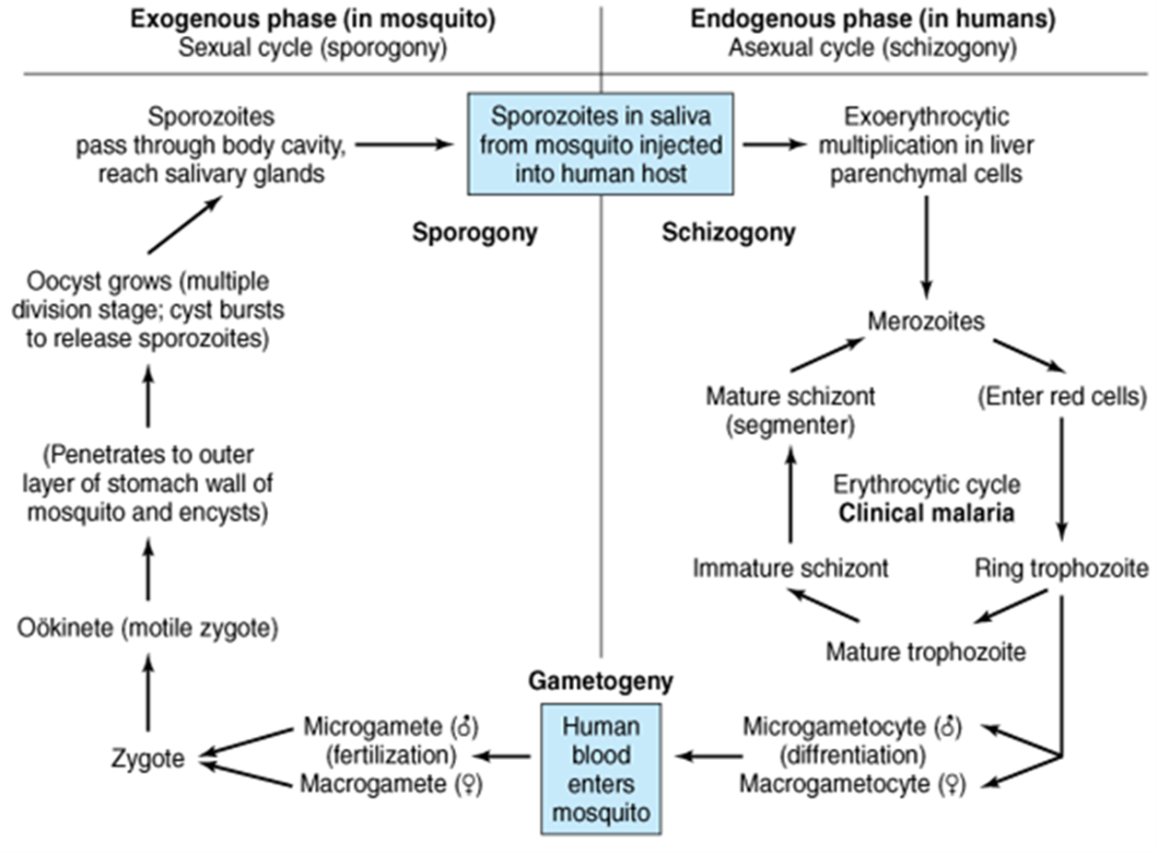

Slide 15
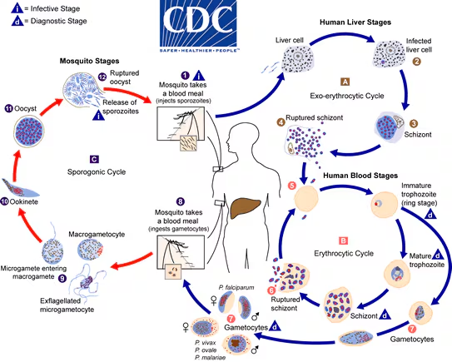

Slide 16
Pathogeneses
•Sporozoites Injected into bloodstream, migrate to liver, form cyst-like structures schizont .
• Invade red blood cells, using hemoglobin as nutrient.
• Infected red cells rupture, releasing merozoites.
• Febrile paroxysm of fever can result from massive toxic substance release.
P.falciparum: Globally High Mortality Rate most dangerous plasmodial species causes rapidly fulminating disease with high fever and orthostatic hypotension.

Slide 17
• Infection can lead to capillary obstruction and death if untreated.
Destruction of red blood cells by release of merozoites & the action of the spleen to first sequester the infected red cells & then to lyse them.
The enlarged spleen is due to congestion with erythrocytes, coupled with hyperplasia of lymphocytes & macrophages.

Slide 18
Malaria Disease Types
• P. malariae, P. vivax, P. ovale cause milder disease they invade either young or old red cells .
• P. falciparum invades all RBC ages.
• Malaria is common, causing 300 million cases annually.
• Death rate is about 1%.

Slide 19
P. falciparum Malaria Characteristics
• More severe than other plasmodia due to increased red cell infection and capillary occlusion causes cerebral malaria due to hemorrhage and necrosis.
• High parasitemia due to infecting red cells of all ages.
• Causes extensive hemolysis and kidney damage, leading to hemoglobinuria.
• Black water fever term derived from dark urine color.
• Hemoglobinuria can lead to acute renal failure.

Slide 20
Clinical symptoms:
Malaria symptoms, typically seen after the first exposure, seen in cases of the flu, include nausea, vomiting, headache, muscle pains, abdominal pain, splenomegaly and hepatomegaly, myalgias, and arthritis, similar to flu symptoms.
Infected RBCs rupture, causing merozoites, hemoglobin, and toxic cellular waste.
• Paradoxes fever occur every 48 hours.
• Main symptoms: Anemia, paroxysms fever high-grade fever (reach 41 C), chills.
• Fever cycle timing: 72 h for P. malariae, 48 h for other plasmodia types.

Slide 21
After infection liver and RBC, typical picture of malaria is: Febrile paroxysm. Has three stages
Cold stage: it lasts for 15–60 minutes, the patient has intense cold and uncontrolled shivering
Hot stage: it lasts for 2-6 hrs. the temperature is 41°C or higher
Sweating: when the patient goes in profuse sweat. The temperature drops rapidly & the patient usually falls into deep sleep, to wake up refreshed

Slide 22
Lab Diagnosis of Plasmodium
1\ Detection of parasite in RBC intracellular.
• Microscopic examination of blood using thin and thick Giemsa-stained smears.
• thick Screening for organisms during febrile paroxysm.
2\ PCR-based test for Plasmodium nucleic acids.
3\ Serologic procedures (ELISA test) for P. falciparum protein.

Slide 23
Control and Prevention
• Vector control and avoidance of anopheles mosquitoes.
• Use of insecticides and repellents.
• Prevention at peak feeding time.(usually dusk to dawn)
• Widespread use of bed nets and suitable clothing.
Plasmodium Treatment • Treatment depends on infection stage.
• Primaquine effective against exoerythrocytic and gametocytic forms.
Inactive against red blood cell parasites.
• For erythrocytic form, Primaquine with chloroquine.
• Mefloquine or quinine & doxycycline used for chloroquine-resistant P. falciparum strains.

Slide 24
B: Toxoplasmosis (Toxoplasma gondii)
is obligatory intracellular, T. gondii is found inside the reticuloendothelial cells.
Mode of infection
1• Accidental ingestion of mature oocysts in food, water, raw/undercooked meat, or finger contaminated with cat feces.
2• Congenital infection from infected mother to fetus uterine infection from mother to fetus
3• Blood transfusion or transplantation from infected donors.

Slide 25
-Intermediate host: human (Accidental host ), cattle , lamb and pork, rodents.
-Final host or definitive hosts : cats (sexual cycle(
-Infective stage: fecal oocyst from cats , or tissue cyst from cattle or Tachyzoite → from pregnant women

Slide 26
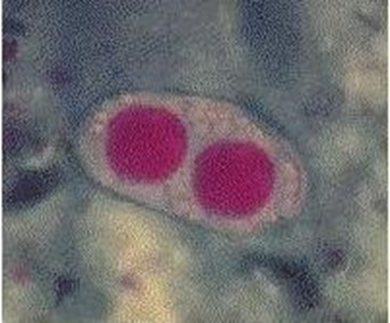
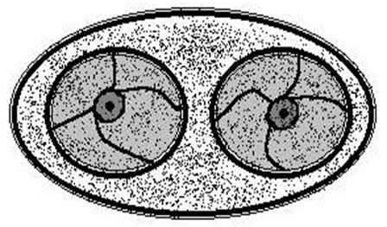
Toxoplasma gondii oocyst :
Typical characteristics by size range 25 to 35 μm long , 10 to 15 μm wide. Its appearance is transparent with oval shape.
Other features: Young oocyst contains two sporoblasts.
Mature oocyst contains two sporocysts, containing four sporozoites
Matuer
young

Slide 27
There are two kinds of Toxoplasma trophozoites (tachyzoites &bradyzoites)
Table ( 3 ): Toxoplasma gondii tachyzoite : Typical characteristics
General comment | Actively multiplying morphologic form (multiply rapidly)
Size | 3 to 7 μm by 2 to 4 μm
Shape | Crescent shaped , often more rounded one end
Number of nucleui | One
Other features | Contains a variety of organelles that are not readily visible (intracellular trophozoite) proliferating tachyzoites within a host cell are known as pseudocyst

Slide 28
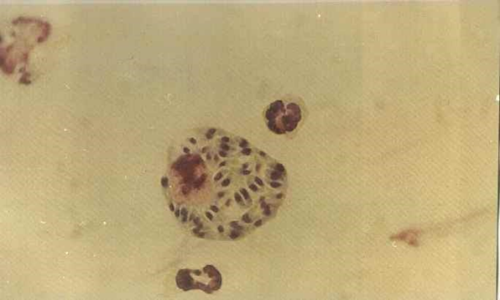
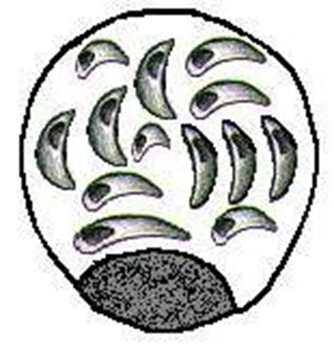
Tachyzoites

Slide 29
Table ( 4 ): Toxoplasma gondii Bradyzoite : Typical characteristics
General comment | Slow - growing morphologic form (multiply slowly)
Size | Smaller than tachyzoites
Physical appearance | Similar to that of the tachyzoites
Number of nucleui | One
Other features | Hundreds to thousands of bradyzoites enclose themselves to form a cyst that may measure 12 to 100 μm in diameter Young tissue cysts contain only 2 bradyzoites, while the older ones may contain hundreds of bradyzoites.

Slide 30
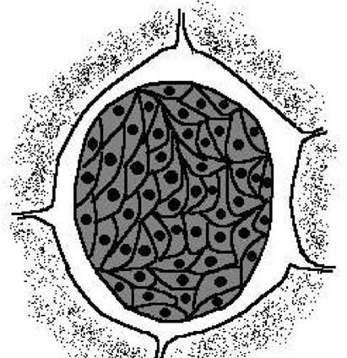
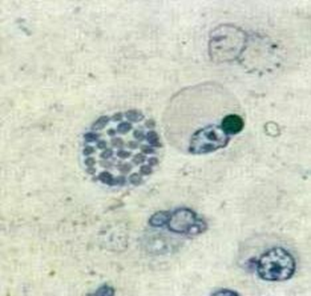
Bradyzoite

Slide 31
Toxoplasmosis Pathogenicity and Clinical Symptoms
• Common and usually asymptomatic infection of normal human hosts.
• Cysts spread to brain, lungs, liver, muscle, and eyes.
• Tachyzoites destroy cells, particularly parenchymal and reticuloendothelial cells.
• Bradyzoites cause local inflammation, blood vessel blockage, and necrosis.
• Most common finding is cervical lymphadenopathy, usually painless and fever.
• Single or multiple enlarged nodes may persist at one site or involve scattered nodes.

Slide 32
the fulminating fatal infections serious consequences are limited to:
1-Pregnant women (congenital infections)
2-Immunodeficient or in debilitated or in immunocompromised individuals.
• Severe infections in compromised hosts can lead to encephalopathy, meningoencephalitis, or cerebral mass lesions.
• Underlying conditions include malignancies (such as Hodgkin’s disease, nonHodgkin’s lymphomas , leukemia, or tumors), , collagen vascular disease, organ transplantation, and AIDS.
• T. gondii is the most common cause of secondary CNS infection in AIDS patients and intracerebral mass lesions.

Slide 33
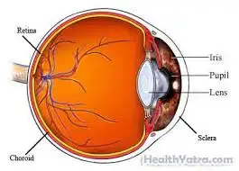
Congenital infection:
Mean the mothers are infected during pregnancy that transported to the fetus. In the fetus, the infection clears from visceral tissues and may localize in the central nervous system. Infections in the first trimester and early second trimester may lead to spontaneous abortion
Congenital Infection Stillbirths and Their Impact
• Causes Hydrocephalus & Microcephaly.
• Causes Chorioretinitis.
• Causes Convulsion (Seizure).
• Causes Blindness and Hearing Loss.

Slide 34
• Leads to Cerebral Calcification.
• Causes Psychomotor Disturbances.
• Involves Lymphadenopathy, affecting deep cervical lymph nodes.
• Rarely leads to Pneumonitis, Myocarditis, and Meningoencephalitis.
• Can lead to fatal central nervous system disorders and lifelong disabilities.

Slide 35
Life cycle
the oocyst is formed by sexual reproduction (gametogony) occurs in cat which are the definitive host.
Tachyzoites and tissue cysts represent stages of asexual multiplication (schizogony) occurs in humans, mice, rats, sheep, cattle, pigs, and certain birds, which are the intermediate hosts
• tissue of mice or rats contaminated with bradyzoites ingestion by cat releases enclosed bradyzoites .
• in the Cats , it transform into tachyzoites.
• it reproduce sexually and asexually in gut of cat .
• Sexual cycle produces immature oocysts, shed in stool.

Slide 36
Domestic Cat Enteric Cycle
• Involves schizogony and gametogony in mucosal epithelial cells of small intestine.
• Infection acquired through ingestion of tachyzoites and bradyzoites from rodent tissue cysts and sporozoites from cat feces.
• Invades cat's small intestine, undergoes asexual generation cycles before sexual cycle begins.
• Formation of male and female gametocytes, resulting in male and female gametes respectively.

Slide 37
• Oocysts develop after sexual fertilization, exit host cell, and pass out in feces.
•oocyst contains sporoblast, becomes infectious after 3-4 days of development in soil by the sporoblast divides then become sporocyst by acquiring a cyst wall
• Mature oocyst contains eight sporozoites, infective form.
• Infective in moist soil for about one year.
• Repeats cycle in cats or rodents, humans, or birds when ingested.

Slide 38
Exoenteric cycle
occurs in humans, mice, rats, sheep, cattle, pigs, and certain birds, which are the intermediate hosts. Man acquires infection by:
1\ ingestion of food and drinks contaminated with cat’s feces containing sporulated oocysts. In the duodenum the oocysts release sporozoites,
2\ ingestion of undercooked meat containing tissue cysts. Tissue cysts release bradyzoites.

Slide 39
• Invades cells, especially macrophages, forming tachyzoites.
• Multiply, break out, and spread to other organs.
• they enter into the neural and muscular tissues, such as the brain, eye, and skeletal and cardiac muscles where they multiply slowly (as bradyzoites) to form tissue cysts, initiating chronic stage of the disease. Develop in lungs, liver, kidneys.

Slide 40
• Infective when ingested by both definitive and intermediate hosts.
• Acquired through organ transplantation, blood transfusion, transplacental transmission, and tachyzoite accidental neoplasm.
• Maternal infection estimated at 3-5% during reproductive years.

Slide 41
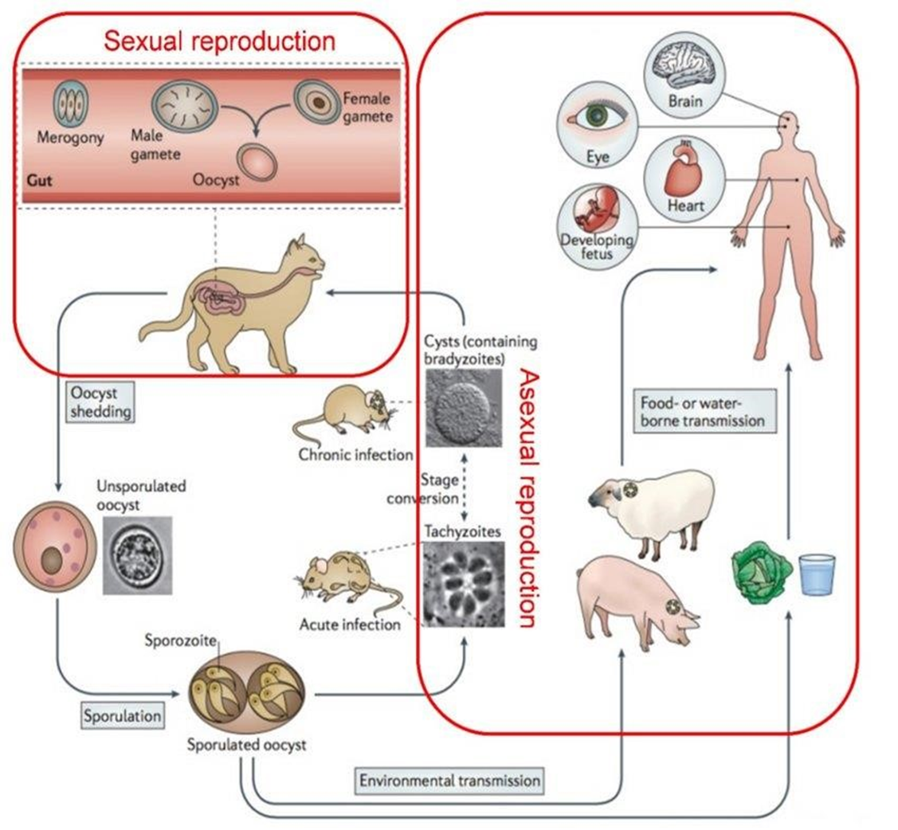

Slide 42
Diagnosis and Treatment of Toxoplasma
• Initial diagnosis involves tissue specimen
• Serologic tests like IgG and IgM used.
• T.gondi can be isolated via tissue culture inoculation. Toxoplasma antigen detection in blood or CSF may be demonstrated by ELISA.
• ELISA and PCR used for DNA detection.
Treatment of Toxoplasma gondii by pyrimethamine ,combination with sulfadiazine
For pregnant woman spiramycin is a successful alternative drug for toxoplasmosis

Slide 43
Toxoplasma gondii Control Measures
• Avoid human contact, especially with pregnant women.
• Handle uncooked and undercooked meat carefully.
• Wear gloves when handling soil.
• Wash hands with soap and water after outdoor activities.
• Wash cutting boards, sinks, knives thoroughly when preparing raw meat.

Slide 44
Thank you

