Slide 1
Parasitology
Lec 7
Nematodes (roundworms) part III
By Dr. MAYSAM ALI AMEEN

Slide 2
Nematodes (roundworms)
1.Ascaris lumbricoides (Giant roundworms)
2.Enterobes (pinworm)
3. Trichuris trichiura (Whipworm)
4.Anchylostoma (Hook worm)
5.Necatoramericanus Associated with Nocturnal Pruritus.

Slide 3
Nematodes Overview
• Elongated, non-segmented worms with tapered ends.
• Dioecious (bisexual) with complete digestive system.including a mouth, an intestine that spans most of the body length, and an anus.
• Protected by a tough non-cellular cuticle.
• Have separate, distinct sexes.
• Invade liver, kidneys, intestines, subcutaneous tissue, or eyes.
• Humans are the sole hosts.

Slide 4
The mode of transmission of All types of Nematodes except Anchylostoma by ingestion of contaminated soil, food & water Anchylostoma by skin penetration
The infective stages and diagnostic stages of All types of Nematodes are eggs except Anchylostoma The infective stages is larvae

Slide 5
1\Ascaris lumbricoides, giant roundworms: cause Loeffler's syndrome or ascariasis, a serious disease worldwide. It is transmitted through soil containing egg, Larva grow in the
Intestine , causing intestine obstruction, blood and lung damage, and being the sole host.
Adult
• White with pink tint. Fine striations are visible on the cuticle
• Largest known intestinal nematodes.
• Males are characteristically slender, prominent incurved tail. reaching 30 cm in length
• Females measure 22-35 cm, resembling pencil lead thickness.

Slide 6
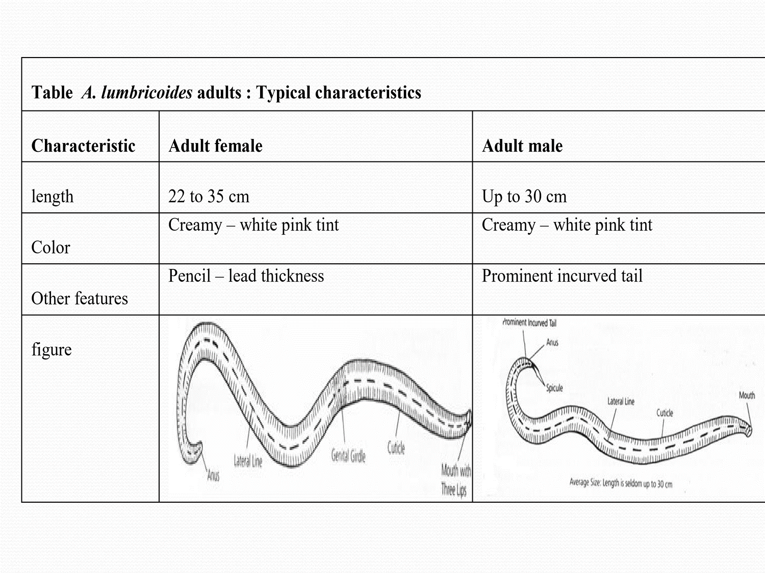

Slide 7
Nonfertilized egg | Fertilized egg
85 to 95 μm by 38 to 45 μm size variations possible | 40 to 75 μm by 30 to 50 | Size
Various | Rounder than nonfertilized version | Shape
Unembryonated ; amorphous mass of protoplasm | Undeveloped unicellular embryo | Embryo
Thin | Thick , chitin | Shell
Usually corticated | My be corticated or decorticated | Other features

Slide 8
A. Lumbricoides Life Cycle :
• Infection begins with ingestion of infected eggs containing viable larvae.
• Larvae emerge from eggs inside the small intestine entering blood via intestinal wall penetration. Complete a liver-lung migration
• Liver is the first "stop" on the journey.
• Larvae continue via blood stream to lung.
• Lung larvae burrow into alveoli through the capillaries
• migrate to bronchioles, and then pharynx through coughing where they are then swallowed and returned to the intestine.
• Adult worms multiply and pass undeveloped eggs in feces. (up to 250,000 per day)

Slide 9
• Small intestine is the normal habitat of Ascaris lumbricoides.
The size of fertilized eggs in Ascaris lumbricoides is the main distinguishing feature, while unfertilized eggs are characterized by the second stage larvae, known as Rhabtitiform larvae.
ingestion of infective stages (egg)_____in small intestine convert to larva ______penetration the intestinal wall ______ in to blood ______liver (the first “stop” on this journey) ______ in to blood ______lung (the second“stop” on this journey) _____ into the alveoli ______into the bronchioles ______the larvae are transferred through coughing into the pharynx ______then swallowed ______returned to the intestine_____adult worms

Slide 10
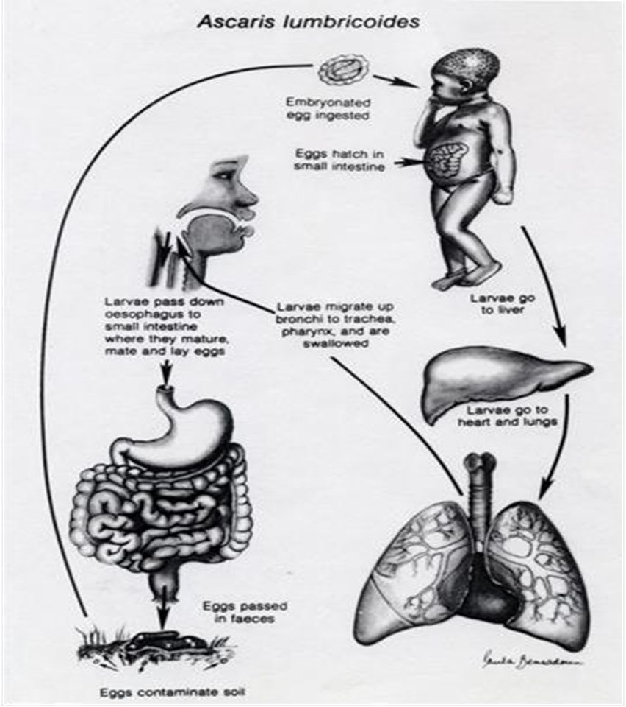
Control of Ascaris Lumbricoides:
• Avoid contaminated food and water.
• Treat Nematodes with mebendazole.
• Treat Ascaris with albendazole and mebendazole.

Slide 11
Symtomatic Ascariasis Infection
• Patients who develop symtomatic
can be infected with single worms.
• Worms may cause tissue damage during migration.
• Secondary bacterial infection may occur after worm perforation.
• Infected patients with many worms
may experience abdominal pain, vomiting, fever, and distention.
• Worms can entangle themselves into a mass that
obstruct intestine, appendix, liver, or bile duct.

Slide 12
•intestinal Complications can lead to death.
• Worms can exit through anus, mouth, or nose.
• Infected children may develop protein malnutrition.
Diagnosis
• Macroscopic examination of adults in stool, throat, mouth, nose.
• Detection of larva stage in sputum and eggs in feces.
• Egg in stool, with heavy protective tuberculated shell, common specimen source.
Treated with mebendazole.

Slide 13
Pathogenicity: The pathogenicity can be caused by
1\Larvae Migration :
• Pathogenic effects due to allergic reactions, not larvae presence.
• Initial exposure usually asymptomatic, except when the larval load is very heavy .But when reinfection occurs subsequently there may be intense cellular reaction.
in lung Ascaris Pneumonitis (Loefflers Pneumonitis)
• Lung capillaries destroyed by larva , causing hemorrhage.
• Heavy infections cause blood pools blocking air sacs.
• Migration of white blood cells causes congestion.
• Lung tissue destroyed, bacteria infections occur, potentially fatal.

Slide 14
Adult Worm Overcrowding
• Leads to wandering.
• Migrates to stomach, causing acid irritation.
• Penetration into intestine can cause fatal peritonitis.
• Migrates to lung, causing extensive damage and death.

Slide 15
2\ Enterbius vermicularis (pinworm)
Enterobies caused by it . common Nematode Infection (oxyuris or Seat worm)
• Causes anal itching.
• White worms visible in stool or perianal region.
• Male and female mate in small intestine ileum.
• Adult female and egg found in stool. Plano-covex D-shaped ovum, flattening on side, thin shell. Deposited on perianal skin)
• Egg found in dirt under nails and household dust.
• Egg remains viable for 2 weeks under cool, moist conditions.
• Transmission via ingesting.

Slide 16
Clinical features of Enterobiasis:
About 1\3 infection are asymptomatic.
External autoinfection from anus to mouth: when female lay eggs on the perianal area carried with fingers leads to the deposition of eggs under nails.
Internal Autoinfection from Anus to Colon:
• Eggs hatch into larvae, migrate through anus, and develop into worms in colon.
• Most common in children, especially females.
• Females crawl out of anus to lay eggs, causing scratching and itching.

Slide 17
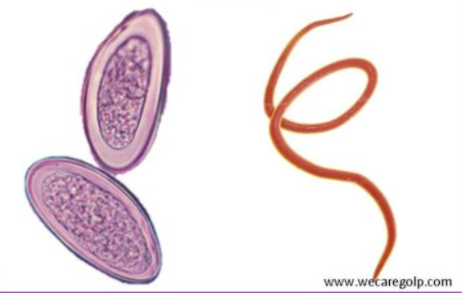
• Worm crawls into vulva and vagina, causing irritation and mucous discharge.
• May migrate to uterus and fallopian tubes, leading to sleeping disturbances.
Treatment = mebendazole

Slide 18
E. vermicularis Life Cycle
• Monoxenous worm, passes entire life cycle in human host . It has no intermediate host
• Male rarely seen seldom dies after mating and passed in feces.
• The gravid female migrates down the colon to the rectum at night and crawls about on the perineal skin to lay its sticky eggs.
• Retains in anal canal and come out again to lay more eggs.

Slide 19
• Single worm lays 5000-17,000 eggs.
• The worm dies or gets crushed by the host during scratching, eggs are rarely found in feces.
•When eggs containing infective larvae are swallowed,
Infective larvae hatch in intestine.
• larvae moult in ileum, enter caecum, mature into adults.
• Development of gravid female takes 2 weeks to 2 months.

Slide 20
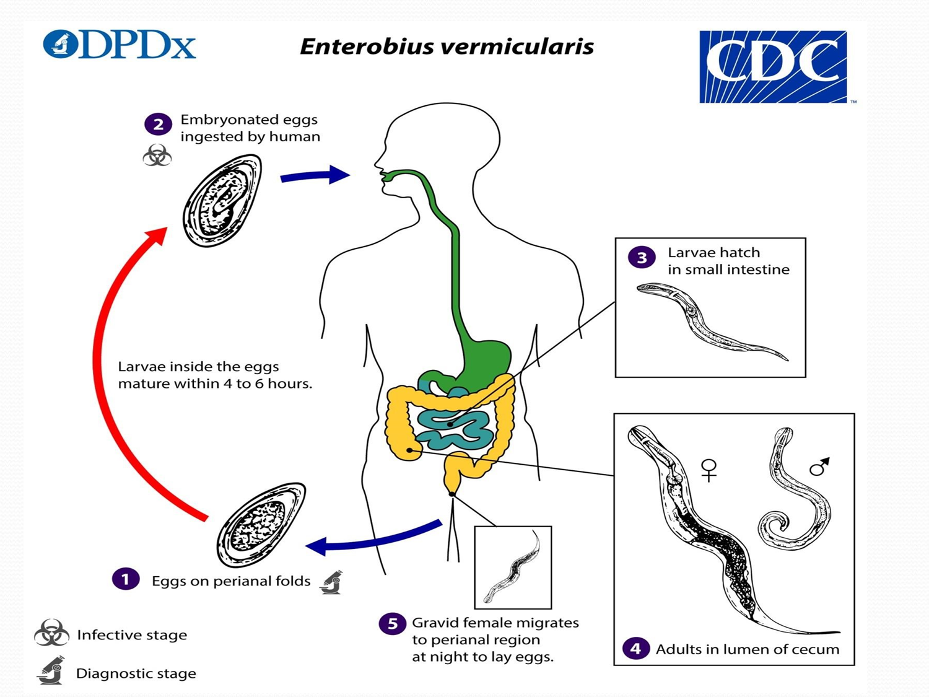

Slide 21
4\ Trichuris trichiura (Whip Worm) :
• Morphology: Flesh-colored worm The name Trichuris means a hairlike tail (Greek trichos—hair, oura—tail).
• Infection: Asymptomatic, found on rectal mucosa.
• Causes: Abdominal pain, dysentery, diarrhea, rectal prolapse.
• Transmission: Disease transmitted by ingesting the egg.
• Diagnosis: Egg in stool,( barrel-shaped with bipolar or double plug or 2 cell stage Undeveloped cell, embryonated, American foot ball shape).
• Habitat: Adult cecum, appendix, colon, rectum.

Slide 22
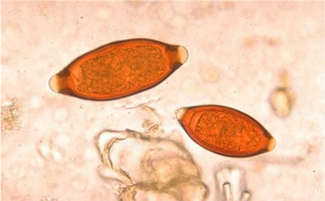
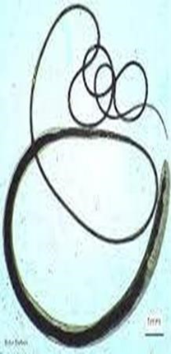
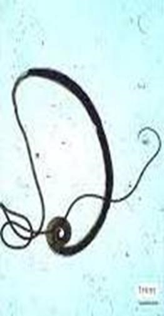
mail
egg
female

Slide 23
Life cycle :
• Egg develops in soil and infects humans.
• Similar morphologically worms infect pigs and monkeys.
• Humans are the only natural host for T. trichiura, attached to caecum wall and appendix.
• Fertile female lays 5000 eggs daily.
• Egg passed in feces contains unsegmented ovum, not infective for humans.
• Egg develops in soil under warm, moist, shady conditions.
• Infective rhabditiform larva develops within egg in 3-4 weeks.

Slide 24
• Eggs containing infective larvae swallowed in food or water.
• Eggs hatch in small intestine.
• Adults mature in 2-3 months, embedded on caecal wall with the
thread-like anterior portion and thick posterior end.
• Eggs appear in feces 3 months post-infection.
The entire life cycle can be passed in one host, from the ingested infective egg to the development of the adults and the release of their eggs in faeces.

Slide 25
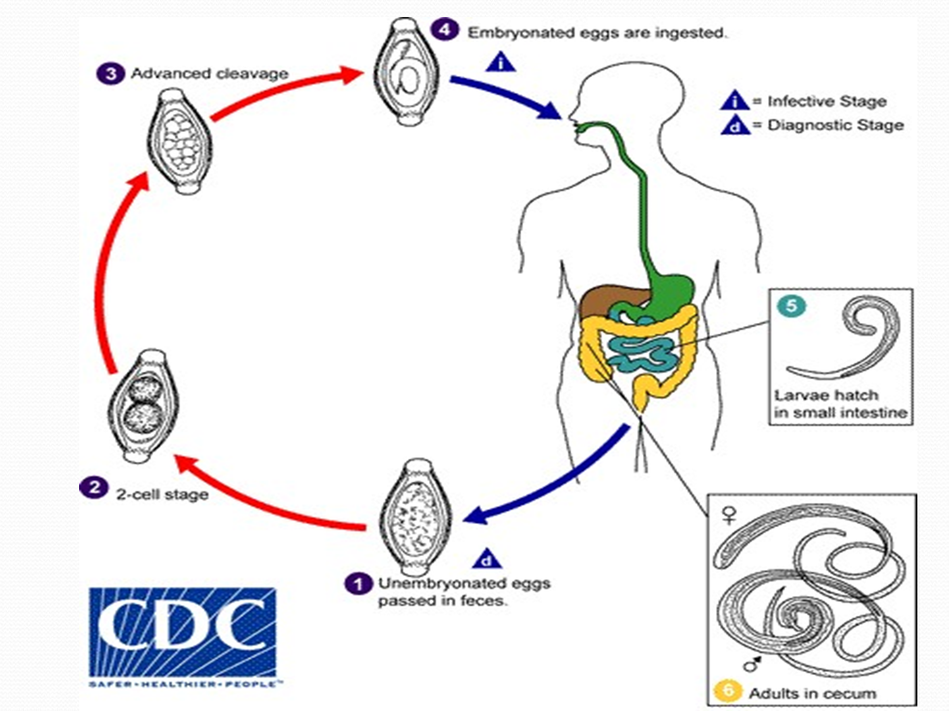

Slide 26
Pathogenesis and Clinical Features
"Trichuriasis or Trichocephaliasis"
• Asymptomatic except in heavy worm loads.
• Caused by mechanical effects or allergic reactions.
• Blood loss: 0.005 ml per worm per day.
• May lead to anemia and malnutrition over time.
• by masses of whipworms Mechanical blockage of appendiceal lumen lead to acute appendisite .
• Symptoms: Mucus diarrhea, chronic dysentery, abdominal pain.
• Rectal prolapse risk in young children.
• Mebendazole treatment recommended.

Slide 27
5&6\ Anchylostoma & Necator American Disease
• Caused by Anchylostoma duodenale.
• The worm attaches to the intestinal mucosa, Causes anorexia, ulcer-like symptoms, and chronic intestinal blood loss.
• Leads to Iron deficiency anemia.
• Transmitted through skin penetration by Filariform larvae in soil.
Morphology
Adult woorm Stout cylindrical worms, pale pink or greyish white, may appear reddish brown due to ingested blood.

Slide 28
egg in stool (thin shall, 4-8 cell stage) they are oval. When released by the adult worm in the intestine, contains an unsegmented ovum
Reservoir host: dogs
Habbit :Adult worms reside primarily in the jejunum of infected individuals, with less frequent presence in the duodenum and ileum.
Transmission:
• Bacteria penetrate skin and subcutaneous tissue when barefooted.
• Common entry sites: skin between toes.
• Rarely through oral route, possibly from contaminated vegetables or fruits.

Slide 29
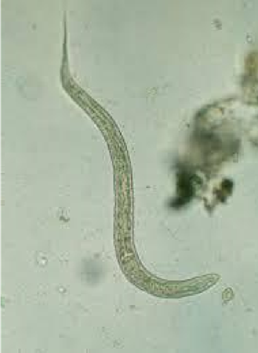
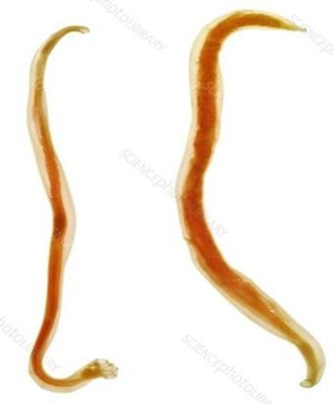
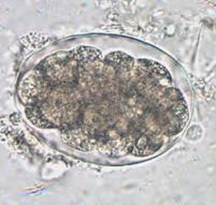
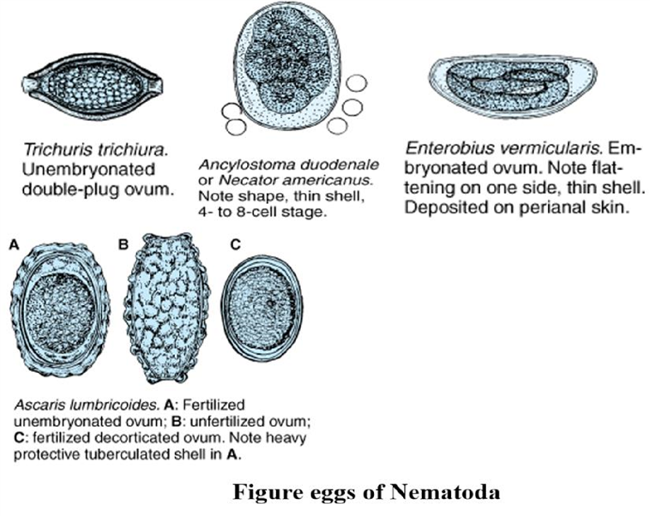
Adult warm
egg
larva

Slide 30
Life Cycle of Infectious Bacteria
• Humans are the only natural hosts.
•fresh Eggs from feces are not infective.
• the embryo develop inside egg into rhabditiform larvae.
• Rhabditiform larva hatches out of egg in 2 days.
It feeds on bacteria and other organic matter in the soil,
• Grows and moults twice in 3rd and 5th days after hatching
, becoming infective form filariform larva with a sharp pointed tail.
• Filariform larvae are non-feeding and live in soil, grass, or vegetation for 5 weeks waiting the host .

Slide 31
• They penetrate skin when barefooted on soil containing filariform larvae.
• Larvae enter venues in subcutaneous tissue and circulate to right heart and lungs.
• In lungs, they break out of capillaries to reach alveoli.
• They migrate up the respiratory tract to the epiglottis They crawl over the epiglottis to the pharynx and are swallowed.
• During migration or reaching the jejunum, they moult and develop a temporary buccal capsuleby which they get attached to the gut mucosa.

Slide 32
• They feed, grow, undergo a fourth moulting, and grow into adults.
• Adult worms mature sexually and start laying eggs within 6 weeks to 6 months.
Rarely infection may take place by the oral route, the filariform larvae being carried on contaminated vegetables or fruits. The larvae may penetrate the buccal mucosa to reach the venous circulation and complete their migration via the lungs and causes Anemia .

Slide 33
Hookworm Infection Complications
• Long-term hookworm infections can lead to severe anemia, a condition characterized by low red blood cell count.
• Complications include nutritional deficiencies and ascites, a condition caused by serious protein loss and fluid buildup in the abdomen.
• Frequent hookworm infections can cause slow growth and mental development in children due to loss of iron and protein.

Slide 34
Laboratory Diagnosis
• Demonstrates eggs in feces via direct microscopy or concentration methods.
• Eggs may hatch and rhabditiform larvae present in stool samples 24 hours or more.

Slide 35
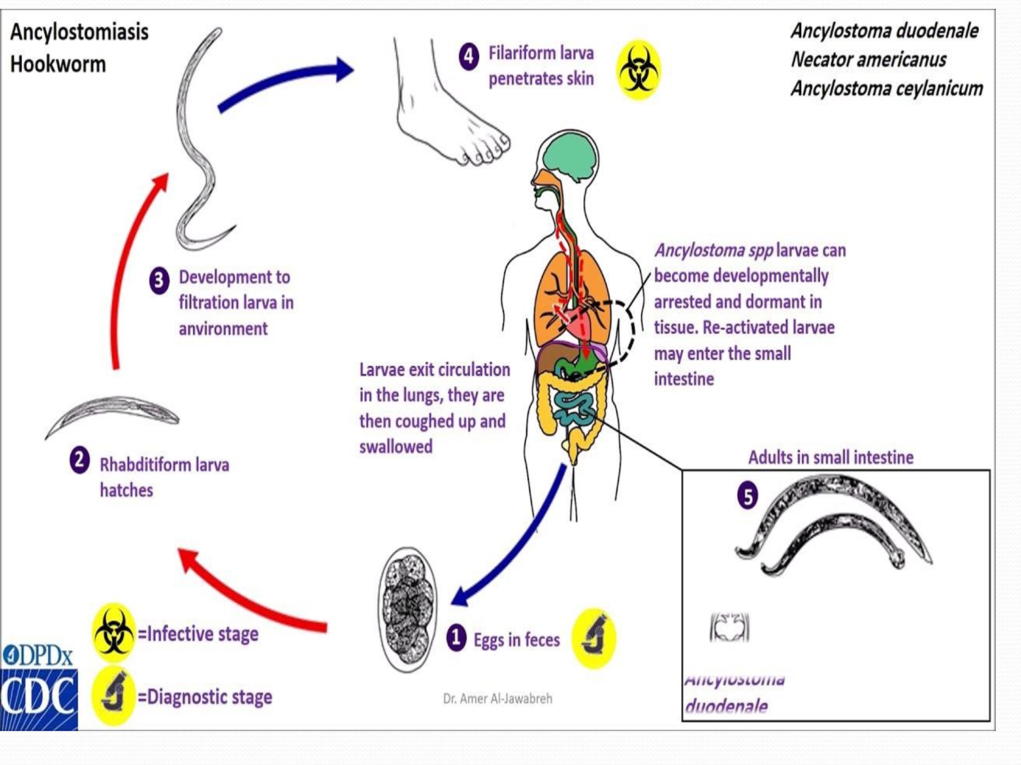

Slide 36
filariform larvae (infective stages ) penetration the skin
_____ blood _____heart _____ lung _____ into the alveoli
______into the bronchioles ______the larvae are transferred through coughing into the pharynx ______then swallowed______returned to the intestine_____adult worms
eggs in the feces is ( diagnostic stage )

Slide 37
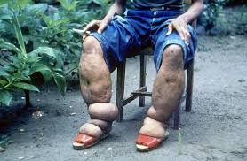
Wombat Infections
• Onchocerca volvulus causes river blindness.
• Wuchereria bancrofti causes elephantiasis, transmitted by mosquitoes.
• Chinese liver worm (Clonorchis sinensis) infects human's bile duct.
• Liver fluke causes jaundice (Fasciola hepatica and Clonorchis sinensis).
• Babesia like Plasmodium causes anemia.
• Paragonimus westermaniis causes Japanese lung fluke.

Slide 38
Thank you

