Slide 1
Parasitology
Lec 3
Hemoflagellates
By Dr. MAYSAM ALI AMEEN

Slide 2
Hemoflagellates are parasites that infect humans and animals, living in their blood, tissues, and guts, and possess a thin hair-like flagellum. They belong to familyTrypanosomatidea and have two genera : Leishmania & Trypanosoma
Common features of these parasites are:
All family member are Similar lifecycles between vertebrate and arthropod hosts.Leishmania: mediated host (Sandfly). Trypanosoma: mediated host (Tse-Tse fly).
They live in the blood and tissues of man and other vertebrate host, and in the gut of the insect

Slide 3
3. Multiplication in both the vertebrate and invertebrate host is by binary fission. No sexual cycle is known.
4.Haemoflagellates exist in two or more of four morphological stages, which depend on :the shape of the body ,presence of flagellate or absent ,the shape and locate of motile generator and the presence of waved (undulating) membrane orabsent.
Leishmania=haveAmastigotes,Promastigote
Trypanosoma=haveAmastigotes,Promastigote,Epimastigotes,Trypomastigotes

Slide 4
5. It consest of Nucleus, kinetoplast, and single flagellum.
• Kinetoplast: Deeply staining Parabasal body and adjacent dot like blepharoblast they connected by fibrils.
• Flagellum arises from blepharoplast.
• The portion of the flagellum which is inside the body of the parasite is called as axonemes or axial filament.

Slide 5
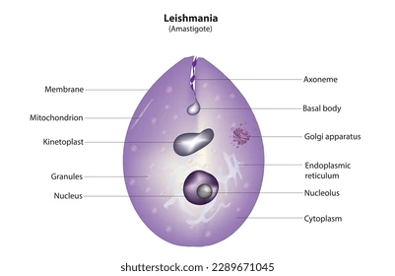
Morphological stages of heamoflagellates
1\ Amastigotes Stage
• Roundish to oval amastigote, 5 by 3 Mm in size.
• Composed of a nucleus and kinetoplast.
• Large single nucleus off-center, sometimes towards organism's edge.
• Dote-like blepharoplast gives rise to small axonemes.
• Axonemes extend to organism's edge.
• Single parabasal body adjacent to blepharoplast.
•present in the microphage of humen

Slide 6
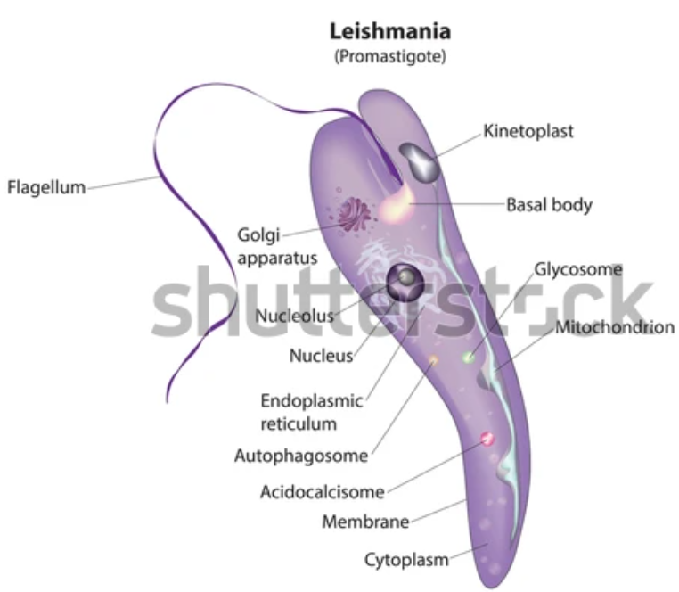
2\ Promastigotes (Leptomonad Stage)
• Spindle body with single nucleus.
• Kinetoplast located anteriorly.
• Single free filament extends anteriorly.
• Forms parasite lives in vectors and fly gut.
3\ Epimastigotes (Crithidial Stage)
• Spindle body with single lenucleus.
• Kinetoplast located anterior to thenucleus.
• Unulating membrane forms into free flagella at anterior end.

Slide 7
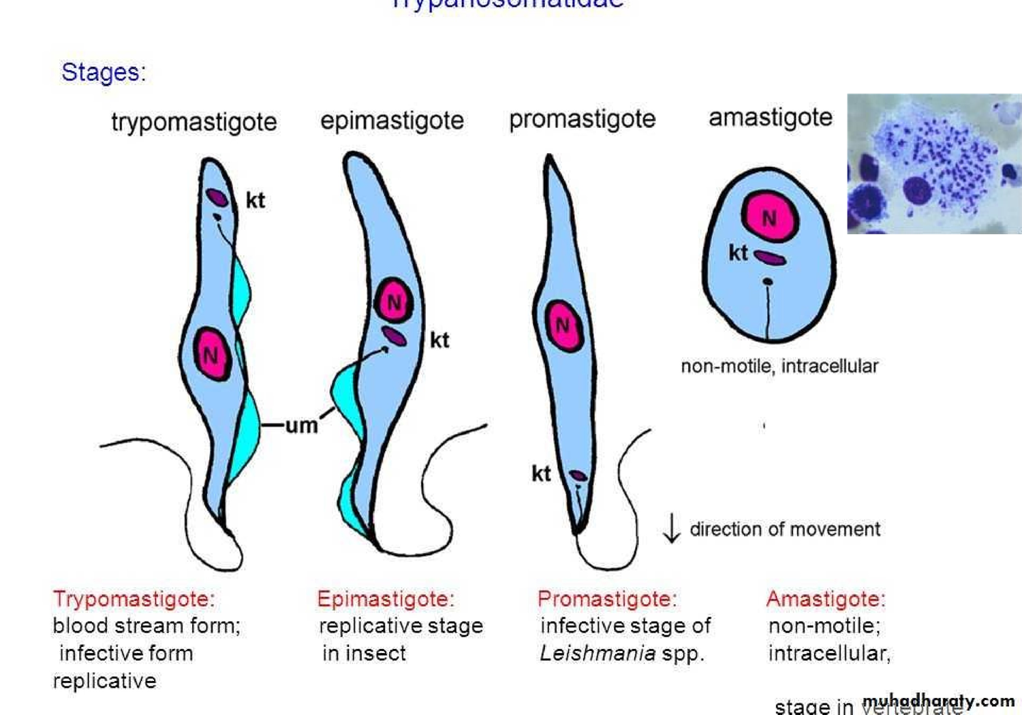
4\ Trypomastigotes (Trypanosomal Stage)
• Spindle-like body with single lenucleus.
• Kinetoplast located at the end.
• Previous free flagellum and long, undulating membrane.coveringallthebody.

Slide 8
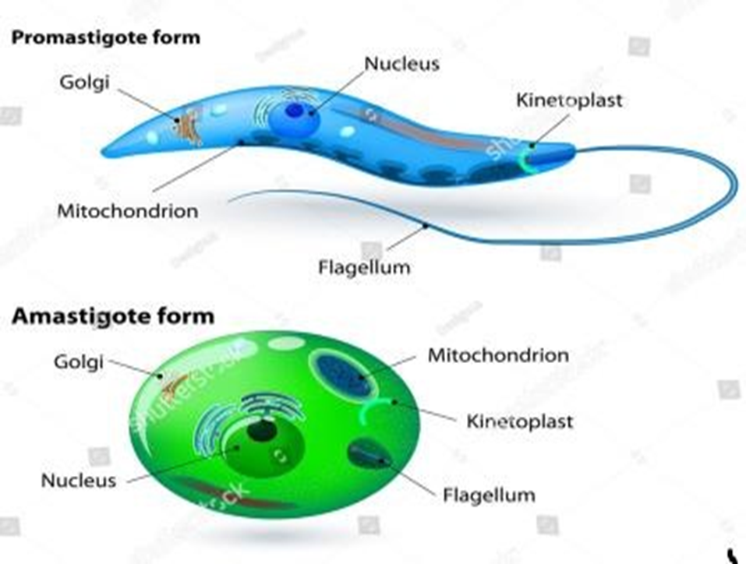
Leishmania
Parasite in human present in amastigote (diagnostic stage for human),
while in the insect (Sand fly) promastigote (infective stage for human).
Include 4 major species:
Leishmania donovani,
Leishmania tropica,
Leishmania braziliensis,
Leishmania Mexicana

Slide 10
Life Cycle
• Sand fly as vector and various mammals as reservoirs.
• Female flies are vectors due to blood meal requirement because only they take blood meals (a requirement for egg maturation).
• Infected sand fly bites human where promastigotes transform into amastigote
• Infected cells die, releasing amastigotes that infect macrophages and reticuloendothelial cells.
• Female sandfly When tsucks blood from an infected host, it ingests macrophages containing amastigotes

Slide 11
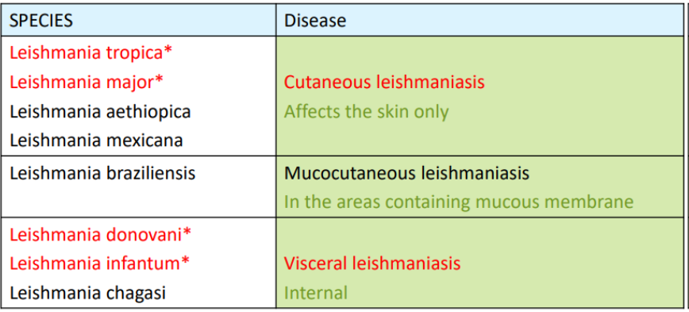
• Amastigotes differentiate into promastigotes in gut, multiply, and migrate to pharynx.
• Cycle takes approximately 10 days.
Leishmania mediated host (Sand fly), terminal host(humen).
Parasite in human present in amastigote (diagnostic stage for human) while in the insect (Sand fly) promastigote (infective stage for
human).

Slide 12
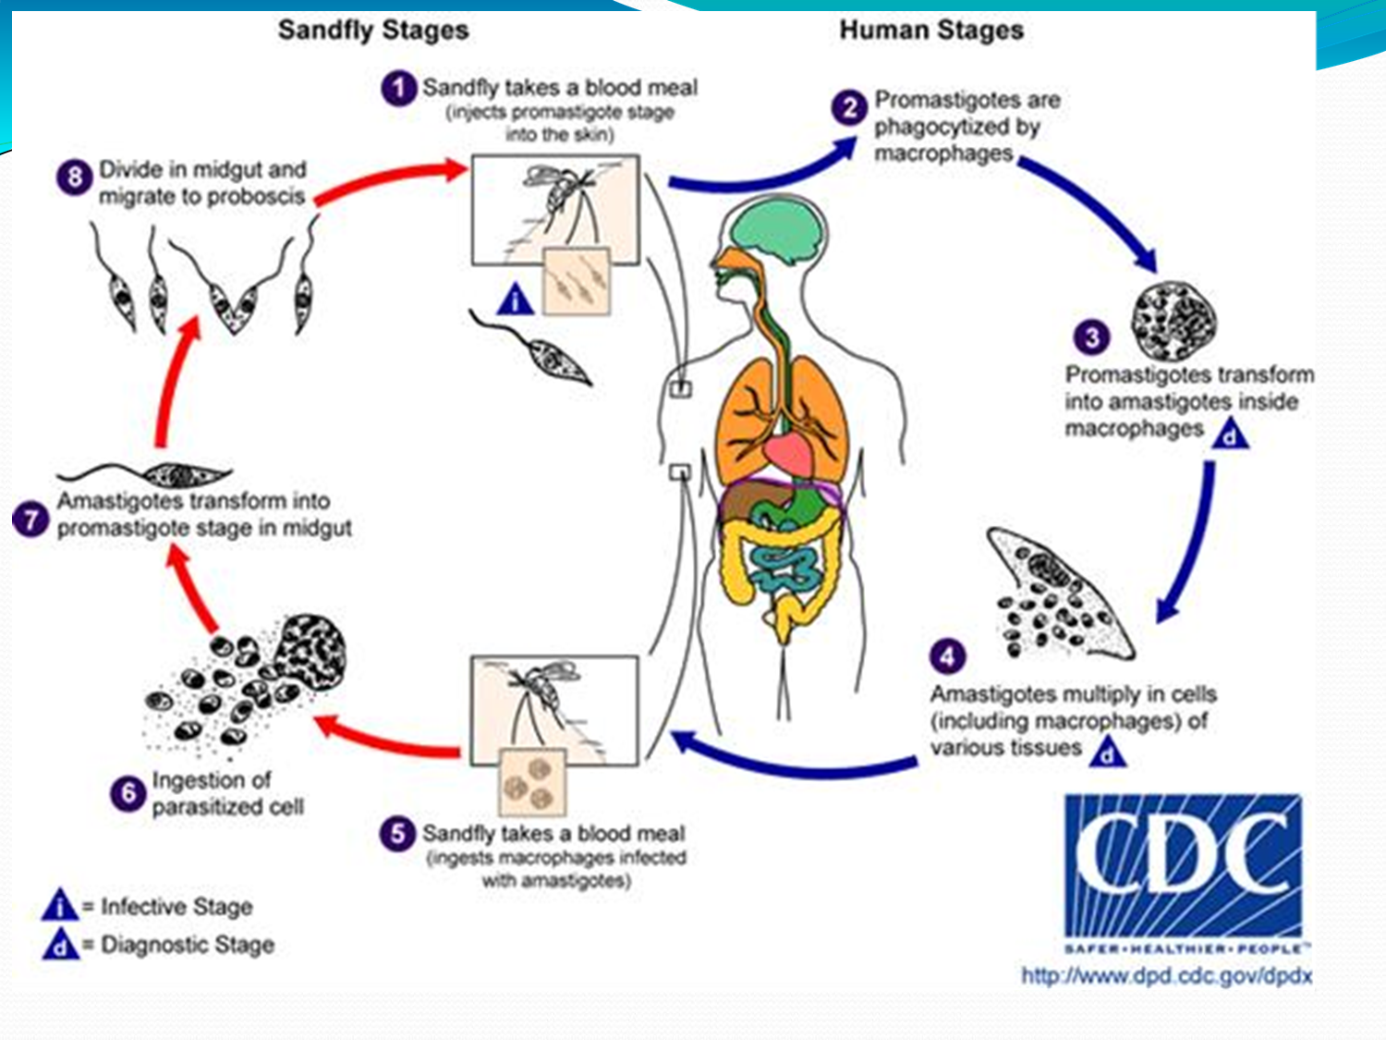

Slide 13
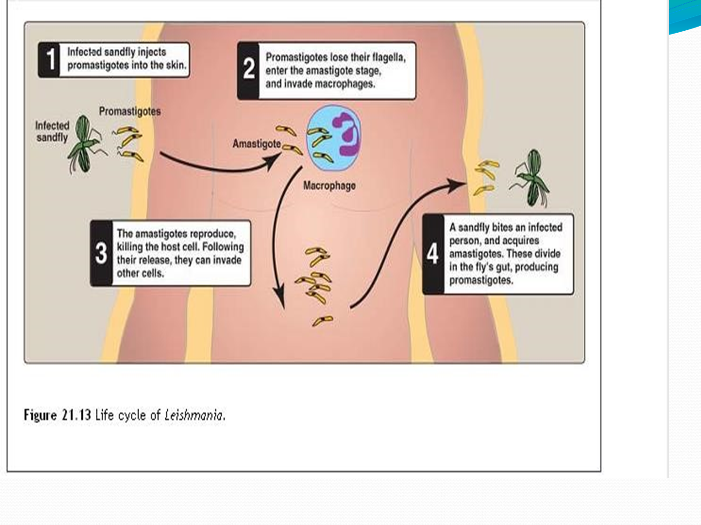

Slide 14
1\ L.donovani: causes visceral Leishmianiasis, Post kala-azar dermal leishmaniasis (PKDL), Kalaazar and Dum Dum fever
• Caused by Leishmania donovani in India, East Africa, and China.
• Infects macrophages, migrates to spleen, liver, and bone marrow.
• Rapid parasite multiplies, enlarges spleen and liver, and may cause jaundice.
• Majority of patients have minor symptoms.
• May resolve spontaneously.
• Secondary infection and emaciation can cause death.
• Untreated severe disease often fatal due to secondary infection.

Slide 15
Clinical Symptoms:
• Intermittent fever, weakness, weight loss.
• Typical spleen enlargement.
• Hyperpigmentation of skinblack fever.
• Profound anemia, leukopenia, thrombocytopenia, gastrointestinal bleeding.
hepatomegaly

Slide 16
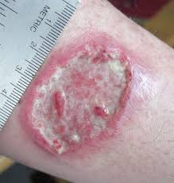
L.tropica Insect Transport and Causes
• L.tropica, a sand fly, causes tropic sore or Baghdad boil.
• Cutaneous Leishmianiasis, also known as oriental sore Baghdad boil , is caused by Leishmania tropica in north and west Africa, Iran, and Iraq.
• The cutaneous form of the disease involves ulcerating single or multiple skin sores, often healing spontaneously but leaving unsightly scars.
• In Mexico and Guatemala, Leishmania mexicana produces single, rapidly healing lesions.

Slide 17
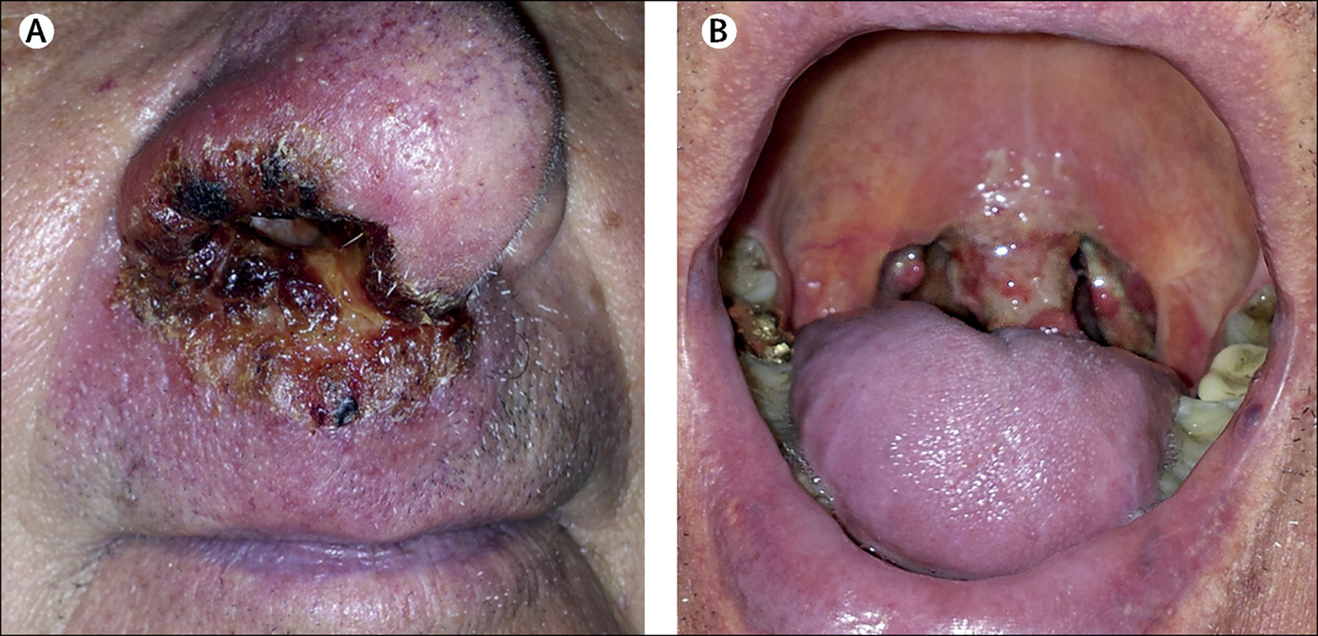
Leishmania braziliensis Causes: Mucocutaneous leishmaniasis
• Caused by parasite in Central and South America, particularly Amazon regions.
• Attacks mucosal-dermal junctions of nose and mouth, causing multiple lesions.
• Spreads into mucosal tissue, obliterating nasal septum and buccal cavity.
• Can lead to death from secondary infection.

Slide 18
Diagnosis of L.donovani
1.thick blood film (amastigot).
skin test: is used to measure delayed hypersensitivity.
detection of antibody by ELISA.
can be cultured on NNN media (Novy Macneel Nicolle)
Molecular method (PCR polymerase chain reaction) the most sensitive and specific diagnostic method.

Slide 19
Prevention and Control
control of L. donovani, L.tropica At present the only effective preventative measure is to prevent sand fly bites either by killing them with pesticides or by using insect repellents
Treatment of Leishmania donovani :
Pentostam ( sodium stibogluconate) ,Amphotericin B
Treatment of Leishmania tropica :
Promomycin + Sodium Stibogluconate

Slide 20
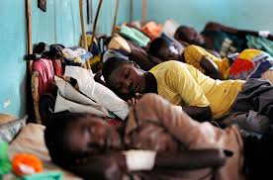
Trypanosoma
T. gambiense cause Sleeping Disease
• T. gambiense causes sleeping disease in humans.
• Tse_Tse fly hosts the disease.
• Endemic in sub-Saharan Africa.temperature & humidity
• Trypomastigotes spread from skin to blood, lymph nodes, and brain.
• Sleeping sickness progresses to coma due to demyelinating encephalitis.

Slide 21
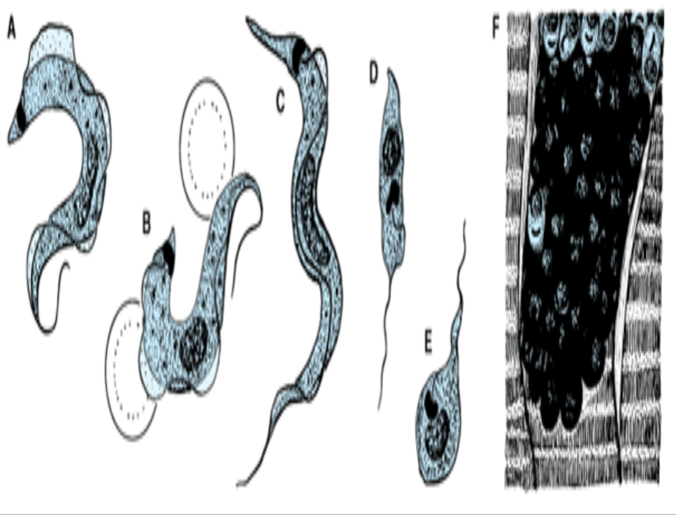
T. cruzi Causes Chagas' Disease
• Transmitted by bugs in rural Central and South America.(temperature & humidity).
• Involves trypomastigotes forming nonflagellated amastigotes within host cells.
• Amastigotes cause inflammation, mainly mononuclear cells.
• Cardiac muscle is most severely affected.
A, B, C: Trypomastigotes in blood
,D: epimastigote
,E: promastigote
F: amastigote colony in heart muscle

Slide 22
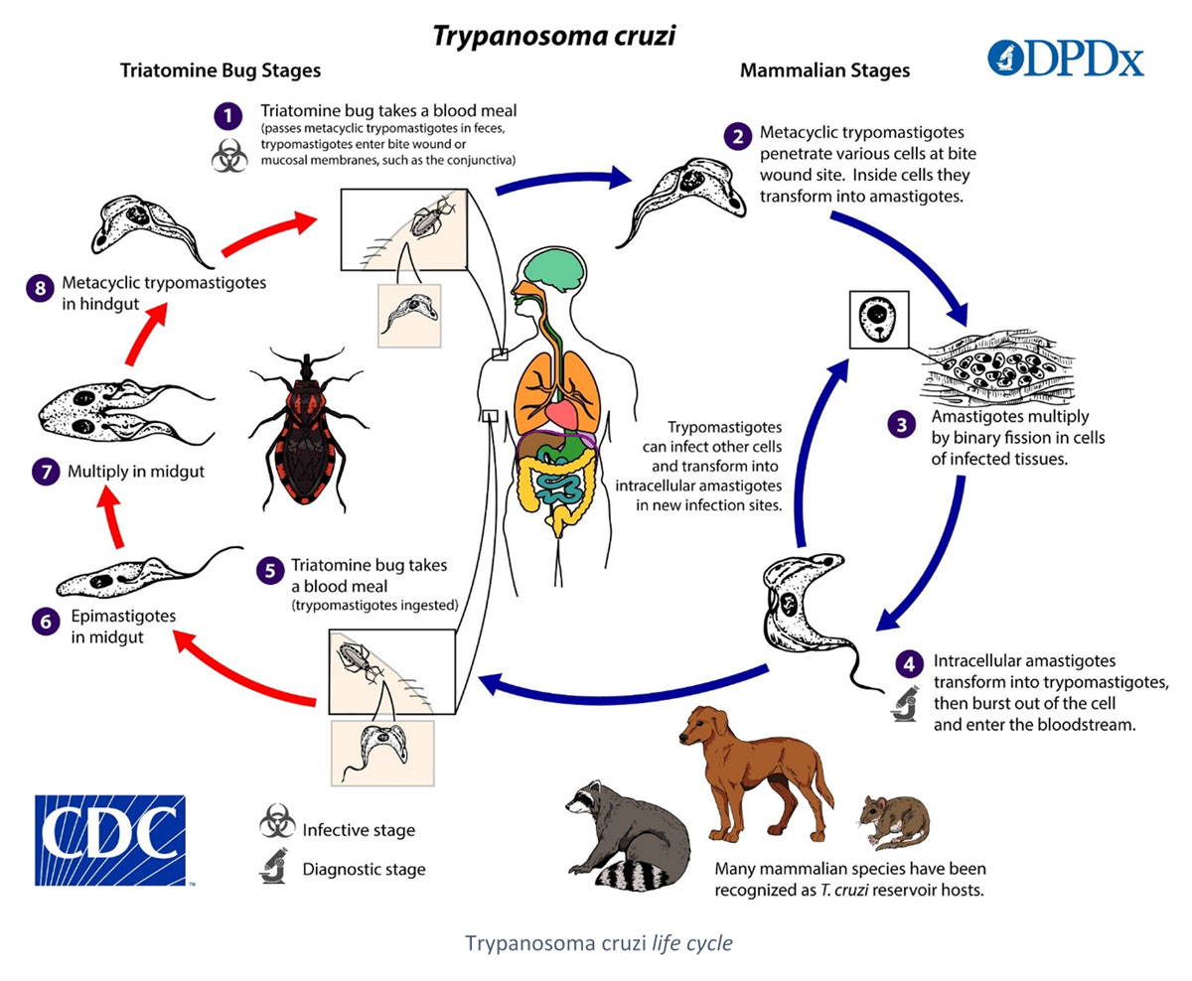

Slide 23
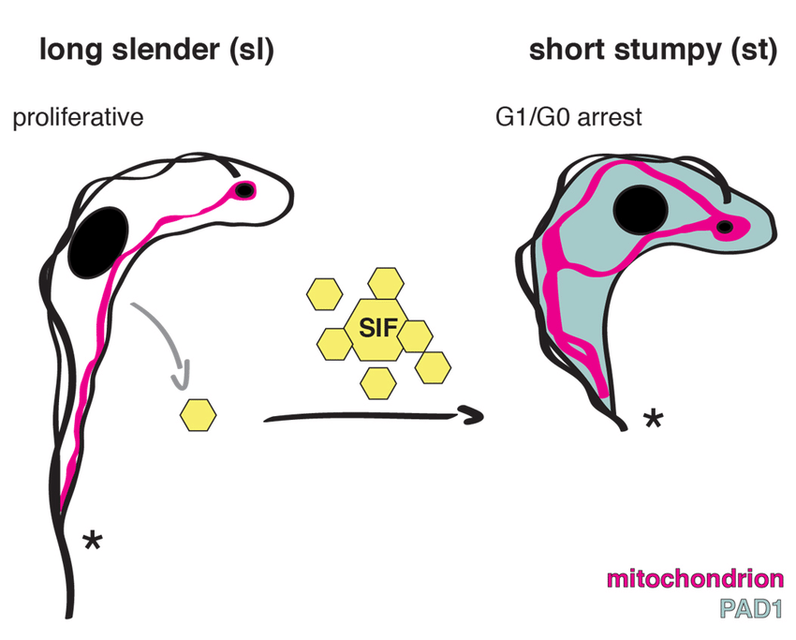

Slide 24
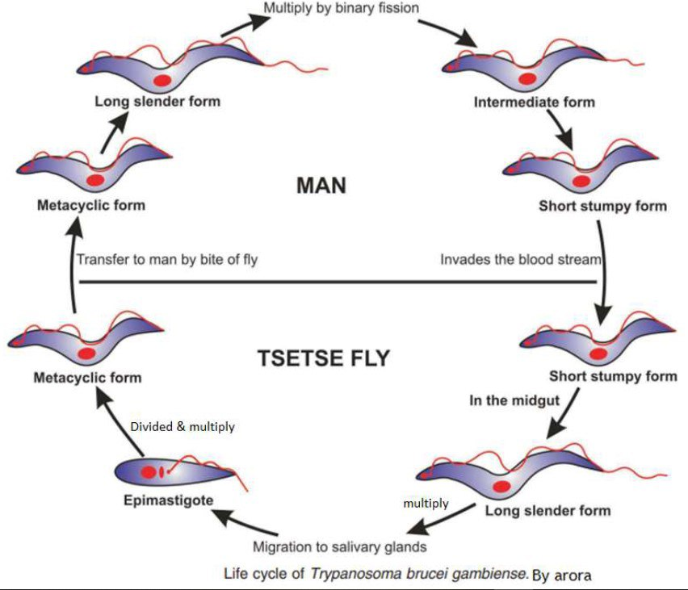

Slide 25
Thank you

