Slide 1
Nurse – Patient Relationship

Slide 2

Interpersonal relationship
An interpersonal relationship is a social connection or affiliation between two or more people. Interpersonal relationships can include your partner, loved ones, close friends, acquaintances, co-workers, and many others who make up the social connections in your life.

Slide 3

Components of interpersonal relationship
1- Scientific principles
2- Specific communication skills and strategies
3- Creative application of self

Slide 4
Types of relationship:
1- Social Relationship
It is a primarily initiated for the purpose of friendship, socialization, companionship, or accomplishment of a task. Communication, which may be superficial, usually focuses on sharing ideas, feelings, and experiences and meets the basic need for people to interact. Advice is often given.
Roles may shift during social interactions. When a nurse greets a client and chats about the weather or a sports event or engages in small talk or socializing, this is a social interaction. This is acceptable in nursing, but for the nurse–client relationship to accomplish the goals that have been decided on, social interaction must be limited.

Slide 5
2-Intimate Relationship:
A healthy intimate relationship involves two people who are emotionally committed to each other. Both parties are concerned about having their individual needs met and helping each other to meet needs as well.
The relationship may include sexual or emotional intimacy as well as sharing of mutual goals. The intimate relationship has no place in the nurse– client interaction .

Slide 6
3- Therapeutic Relationship
The therapeutic relationship differs from the social or intimate relationship in many ways because it focuses on the needs, experiences, feelings, and ideas of the client only. The nurse and client agree about the areas to work on and evaluate the outcomes.
The nurse uses communication skills, personal strengths, and understanding of human behavior to interact with the client. In the therapeutic relationship, the parameters are clear: the focus is the client’s needs, not the nurse’s. The nurse must constantly focus on the client’s needs, not his or her own.

Slide 7
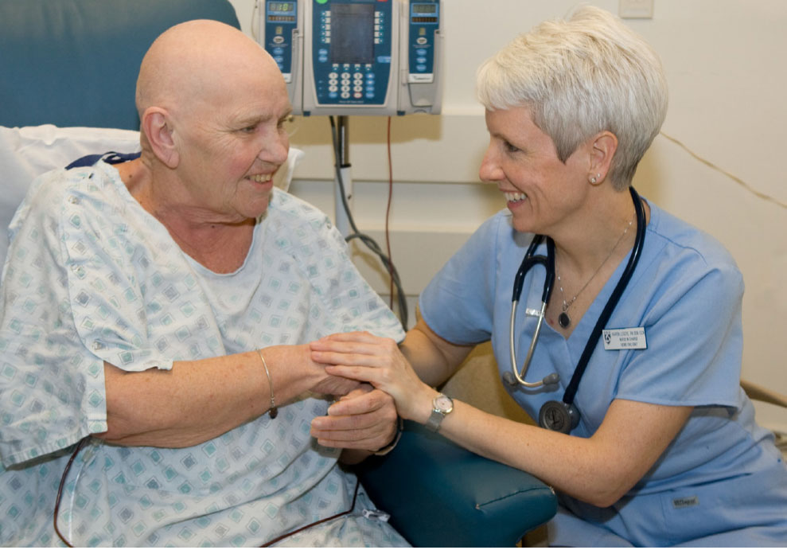
Therapeutic Relationship: An interaction between two people (usually a caregiver and a care receiver) in which input from both participants contributes to a climate of healing, growth promotion, and/or illness prevention.

Slide 8

Requisites for nurse-patient relationship
Careful thinking
Sensitiveness
Energy
time

Slide 9
Phases of Relationship Development and Major Nursing Goals
Phase Goals:
1. Pre interaction : Explore self-perceptions.
2. Orientation (introductory):Establish trust and formulate contract for intervention.
3. Working : Promote client change.
4. Termination :Evaluate goal attainment and ensure therapeutic closure.

Slide 10
A-The Pre interaction Phase
The pre interaction phase involves preparation for the first encounter with the client. Tasks include:
1- Obtaining available information about the client from his or her chart, significant others, or other health team members. From this information, the initial assessment is begun. This initial information may also allow the nurse to become aware of personal responses to knowledge about the client.
2- Examining one’s feelings, fears, and anxieties about working with a particular client.

Slide 11

Pre-interaction phase
During this phase
  Nurse assess the environment in which the nurse meet with patient
  Explain the professional goals and set priorities
  Both parties enter to the relationship with expectations
  Patients develop uncertainties and hesitate to comply with care and treatments
  Patient and nurse become oriented to overall needs and expectations from the relationship

Slide 12
B- The Orientation (Introductory) Phase:
During the orientation phase, the nurse and client become acquainted. Tasks include:
1-Creating an environment for the establishment of trust and rapport
2-Establishing a contract for intervention that details the expectations and responsibilities of both the nurse and client

Slide 13
cont.
3-Gathering assessment information to build a strong client database
4-Identifying the client’s strengths and limitations
5-Formulating nursing diagnoses
6-Setting goals that are mutually agreeable to the nurse and client
7-Developing a plan of action that is realistic for meeting the established goals
8-Exploring feelings of both the client and nurse

Slide 14
C- The Working Phase
The therapeutic work of the relationship is accomplished during this phase. Tasks include:
1. Maintaining the trust and rapport that was established during the orientation phase
2. Promoting the client’s insight and perception of reality
3. Using problem-solving strategies.
4. Overcoming resistance behaviors on the part of the client as the level of anxiety rises in response to discussion of painful issues
5. Continuously evaluating progress toward goal attainment

Slide 15
D- The Termination Phase
Termination of the relationship may occur for a variety of reasons:
1- The mutually agreed-on goals may have been reached.
2- The client may be discharged from the hospital; or, in the case of a student nurse, it may be the end of a clinical rotation.
3-Termination can be a difficult phase for both the client and nurse.

Slide 16
cont.
4-The main task involves bringing a therapeutic conclusion to the relationship.
5-Both the nurse and client may experience feelings of sadness and loss.
6-The nurse should share his or her feelings with the client.
7-Through these interactions, the client learns that it is acceptable to have these feelings at a time of separation.

Slide 17
Boundaries in The Nurse-Client Relationship
1- Social boundaries: These are established within a culture and define how individuals are expected to behave in social situations.
2- Personal boundaries: These are boundaries that individuals define for themselves. These include physical boundaries, emotional boundaries.
3- Professional boundaries: These boundaries limit and outline expectations for appropriate professional relationships with clients.
For example: Favoring a client’s care over that of another. Keeping secrets with a client. Giving special attention or treatment to one client over others.

Slide 18

Nurses’ roles in nurse-patient relationship
Care giver
Counselor
Educator
Consultant
researcher

Slide 19
Roles of the nurse in (Therapeutic Relationship)
1-Teacher
The teacher role is inherent in most aspects of client care. During the working phase of the nurse–client relationship, the nurse may teach the client new methods of coping and solving problems. He or she may instruct about the medication regimen and available community resources.
To be a good teacher, the nurse must feel confident about the knowledge he or she has and must know the limitations of that knowledge base. The nurse must be honest about what information he or she can provide and when and where to refer clients for further information. This behavior and honesty build trust in clients.

Slide 20
2-Caregiver
The primary care giving role in mental health settings is the implementation of the therapeutic relationship to build trust, explore feelings, assist the client in problem solving, and help the client meet psychosocial needs.
Some clients may confuse physical care with intimacy, which can erode the therapeutic relationship.

Slide 21
3-Advocate
Advocacy is the process of acting in the client’s behalf when he or she cannot do so. This includes ensuring privacy and dignity, preventing unnecessary examinations and procedures, accessing needed services and benefits, and ensuring safety from abuse and exploitation by a health professional or authority figure.

Slide 22
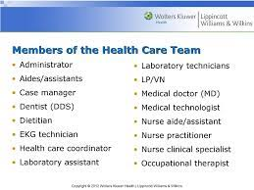

Nurse – health team relationships

Slide 23

Characteristics of good nurse-patient relationship
Relationship is therapeutic
Exist until patient have fulfilled the health care needs
Nurses’ work is to attain, maintain, and restore the patients’ health
Patients are satisfied
Based on nurses’ competent care derived from skills and knowledge

Slide 24
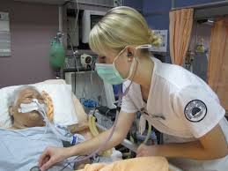
Characteristics of good nurse-patient relationship
Provide holistic care
Patient/client is an active participant
Nurse uses patients’ knowledge, attitudes, values, and thoughts to plan interventions
Reciprocal relationship influenced by professional and personal characteristics of both parties .

Slide 25
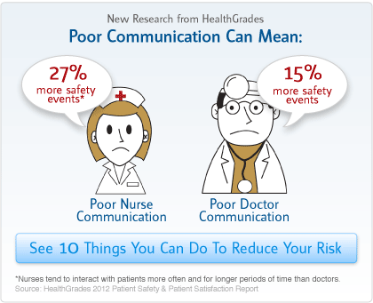
Barriers for effective professional relationship
Role stress
Lack of inteprofessional understanding
Autonomy struggle

Slide 26

Role stress
The stress arises from role conflict or role confusion
Role conflict is a situation that you happen to play a role different from what you expected to play
Role stress occur when you are expected to do than what you can do
Result in stress and communication is disturbed

Slide 27

Prevention of role stress
Experienced persons are responsible
Understand individual capabilities
Identify the individual weaknesses
Assign tasks accordingly
Kindly and duly respond against inexperienced behaviors or faults

Slide 28
Autonomy struggles
What is autonomy?
  autonomy is one’s ability to be one’s own person directed by own desires, not imposed by others.
When this ability is threatened by others autonomy struggles are arose.
People with higher level of autonomy underestimate others bringing struggles.

Slide 29

Thank you

