Slide 1
Medical sociology
Third stage
Presented By : Salim Amer
Prepared By :Dr.Maryam A.Al-kareem

Slide 2
Definitions:
Health: is a state of complete well‐being: physical, mental, and emotional. This definition emphasizes the importance of being more than disease free, and recognizes that a healthy body depends upon a healthy environment and a stable mind (WHO definition).
Illness: is a subjective term referring to an individual's experience of mental and physical sensations. Illness is something that needs to be managed such as feelings of pain, discomfort, distress, weakness, fatigue.
Social Health: is the ability to form meaningful relationships with other people in the society and interact in healthy, positive ways .

Slide 3
CONT:
A social interaction: is a social exchange between two or more individuals.
Social interaction is important for health & disease in many ways:
1. it can enforce unhealthy behavior. For example, peer pressure can prevent people from committing to a diet when they are trying to lose weight or from quitting smoking.
2. transmission of infection is more common in crowded populations.
3. social support is important for psychological health, especially when people experience big life changes. For example, death of a loved one and retirement.

Slide 4
Medical Sociology:
Medical Sociology is one of the most important sub-disciplines in sociology due to the importance of its subjects and what it teaches.
It is the science that deals with the active relation between the society and the social life with the diseases, their causes, and how transmitted. It also study the communication between the health organization and the society.

Slide 5
Social Epidemiology
Social epidemiology is a branch of epidemiology that focuses particularly on the effects of social-structural factors on states of health. Social epidemiology assumes that the distribution of advantages and disadvantages in a society reflects the distribution of health and disease branch of epidemiology concerned with the way that social structures, institutions, and relationships influence health .

Slide 6

Social Epidemiology:
The Epidemiological Triad (Triangle)
The triad consists of an external agent, a susceptible host, and an environment that brings the host and agent together.

Slide 7
cont.
Host: age, gender, occupation, education, income.
Agent: the agent can be physical, biological, social, or psychological (stress).
Environment: physiological (e.g. heat, cold, noise, radiation), living situation (e.g. crowdedness, housing), psychological environment.

Slide 8
Factors that affect social health:
1. environment (early childhood social and physical environments, including childcare).
2. income & economic status.
3. culture & spiritual/ religious values.
4. interpersonal relationships.
5. education.
6. occupation and job security.
7. social stressors, such as exposure to violence.
8. quality of life.
9. Access to health care.
10. social safety.

Slide 9
Examples of behaviors and social conditions that contribute to causing diseases:
1. smoking.
2. alcoholism.
3. drug abuse (e.g. morphine).
4. unprotected sex with multiple partners (sexually transmitted diseases e.g. AIDS, gonorrhea).
5. stressful life events (e.g. community violence, domestic violence, economic insecurity).
6. socioeconomic status (income, education).
7. sedentary lifestyle.
8. unhealthy eating habits.

Slide 10
The Relationship of Sociology with Nursing:
1. Nursing plays a vital role in healthcare profession. Nurses are the key persons who have significant influence over the group members within the society.
2. To provide total patient care in a comprehensive manner to meet the total needs of the clients either in the hospitals or in the community.
3. To understand the cause and meaning of many kinds of patient behavior to make them comfortable for improvement of client care.
4. To broaden the view of nursing students to understand human behavior in relation to the society. To understand the problems of clients.

Slide 11
cont.
5. To suggest the ways to work with families, community agencies and groups of persons to provide health counselling in planning for continuity of care.
6. To provide right motivation, treatment and physical, medical, vocational, psychosocial rehabilitation.
7. To understand the emotional reaction pattern, (e.g.: Level of perception, attitudes of people towards medical care, barriers of communication, individual differences, social distance…..
9. To gain greater insight into the human problems as related to the illness.

Slide 12
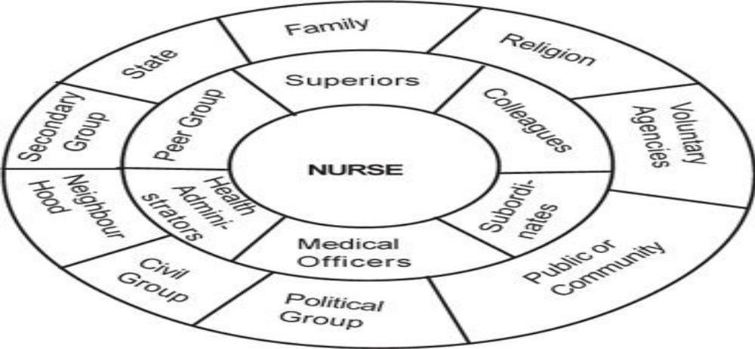
Relationship of Sociology with Nursing

Slide 13
The goals of sociology in nursing:
1. Promotion of health.
2. Prevention of illness and injury.
3. Sociology plays, an important role in the area of health sciences.
4. Giving of caring.

Slide 14
Uses of Sociology for Nurses:
1. Knowledge of culture and social life patients.
2. Maintained of friendly relationships between different personnel's.
3. Knowledge of social system and social relationships.
4. Knowledge of community, resources, and facilities, available.
5. Knowledge of different sections of society ( trial, health, military).
6. Knowledge of technology progress and complication.
7. The study of sociology helps nurses identify the psycho- social problems of patients, which helps important the quality of treatment.

Slide 15
Importance of sociology in Iraq:
In Iraq, rapid social changes have produced many social problems like: terrorism, prejudice and discrimination, crimes, public unrest, un-employment, housing problems, illiteracy, and poverty. As we known that the sociology is a source of knowledge along with its practical applications and also as a profession, therefore it will help by planning and solution of problems by sociological knowledge.

Slide 16
Research in sociology

Slide 17
Research in sociology:
Research framework for sociology and nursing provides the first key link between the two disciplines. Defining sociology usually begins with an attempt to understand the social factors that affect a particular topic, or human social interactions at large.
Thus, nursing itself takes place with a range of social interactions between nurses and patients and between nurses and other healthcare participants as well as between nurses and those outside the healthcare system who may have a stake in health-related outcomes, such as the relatives of a patient.

Slide 18
cont.
Sociological research: sociological research methods may be divided into two broad categories:
• Quantitative designs: approach social phenomena through quantifiable evidence, and often rely on statistical analysis of many cases (or across intentionally designed treatments in an experiment) to create valid and reliable general claims
• Qualitative designs: emphasize understanding of social phenomena through direct observation, communication with participants, or analysis of texts, and may stress contextual and subjective accuracy over generality.

Slide 19
The main methods to test theories:
1. Surveys: sometimes referred to public opinion poll, is the widely accepted ways of studying human behavior. Using variables, surveys measure people's attitude towards different matters. Sociology often studies the relationship between a viewpoint and a subject while considering elements like education, age, and gender. Questionnaires are usually given to a controlled group where they will answer either worded or objective type questions.
The survey questions also ask about their background and demographic information. Through this method of data gathering, information such as consumer habits, racial discrimination, and other human behavior and activity are provided. In addition, surveys answer issues in the society to have a clear understanding concerning the problems involved.

Slide 20
2. Controlled experiments: some of the experiments are conducted in a laboratory and in small groups. In some cases, a two groups are studied for contrasting and comparing. They want to know the significant difference in the attitudes and behavior of certain groups.

Slide 21
3. Filed observation: information is primarily gathered through observations and talk within the community. During the period of study, the sociologist will participate in societal activities such as political activities, networks, and functions.
Field observation gives first-hand information about a group of people, but is least reliable method of testing theories. A fact can be true to community A, but cannot be applied to community B. Additionally, there are also outside factors that may influence the conclusions made.

Slide 22
Survey tips:
Questionnaires
Interviews
Yields many responses
Can survey a large sample
Quantitative data are easy to chart
Can be time consuming
Can be difficult to encourage participant response
Captures what people think and believe but not necessarily how they behave in real life

Slide 23
Research definitions:
Survey: research method in which people respond to questions.
Population: a group of people with certain specified characteristics .
Sample: a group of people that represents a large population.
Reprehensive sample: a sample that accurately reflects the characteristics of the population as a whole .
Questionnaire: a written set of questions to be answered by research participant.
Interview: a survey method in which a trained researcher ask questions and record the answers.

Slide 24


