Slide 1
Principles of Study Designs

Slide 2
-A study design is a specific plan or protocol for conducting the study.

Slide 3
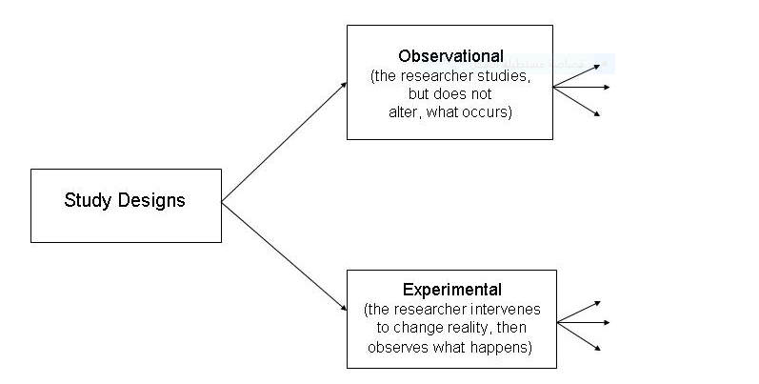
Study design

Slide 4
-In observational studies الدراسات الملاحظتية , the researcher observes and systematically collects information, but does not try to change the people or animals, being observed. In an experiment التجريبية , by contrast, the researcher intervenes يتدخل to change something (e.g., gives some patients a drug) and then observes what happens.
In an observational study there is no intervention.
.

Slide 5
-Examples of observational studies:
1.A survey of nutritional habits among students.
2. Taking blood samples to measure hemoglobin levels.
-Examples of experiments:
1.Test of new treatment on patient.
2. Effect of gentle massage on remove lower back pain in elderly individual

Slide 6
OBSERVATIONAL STUDIES:
Observational
  Descriptive
    Study of the amount and distribution of disease within a population by person, place, and time
  Analytic
    Study of the determinants of disease or reasons for relatively high or low frequency in specific groups

Slide 7
1-Observational studies
/ Descriptive observational studies which include the following :
1- Case report.
2- Case series.
3- Ecological studies (correlational)
4-Crossectional (prevalence studies

Slide 8
Observational studies:
the investigator measures but does not intervene. They include descriptive and analytic studies.
A/ descriptive study is limited to a description of the occurrence of a disease in a population and is often the first step in an epidemiological investigation.

Slide 9
Advantages of observational descriptive studies
They use already available data.
They are less expensive and less time-consuming.
They describe the pattern of disease occurrence.
.

Slide 10
1.Case report(case study);
Nurse who sees unusual presentation of a common disease or a very rare disease and he/she describes the findings of this case, case description may take any relevant description of findings.
An unusual case may add to our knowledge for example MI in very young person without ECG findings is unusual presentation of MI.

Slide 11
2.Case series ( Clinical series ) studies:
When a group of cases of the same disease are reported but in this study we can not;
Study the etiology of the disease
Have a control group

Slide 12
Example of case series دراسة سلسلة حالات :
Vaginal cancer is very rare in young females if 10 cases were reported and studied
Discovery of AIDS was a case series

Slide 13
Advantages of case reports or case series
Use available clinical data.
Detailed individual data.
Add to our knowledge.
Not expensive and not time consuming

Slide 14
Disadvantages of case report or case series
May reflect experience of one person (one nurse).
No explicit(clear) comparison group.

Slide 15
Ecological Studies(correlation): based on studying of a group of people not individual as in previous studies.
Correlation data represent average exposure level rather than individual level so we do not have each person information.

Slide 16
Example : as meat consumption in different countries increases prevalence of ca colon increases , Cigarette smoking increases ca lung prevalence increases as well

Slide 17
Advantages of Correlational Study
They describe the disease in the entire population in relation to the factor of interest.
They are easy to do, inexpensive and can be conducted quickly.
They use available data (administrative or other aggregate data).

Slide 18
Cross-Sectional studies (prevalence studies or surveys)دراسة المقطع العرضي او دراسة الانتشار
It is a study of a group of people at a point in time for the prevalence of a disease or an attribute متعلقin a well defined population but data is collected at individual levels. In this study the measurements of exposure and effect are made at the same time .

Slide 19
Advantages of cross sectional study
Provide generalization from the sample to the population.
They are short term studies and not expensive.
Provide good information for the health problems and good for health planners to assess health care needs.
Used for generating hypothesis to be tested in further studies.

Slide 20
Disadvantages of cross sectional study
1. It is difficult to separate cause and effect because measurement of exposure and disease are made at one point of time and it is impossible to determined which came first.
2. Cases detected are prevalent cases (survivors) leading to survival bias cases cured or died are not detected.

Slide 21
Thanks

