Slide 1
Sampling in nursing research

Slide 2
Definition of certain terms :
Definition of certain terms:
Population : Is the entire aggregation of cases that meet a designated set of criteria.
Data : any group of numbers
Information : treated data
sampling an important step in research process.

Slide 3
Examples
1. All the women in Gaza strip who gave birth to a live baby during the past decay
2. All the women older than age 60 whom are under psychological care.
Population may be human subjects and might consist of hospital records, all of the blood samples taken from clients

Slide 4
Accessible population: Is the population of subjects available for particular study.
It is the aggregate of cases that conform to the designated criteria and that are accessible to the research as a pool of subjects of a study
The sample is obtained from the accessible population, and findings are generalized first to the accessible population and then, to the target population.

Slide 5
The target population: Is the total group of subjects about whom the investigator is interested and whom the results could be reasonably generalized.
Population: All pregnant women in Babil.
Accessible population: Pregnant in the 2nd trimester and registered in Hila sector at health centers.
Target population: All pregnant women in the 2nd trimester in Babil

Slide 6
Sampling - refers to process of selecting a portion of the population to represent the entire population
A sample consists of a subset of the units that compose the population
Sampling determines who will be participants in the study
Aim
A representative sample, A sample which accurately reflects its population,
Avoiding bias .

Slide 7
Why Use a Sample
Ideally the whole population should be used in a study
Why would this be impractical in most studies?
When would it be feasible to use the whole population?

Slide 8
Quantitative variable( can be measured by certain units ) : continuous e.g. age , weight etc.
Discrete : we can not have fractions e.g. no. of
pregnancies , no. of children.

Slide 9
When we group quantitative continuous variables there must be no overlapping.
0-9 years
10-19 years
20-29 years

Slide 10
Concept of sampling
One of the most important decisions that any researcher makes is how to obtain the type of participants needed for the study. This important step should be address in the design of the research as the main task of research is to generalize the results that obtained from study sample to reference population.

Slide 11
Target population and accessible (sampled) population
Before drawing a sample the researcher should define the population from which it is to approach. The term population refers to all elements in the study, and ideally, the study design should include all the target population.

Slide 12
The target population could be human subjects, animals or inanimate objects.
We might define target population as "all children aged between six and twelve years living in Hilla City or all diabetic patients in Iraq.

Slide 13
Sampling is the process of selecting units(sub set) from a specific population to collect information on a variable of interest.
Population means the largest entities or units sharing one characteristic.
Sample means subset or part of population.

Slide 14
Population: the entire group of objects about which information is wanted.
Target Population:
The population to which the investigator wants to generalize his results
Accessible Population: members of the population that you can reach.
Sampling Unit:
any individual member of the population
Sample-a part or of the population used to gain information about the whole
Sampling frame
the list of units from which the sample is chosen
Variable-a characteristic of a unit, to be measured for those units in the sample

Slide 15
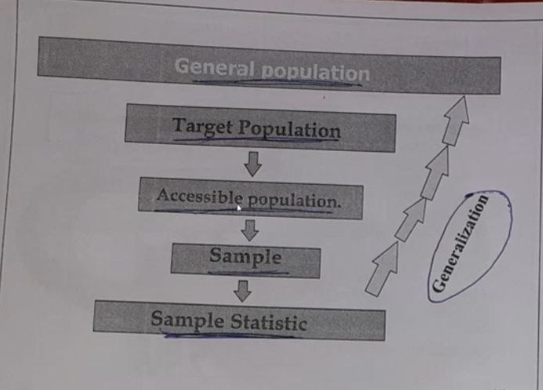

Slide 16
Sample frame
A frame is a surround for something, like a frame for a photograph or a university degree, which we hang on our walls. A sampling frame 'surrounds' the population we want to study in our research. We won't usually have the time or the money to ask questions of each member of the population, so we will interview or survey only a limited number of people(sample).

Slide 17
How do we know that the people we study (interview )are truly representative of the entire population? Usually we don't know for sure but we have a better chance if we select people at random from particular sections of the population, so that we can, at least, say our sample represents all sections of the population as they showed up in our sampling frame

Slide 18
Why sampling?
Get information about large populations
Less costs
Less time
More accuracy i.e. Can Do a Better Job of Data Collection
When it’s impossible to study the whole population

Slide 19
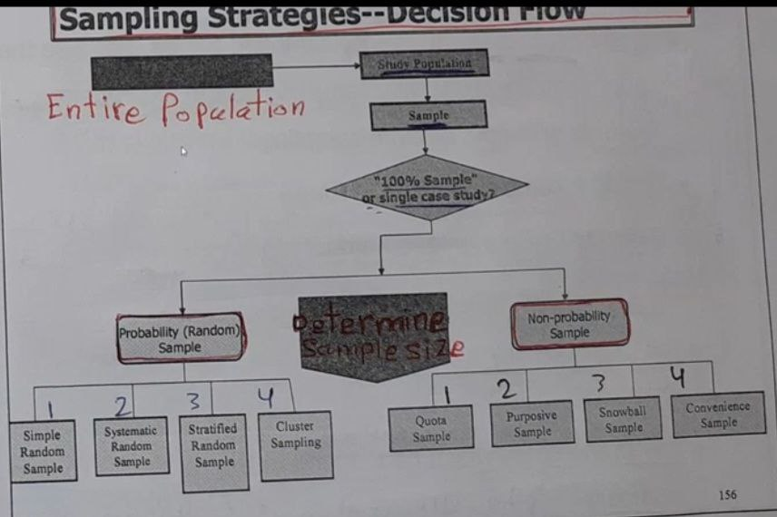

Slide 20
Types of sampling
Non-probability samples()
Probability samples(Random )

Slide 21
Non probability samples
Convenience samples (ease of access)
sample is selected from elements of a population that are easily accessible
Snowball sampling (friend of friend….etc.)
Purposive sampling (judgemental)
    You chose who you think should be in the study

Slide 22
Snow ball sample
" gives an example of producing a sample of drug users by asking a few respondents to name others who might be interviewed, who in turn mention others and so on.

Slide 23
Probability of being chosen is unknown
Cheaper- but unable to generalise
potential for bias

Slide 24
Probability samples
Random sampling
  Each subject has a known probability of being selected
Allows application of statistical sampling theory to results to:
  Generalise
  Test hypotheses

Slide 25
Probability samples are the best
Ensure
Representativeness
Precision

Slide 26
Methods used in probability samples
Simple random sampling
Systematic sampling
Stratified sampling
Multi-stage sampling
Cluster sampling

Slide 27
Systematic sampling
Sampling fraction
Ratio between sample size and population size
Example: 100 out of 2000 (5%)
It is better to be more than 10%?
This depends usually on the prevalence of the disease or health related condition such as smoking .

Slide 28
Cluster sampling
Cluster: a group of sampling units close to each other i.e. crowding together in the same area or neighborhood

Slide 29
Cluster sampling
Section 1
Section 2
Section 3
Section 5
Section 4

Slide 30
We can increase the size of our sample to reduce the sampling error but, unless we research the entire population, we can never eliminate it.

Slide 31
THANK YOU ALL

