Slide 1
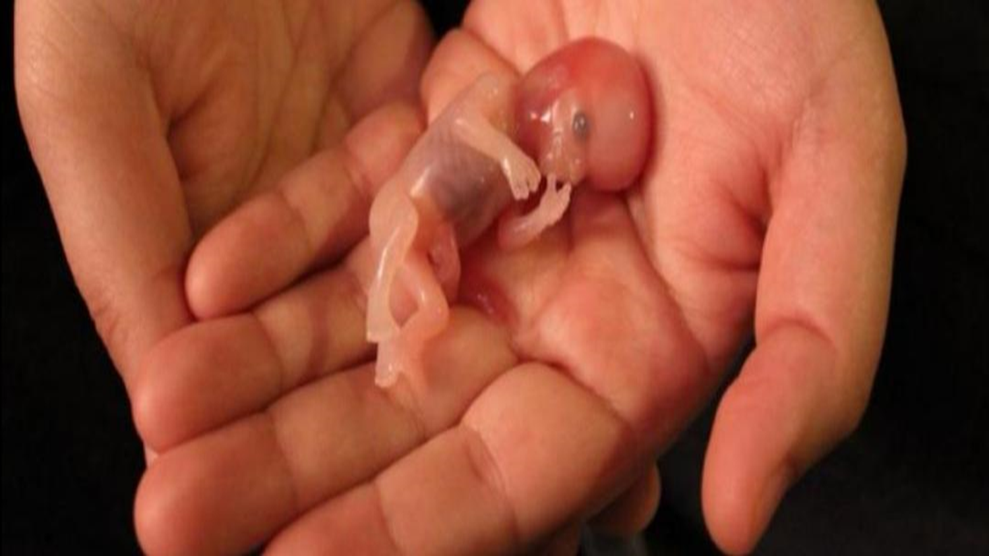
Development &physiology of the fetus
3rd stage A L suad alrubayee

Slide 2
Development and physiology of fetus\
Pregnancy is the process and series of changes that take place in a woman’s organs and tissues as a result of a developing fetus. In just 38 weeks, a fertilized egg (ovum) matures from a single cell to a fully developed fetus ready to be born. Fetal growth and development are typically divided into three periods: pre-embryonic (first 2 weeks, beginning with fertilization), embryonic (weeks 3 through 8), and fetal (from week 8 through birth).

Slide 3
Fertilization
Fertilization is the process wherein the ovum and the spermatozoa unite at the ampullary portion of the fallopian tube, the usual site of fertilization.
• A mature ovum can only be fertilized within 24 to 48 hours after being released.
• The functional life of the spermatozoa is only 48 to 72 hours.
• The best time that fertilization would occur is 72 hours after sexual intercourse.
• The fertilized ovum is propelled along the tube through the help of the peristaltic movements of the fallopian tube and the tube’s cilia.
• The average time that the sperm can reach the cervix is within 90 seconds, and it can reach the outer fallopian tube within 5 minutes.

Slide 4
Fertilization
• If the ovum has already been penetrated by a spermatozoon, it changes its composition so that it becomes impermeable to other spermatozoa.
• After penetration, the chromosomal materials of both the ovum and the spermatozoon combine to form a zygote.
• Three factors determine the certainty of fertilization:
• the maturation of both the sperm and the ovum;
• the ability of the sperm to reach the ovum; and
• the ability of the sperm to penetrate the cell membrane and achieve fertilization.

Slide 5
Implantation
• The migration of the zygote towards the uterus reaches 3 to 4 days, and it is propelled by the muscular contractions in the fallopian tube.
• Mitotic cell division or cleaving starts after 24 hours. The rate of cleaving is an average of one every 22 hours.
• As the zygote reaches the uterus, it already has 16 to 50 cell divisions, and it is now called a morula • The morula floats freely along the body of the uterus within 3 to 4 days, and it becomes a blastocyst.
• The blastocyst attaches into the endometrium, and this process is called implantation, which occurs 8 to 10 days after fertilization.
• On the day of implantation, the woman may experience a small amount of vaginal spotting as the capillaries by the implanting blastocyst. • As implantation occurs, the zygote now becomes an embryo

Slide 6
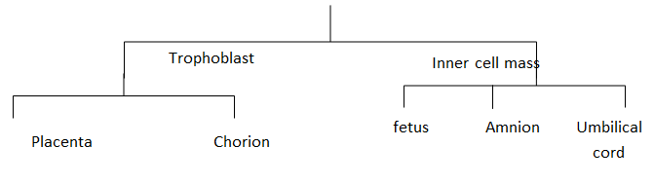
Fetal Structures
Ovum
↓
Fertilized by spermيوم (14)
↓
Zygote → mitosis الانشطار الخيطي
↓
(morula) 3-4 days in the fallopian tube
↓
In the uterus morula convert to blastocyst in the uterus

Slide 7
germ layers
The three germ layers are the endoderm, the ectoderm, and the mesoderm. Cells in each germ layer differentiate into tissues and embryonic organs. The ectoderm gives rise to the nervous system and the epidermis, among other tissues. The mesoderm gives rise to the muscle cells and connective tissue in the body. The endoderm gives rise to the gut and many internal organs.

Slide 8
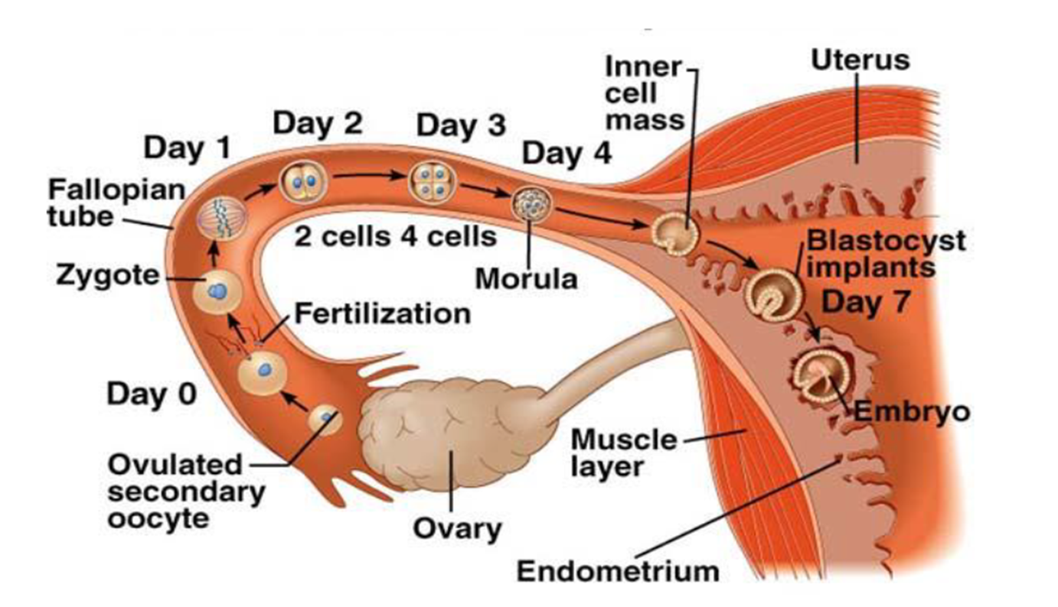

Slide 9
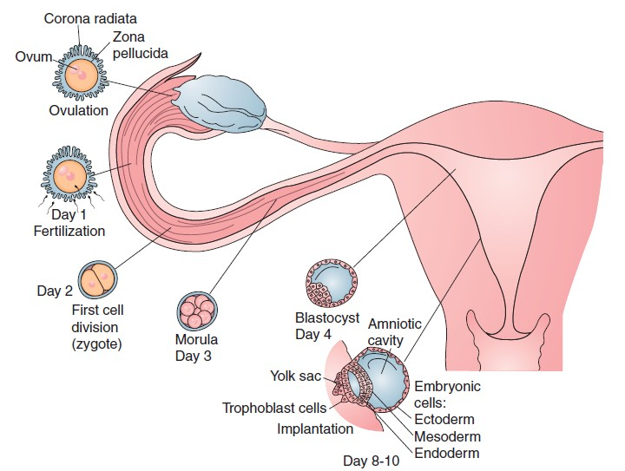

Slide 10
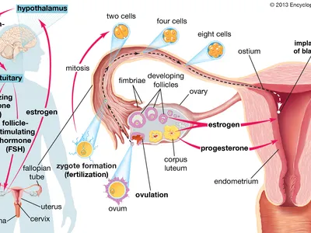

Slide 11
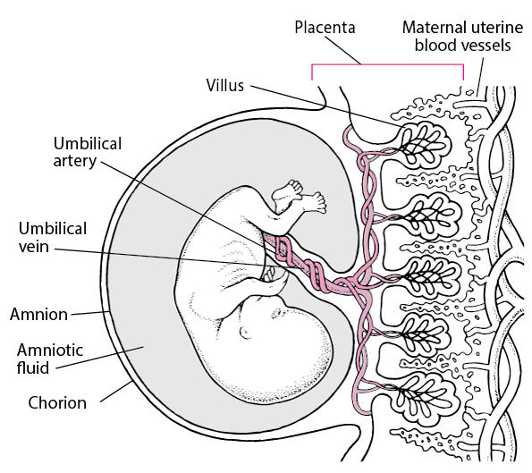

Slide 12
Fetul development
Within 1 or 2 days of implantation, a layer of cells (trophoblast cells) develops around the blastocyst.
The progenitor villous trophoblast cell, the stem cell of the placenta, develops along 2 cell lines:
• Nonproliferative extravillous trophoblast: These cells penetrate the endometrium, facilitating implantation and anchoring of the placenta.
• Syncytiotrophoblast: These cells produce chorionic gonadotropin by day 10 and other trophic hormones shortly thereafter.

Slide 13
Cont.
An inner layer (amnion) and outer layer (chorion) of membranes develop from the trophoblast; these membranes form the amniotic sac, which contains the conceptus (term used for derivatives of the zygote at any stage.
.

Slide 14
Cont.
When the sac is formed and the blastocyst cavity closes (by about 10 days), the conceptus is considered an embryo.
The amniotic sac fills with fluid and expands with the growing embryo, filling the endometrial cavity by about 12 weeks after conception; then, the amniotic sac is the only cavity remaining in the uterus

Slide 15
Cont,
Trophoblast cells develop into cells that form the placenta The extravillous trophoblast forms villi, which penetrate the uterus.
The syncytiotrophoblast covers the villi. The syncytiotrophoblast synthesizes trophic hormones and provides arterial and venous exchange between the circulation of the conceptus and that of the mother.
The placenta is fully formed by week 18 to 20 but continues to grow, weighing about 500 g by term.

Slide 16
Embryo
Around day 10, 3 germ layers (ectoderm, mesoderm, endoderm) are usually distinct in the embryo.
Then the primitive streak, which becomes the neural tube, begins to develop.
Around day 16, the cephalad portion of the mesoderm thickens, forming a central channel that develops into the heart and great vessels.
The heart begins to pump plasma around day 20, and on the next day, fetal red blood cells (RBCs), which are immature and nucleated, appear.
Fetal RBCs are soon replaced by mature RBCs, and blood vessels develop throughout the embryo.
Eventually, the umbilical artery and vein develop, connecting the embryonic vessels with the placenta.
.

Slide 17
Cont,
Most organs form between 21 and 57 days after fertilization (between 5 and 10 weeks gestation); however, the central nervous system continues to develop throughout pregnancy.
Susceptibility to malformations induced by teratogens is highest when organs are forming

Slide 18
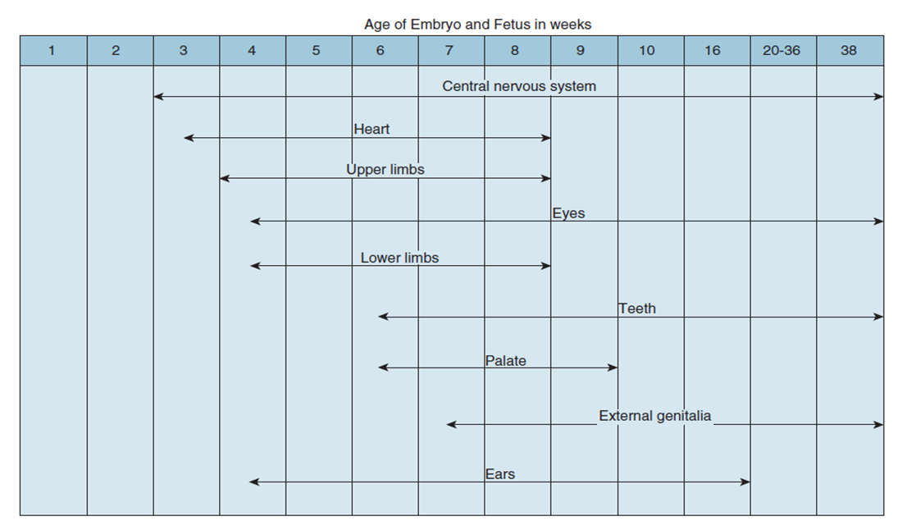

Slide 19
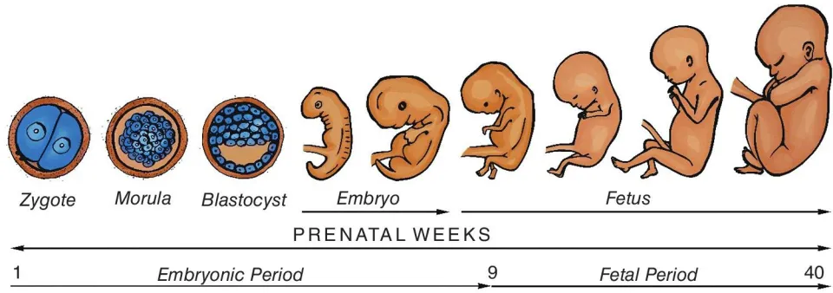

Slide 20
Placenta
The placenta, which is a Latin term for “pancake” for its appearance came from the trophoblast tissues and has a lot of functions that benefit the fetus.
It contains 15–20 subdivision are called cotyledons and has formed by 3rd moth.
Placenta weighs approximately -1.316 (400-600g) (500g at term) measure from 6- 10 inches (15-25 cm) in diameter and (2.5 – 3 cm) thick at term.
Having a rough texture, placenta appears red on the maternal surface and shiny and smooth and gray on fetal surface.
Placenta function as transport mechanism between mother and fetus.

Slide 21
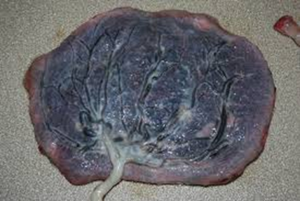
Placenta
Placenta produce hormone including:
Human chorionic gonadotropin (HCG).
Human placenta lactogen (HPL).
Gonadotropin releasing hormone (GnRM).
Thyrotropin releasing factor (TRF).
Corticotrophin estrogen and progesterone (Steroid H).
It supplies fetus with, water , fat, protein, minerals and an organic salts.
-It transfers passive immunity via maternal Antibodies

Slide 22
Amniotic Membranes
Term that contains 800-1200 ml of AMF, is clear and yellowish and has specific gravity of 1.007 – 1.025 and PH 7-7.25 (slightly alkaline).
Maternal serum provides AMF in early gestation with increasing a mounts derived from fetal urine late in gestation.
AMF is replaced every 3 hrs.
Contents in clued albumin urea, creatining bilirubin, fat, enzymes, lecithin, and leukocytes.

Slide 23
Amniotic Fluid
The normal amount of amniotic fluid is 800 to 1000 mL.
The role of the amniotic fluid in the safety of the fetus is it protects the fetus from trauma or pressure to the mother’s abdomen. It also regulates the temperature for the fetus and aids in muscular development allowing the fetus to move freely
The amniotic fluid also protects the umbilical cord from trauma and pressure, thereby protecting the fetal oxygen supply.

Slide 24
Diagnosis value of fluid
sex.
State of health.
Maturity of fetus.
Hydramnios more than 2 liters.
Oligohydrmnios less than 300 ml.
During pregnancy at average rate (800-1200 m) = 1000 ml
25 ml/ week first trimester
50 ml / week 2nd trimester
.

Slide 25
Intrauterine structures and function
Fetal membranes.
  Chorion is fetal membrane closes to the uterus wall (outer), it gives rise to the placenta.
  Amnion is the thin but tough inner fetal membrane that lines the amniotic sac .

Slide 26
Intrauterine structures and function
B-Umbilical cord
It measures from (50 – 55 cm) in length and (2 cm) in diameter at term.
The cord contains two arteries and one vein. (2A and 1V)
It also contains Wharton's Jelly, a gelatinous substance that helps prevent kinking of cord in utero blood flows through the umbilical cord at an estimated rate of 400 ml/ minute.
Umbilical vein which carries oxygenated blood to the fetus from placenta.
It contain no pain receptors.

Slide 27
referances
1-Mandondo, S. D., Hofmeyr, G. J., Mbengo, F., Mshweshwe-Paleka, N. T., & Mavundla, T. R. (2018). Outcomes of self-induced late pregnancy termination in women presenting to a tertiary hospital in the Eastern Cape Province, South Africa. South African Medical Journal, 108(11), 965-971
2-Meka, A., & Reddy, B. M. (2006). Recurrent spontaneous abortions: an overview of genetic and non-genetic backgrounds. International Journal of Human Genetics, 6(2), 109-117.‏.‏

Slide 28
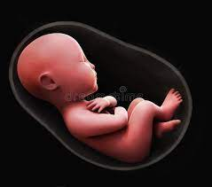
Thank you for listening

