Slide 1
Complications during pregnancy
By suad al rybayee

Slide 2
Gestational Diabetes Mellitus
Metabolic changes during pregnancy lower glucose tolerance. For the majority of pregnant women, this is a normal physiological process. Gestational diabetes mellitus (GDM) is defined as any degree of glucose intolerance with the onset or first recognition in pregnancy When medical nutrition therapy is inadequate to control glucose in GDM, insulin is required.

Slide 3
GDM
Approximately 7% of pregnancies are complicated by GDM, Pregnancy is a condition characterized by
-progressive insulin resistance ..
- Insulin resistance during pregnancy stems from a variety of:-
1-including alterations in growth hormone and cortisol secretion

Slide 4
cases
2- human placental lactogen secretion (which is produced by the placenta and affects fatty acids and glucose metabolism, promotes lipolysis, and decreases glucose uptake), and insulinase secretion., 3-estrogen and progesterone also contribute to a disruption of the glucose insulin balance.
4-Increased maternal adipose deposition
5- decreased exercise, and increased caloric intake Because maternal insulin does not cross the placenta, the fetus is exposed to maternal hyperglycemia and in response the fetus produces more insulin, which promotes growth and subsequent macrosomia.

Slide 5
Risks Factors for GDM
1- No known risk factors are identified in 50%
2- History of fetal macrosomia 3 Strong family history of diabetes
4-Obesity

Slide 6
Risks for the Woman
1- Hypoglycemia and DKA
2- Preeclampsia
3- Cesarean birth
4- Development of nongestational diabetes

Slide 7
Risks for the Fetus and Newborn
1- Macrosomia is the most common morbidity (15%–45%)
2- Hypoglycemia during the first few hours post-birth
3- Hyperbilirubinemia
4- Shoulder dystocia
5- Respiratory distress syndrome

Slide 8
Medical Management
. - For most women with GDM, the condition is controlled with diet and exercise. - Up to 40% of women with GDM may need to be managed with insulin. –
Oral hypoglycemic agents may be used (Glucophage, main mechanism of action in this disease inhibition of hepatic gluconeogenesis), but there is not agreement on their recommended use during pregnancy. - Cesarean/s birth is recommended for estimated fetal weight >4,500 g.

Slide 9
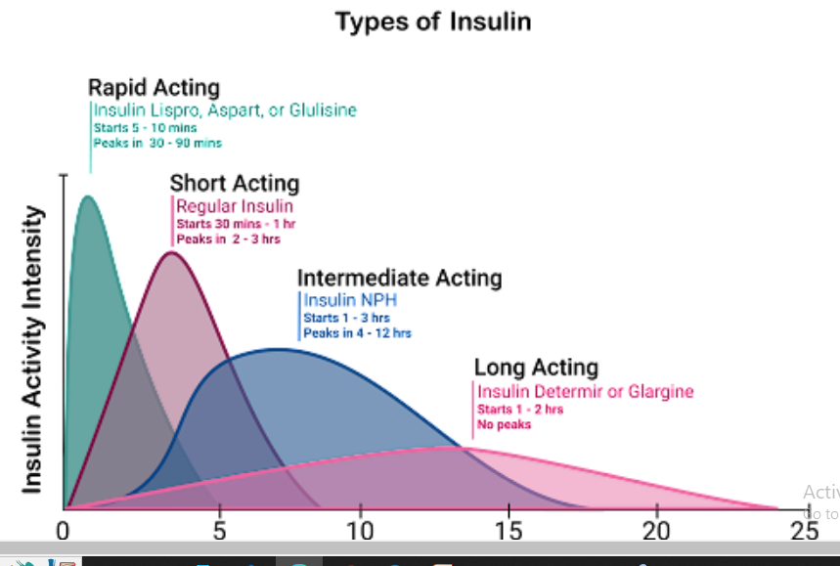

Slide 10
Nursing Actions.
1- Teach the woman to test glucose four times a day, one fasting and three postprandial checks/day
- Teach the woman to monitor fasting ketonuria levels in the morning.
Teach proper self-administration of insulin
- Teach the woman signs and symptoms and treatment for hypoglycemia, hyperglycemia, and diabetic ketoacidosis -.

Slide 11
Nursing cont.
Reinforce diet management. The recommended overall dietary ratio is 33%–40% complex carbohydrates, 35%– 40% fat, and 20% protein. - Reinforce plan of care related to self-management and fetal surveillance.
- Exercise has been shown to improve glycemic control. . Walking 10–15 minutes after a meal is beneficial and can be managed by most pregnant women

Slide 12
Pregnancy hypertension
Pregnancy hypertension identified as systolic pressure 140 mm Hg or greater or diastolic pressure 90 mm Hg or greater. the second leading cause of maternal death and contribute to neonatal morbidity and mortality.

Slide 13
Preeclampsia and eclampsia syndrome
1-Preeclampsia is a systemic disease with hypertension accompanied by: proteinuria after the 20th week of gestation.
2-Eclampsia is the onset of convulsions or seizures that cannot be attributed to other causes in a woman with preeclampsia.
3- Chronic hypertension: Hypertension (BP ≥ 140/90) before conception or before the 20th week of gestation, or hypertension first diagnosed after 20 weeks’ gestation that persists after 12 weeks postpartum; may put the woman at high risk for developing preeclampsia

Slide 14
Preeclampsia etiology
unknown. reduced organ perfusion secondary to vasospasm and endothelial activation . Preeclampsia is a disease of pregnancy that ranges from mild to severe and is hypertension accompanied by underlying systemic pathology.

Slide 15
Cont.
Liver damage may be mild or may progress to HELLP syndrome (Hemolysis, Elevated Liver enzymes, and Low Platelets). Hepatic involvement can lead to periportal hemorrhagic necrosis in the liver that can cause a subcapsular hematoma, which can result in right upper quadrant pain or epigastric pain

Slide 16
Risk Factors for Preeclampsia/Eclampsia
■ Nulliparity
■ Age younger than 19 or older than 35 years
■ Obesity
■ Multiple gestation
■ Family history of preeclampsia
■ Preexisting hypertension or renal disease
■ Previous preeclampsia or eclampsia
■ Diabetes mellitus

Slide 17
Risks for the Woman
■ Cerebral edema/hemorrhage/stroke
■ Disseminated intravascular coagulation (DIC)
■ Pulmonary edema
■ Congestive heart failure
■ Hepatic failure
■ Renal failure
■ Abruptio placenta

Slide 18
Nursing Actions
1- Accurate assessment is essential in that early recognition of worsening disease
2- Blood pressure should be measured with the woman seated and her arm at heart level
3- Administer antihypertensive as per orders (eg .apresoline)(generally for blood pressure >160/110 mm Hg)
4- Administer magnesium sulfate as per order

Slide 19
Nursing care cont.
5- Assess for CNS changes including headache, visual changes
6- Auscultate lung sounds for clarity and monitor the respiratory rate.
7- Assess for signs and symptoms of pulmonary edema such as: , Shortness of breath, chest tightness or discomfort, cough, oxygen saturation less than 95%, increased respiratory and heart rates

Slide 20
Eclampsia
Eclampsia is the occurrence of seizure activity in the presence of preeclampsia Eclampsia can occur ante –intra-, or postpartum; about 50% of cases occur antepartum.

Slide 21
Laboratory Values Indicative of HELLP
Syndrome Platelets 70 units/L Elevated ALT: >50 units/L Bilirubin (indirect) Elevated: >1.2 mg/dL
LDH Elevated: >600 units/L

Slide 22
Risks for the Woman
■ Abruptio placenta
■ Renal failure
■ Liver hematoma and possible rupture
■ Death

Slide 23
Risks for the Fetus and Newborn
■ Preterm birth
■ Death

Slide 24
Assessment Findings
- general malaise, nausea, and right upper gastric pain. , unexplained bruising, mucosal bleeding, petechiae, and bleeding from injection and IV sites. in laboratory tests associated with changes in liver function and platelets

Slide 25
Nursing Actions
■ Evaluate laboratory tests.
■ Notify the physician immediately if HELLP syndrome is suspected or lab values deteriorate. Eclampsia is thought to be triggered by one or more of the following:
■ Cerebral vasospasm
■ Cerebral hemorrhage
■ Cerebral ischemia
■ Cerebral edema

Slide 26
Care during a seizure includes
: ■ Remaining with the patient.
■ Calling for help.
■ Providing for patient safety by assessing airway and breathing. - Lower the head of the bed and turn the woman’s head to one side., suctioning to decrease the risk of aspiration.
■ Preventing maternal injury. (If possible, a padded tongue blade should be inserted to prevent tongue injury
■ Keep side rails up and padded if possible.

Slide 27
Care during a seizure includes
Recording the time, length, and type of seizure activity.
■ Notifying the physician. After the seizure, the following is done:
■ Rapidly assess maternal and fetal status.
■ Assess airway; suction if needed.
■ Administer supplemental oxygen: 10 L/min via mask.
■ Ensure IV access.
■ Administer magnesium sulfate per orders.
■ Provide a quiet environment.

Slide 28
Anemia during pregnancy
Anemia is the reduced ability of the blood to carry oxygen to the cells. Hemoglobin levels that are less than 10.5 g/dL in the second trimester and that are less than 11 g/dL in the first and third trimesters indicate anemia during pregnancy

Slide 29
classification
Mild :9-10,9 gm\id
Moderate:7,8-9 gm\dl
Severe: <7 gm \dl
Very severe: < 4gm \dl

Slide 30
Prevention
Iron supplements are commonly used to meet the needs of pregnancy and maintain iron stores.
2-Vitamin C may enhance the absorption of iron
. Iron should not be taken with milk or antacids because calcium impairs absorption.

Slide 31
Nursing Care for Anemia
take foods are high in iron and folic acid to help her prevent or treat anemia.
She is taught how to take the supplements so that they are optimally effective. For example, the nurse explains that although milk is good to drink during pregnancy, it should not be taken at the same time as the iron supplement, or the iron will not be absorbed as easily. Foods high in vitamin C may enhance absorption

Slide 32
Foods
Foods high in iron Meats, chicken, fish, liver, legumes, green leafy vegetables,
Foods high in folic acid Green leafy vegetables, asparagus, green beans, fruits, whole grains, liver, legumes, yeast Foods

Slide 33
Urinary tract infections (UTIs)
are common in women because of the short urethra and the ease of contamination of the urethra from the rectum and because of contamination from the vagina during sexual activity. The urinary tract is normally self-cleaning because acidic urine inhibits the growth of microorganisms and flushes them out of the body with each voiding.
Urine that is retained in the bladder becomes more alkaline, providing a favorable environment for the growth of microorganisms.

Slide 34
asymptomatic infection may eventually cause:
- cystitis (bladder infection) or pyelonephritis (kidney infection). The woman with cystitis has the following signs and symptoms:
• Burning with urination
• Increased frequency and urgency of urination
• A normal or slightly elevated temperature If not treated, cystitis can ascend in the urinary tract and cause pyelonephritis.
Pyelonephritis is a particularly serious infection in pregnancy and is accompanied by the following signs and symptoms:

Slide 35
Pyelonephritis
Pyelonephritis is a particularly serious infection in pregnancy and is accompanied by the following signs and symptoms:
• High fever
• Chills
• Flank pain or tenderness
• Nausea and vomiting
-Maternal hypertension,
-chronic renal disease,
--and preterm birth.

Slide 36
The high maternal fever is dangerous for the fetus because it increases the fetal metabolic rate, which increases fetal oxygen needs to levels that the mother cannot readily supply.

Slide 37
Treatment UTIs
are treated with short-term oral antibiotics. Asymptomatic bacteriuria is treated with oral antibiotics for 10 days. Pyelonephritis is treated with multiple antibiotics, initially administered intravenously. Cystitis in pregnant women is treated with a full 7 days of antibiotic therapy. e better tolerated.

Slide 38
Nursing care
All female patients should be taught how to
• Assess the symptoms of UTI.
• Encourage patient to drink fluids.
• Administer antibiotic as ordered.
• Encourage patient to void frequently.
• Educate patient on proper wiping (from front to the back)
• Educate patient on drinking acidic juices (Cranberry juice) which help deter growth of bacteria.
• Take antibiotics as prescribed.

Slide 39
Thank you

