Slide 1
Future Perspectives(trends)
Professor Emeritus
Hasan Alwan Baiee

Slide 2
Learning objectives
At the end of this lecture students are able to discuss the effects of the following factors on nursing practice
Changing demography التغير السكاني
Health care costs كلفة الرعاية الصحية
Shift to community التحول للمجتمع
New technology التقنيات الجديدة

Slide 3
Changing demography التغير السكاني
Demographics :
Any change in the demographic feature in the community will alter the approaches of delivering health care practice. In many countries including Iraq , aging of people is increasing rapidly ( the proportion of elderly people>65 years is increasing compared to the proportion of people aged 20 – 60 years they grow slowly), this diversion will challenge the health care system.

Slide 4
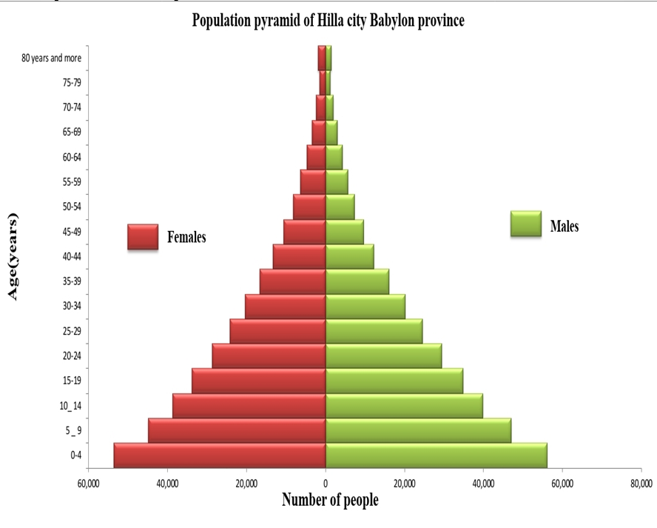

Slide 5
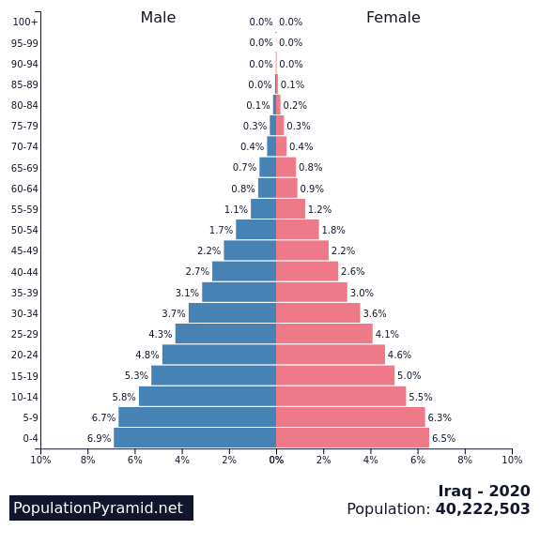

Slide 6
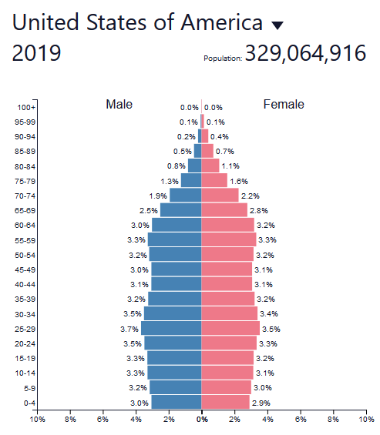

Slide 7
Health care costs كلف الرعاية الصحية
There is an increase in concerns about the value for money قيمة الفائدة المالية due to increase in spending on the healthcare systems in the last years worldwide. Leading to the consideration of cost benefit الجدوى الاقتصادية للأنفاق على الخدمات الصحية

Slide 8
Cost effectivenessالجدوى الاقتصادية
This determine the level of benefit at which interventions are effective enough to justify spending money for healthcare services (funding ).
Attention should be paid to how to gain the most possible benefits or quality outcomes from the budget الميزانية المالية allocated for these healthcare services.

Slide 9
Shift to Community
In nursing perspective ,how to shift the healthcare from the hospitals to outside hospitals, this need to restructured the hospitals, or a whole system research.
Restructuring the hospital cannot take place in isolation but must go hand in hand with reinvestment strategies استراجية اعادة الاستئمارof the health system.
How to provide community health services according to the restructuring of hospitals?.

Slide 10
Integration and coordinated care should be emphasized in future nursing perspective , this will improve continuity and reduce the fragmentation within the health and social care systems دمج النظام الصحي والنظام الاجتماعي في المجتمع in order to achieve good patient care outcomes للحصول على نتائج مشجعة .
Nurses play an important role in coordinated health care

Slide 11
Integrated coordinated system will be effective and successful when the following element are available :
1.When there is evidence of close collaboration between local authorities (inter sectorial collaboration).
Commissioners الحكوميون المفوضون and Non Governmental Organization working in the health field.
Service providers and trained frontline staff should engage in that success.

Slide 12
Barriers to shifting to the community :
Lack of planning قصور التخطيط
Poor resources ضعف الموارد
Inadequate education and preparation of community health nursing.
Insufficient training (knowledge and practice) who are engaged in transferring activities from hospital setting to the community.

Slide 13
5. Increasing workload pressure on nurses and rising wait time to access community services.
6.Lack of nursing specialty such as geriatric and occupational nursing specialties.
7.Short sited community service cuts not long term cut.

Slide 14
Technology
Using advance technology increase the cost of health care services.
Innovate الابداعuse of simple technologies may offer one way to increase cost effectiveness.

Slide 15


