Slide 1
Principles of Study Designs in Epidemiology:
Professor Emeritus Hasan A. Baiee

Slide 2
-A study design is a specific planخطة محددة or protocol for conducting لعمل the study, which allows the investigator to translate the conceptual hypothesisالمفهوم الافتراضي into an operational عمليone.

Slide 3
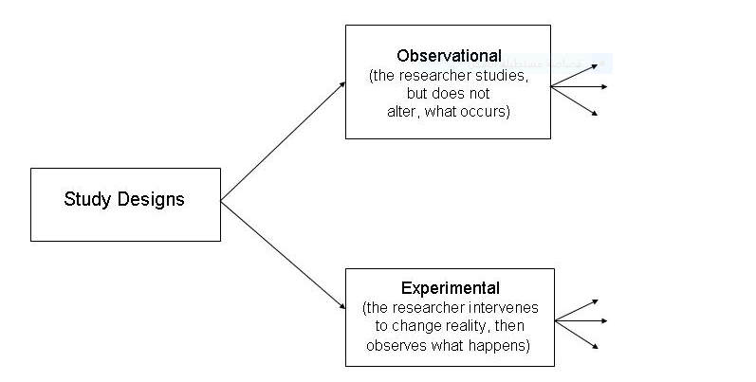

Slide 4
-In observational studies دراسات الملاحظة , the researcher observesيلاحظ and systematically collects information, but does not try to change the people or animals, being observed. In an experiment التجريبية , by contrast, the researcher intervenes يتدخل to change something (e.g., gives some patients a drug) and then observes what happens.
In an observational study there is no intervention.
.

Slide 5
-Examples of observational studies:
1.A survey of nutritional habits among students.
2. Taking blood samples to measure hemoglobin levels among pregnant mothers.
-Examples of experiments:
1.Test of new treatment on patient.
2. Effect of gentle massage on remove lower back pain in elderly individuals.

Slide 6
Descriptive and Analytical Epidemiologic studies continue
-Observation Methods:.
1.Selected Units: individuals.
2.Study Populations: , longitudinal.
3.Data collection timing: prospectively, retrospectively, combination.
4.Data collection types: primary, secondary.

Slide 7
OBSERVATIONAL STUDIES:
Observational
  Descriptive
    Study of the amount and distribution of disease within a population by person, place, and time
  Analytic
    Study of the determinants (possible causes ) of disease or reasons for relatively high or low frequency in specific groups.

Slide 8
1-Observational studies
/ Descriptive observational studies دراسات الملاحظة الوصفية which include the following :
1- Case report دراسة حالة.
2- Case series سلسلة حالات متشابهة.
3- Ecological studies (correlational)الدراسات الترابطية
4-Crossectional (prevalence studies( دراسات الانتشار

Slide 9
Observational studies:
Allow nature to take its course: the investigator الباحث measures يقيس but does not intervene لا يتدخل . They include descriptive and analytic studies.
A/ descriptive study is limited to a description of the occurrence of a disease in a population and is often the first step in an epidemiological investigation.

Slide 10
Advantages of observational descriptive studies
They use already available data.
They are less expensive and less time-consuming.
They describe the pattern of disease occurrence.
They formulate research hypothesis.

Slide 11
1.Case report(case study);
Nurse who sees unusual presentation of a common disease or a very rare disease and he/she describes the findings of this case, case description may take any relevant description of findings.
An unusual case may add to our knowledge for example myocardial infarction (MI) in very young person without ECG findings is unusual presentation of MI.

Slide 12
2.Case series ( Clinical series ) studies:
When a group of cases of the same disease are reported but in this study we can not;
Study the etiology of the disease
Testing hypothesis
Have a control group
But in this study it can help in generating hypothesis.

Slide 13
Example of case series دراسة سلسلة حالات :
Vaginal cancer is very rare in young females if 10 cases were reported and studied it may help us to generate a hypothesis when we interrogated with ( contraceptive pills حبوب منع الحمل ( taking during pregnancy among their mothers ( this can be done by further studies).
Discovery of AIDS was a case series
Many studies in nursing sciences are case series

Slide 14
Advantages of case reports or case series
Use available clinical data.
Detailed individual data.
Add to our knowledge.
Suggest need for investigation (hypothesis generation).
Not expensive and not time consuming

Slide 15
Disadvantages of case report or case series
May تعكسreflect experience of one person (one nurse).
No explicit(clear) comparison group.
No hypothesis testing.

Slide 16
Ecological Studies(correlation): based on studying of a group of people not individuals as in previous studies.
Correlation data represent average exposure level rather than individual level so we do not have each person information.

Slide 17
Ecological studies can generate a hypothesis and need further confirmation , it provides just initial clues to causation.
Example : as meat consumption in different countries increases prevalence of cancer colon increases , Cigarette smoking increases cancer lung prevalence increases as well

Slide 18
Advantages of Correlational Study
They describe the disease in the entire population in relation to the factor of interest.
They are easy to do, inexpensive and can be conducted quickly.
They use available data (administrative or other aggregate data).

Slide 19
Cross-Sectional studies (prevalence studies or surveys)دراسة المقطع العرضي او دراسة الانتشار
It is a study of a group of people at a point in time for the prevalence of a disease or an attribute متعلقin a well defined population but data is collected at individual levels. In this study the measurements of exposure and effects are made at the same time .
Survey either:
Population survey= censusالاحصاء العام
Or Sample survey

Slide 20
Advantages of cross sectional study
Provide generalization from the sample to the population.
They are short term studies and not expensive.
Provide good information for the health problems and good for health planners to assess health care needs.
Used for generating hypothesis to be tested in further studies.

Slide 21
Disadvantages of cross sectional study:
1. It is difficult to separate cause and effect because measurement of exposure and disease are made at one point of time and it is impossible to determine which came first.
2. Cases detected are prevalent cases (survivors) leading to survival bias cases cured or died are not detected.
3. Non response and this will affect the representation of the sample.

Slide 22
The time relationship between cohort and other studies
Cross sectional
Today
Case control
Cohort
Yesterday
Tomorrow
Direction of Time

Slide 23
2.Observational analytic studies
CASE CONTROL Studies الحالات والشواهد
-compare people with a condition ( disease or cases) to a people without the condition (controls) to study risk factors.
For example, the first studies that pointed out the strong connection between smoking and lung cancer were Case-Control Studies.

Slide 24
Advantages of case control studies
1.Can study rare health outcomes quickly/less expensively
2.Can study multiple exposures for a single outcome( disease)
3.Good for cases where the total population at risk is not well defined
4. Easier to conduct

Slide 25
Disadvantages of case control study
Greater potential for bias because of smaller sample size and because selection is done after risk and outcome( disease) have occurred.
Recall biases اخطاء عدم التذكر

Slide 26
Observational analytic studies
Cohort studies, follow up , prospective , longitudinal الدراسات التتابعية :-compare groups of people who have been exposed to suspected risk factors to groups of people who have not been exposed to determine who develops a disease or other outcome.

Slide 27

Direction of inquiry
Time
Diseased
Exposed
Population
Non-diseased
Cohort
Diseased
Not exposed
Non-diseased
Figure shows cohort study design
Notes:
The key element of cohort study is time

Slide 28
Experimental Studies
Investigator can “control” the exposure
Akin مشابه to laboratory experiments except living populations are the subjects
Generally involves random assignment to groups
Clinical trials التجارب السريرية are the most well known experimental design
The ultimate step in testing causal hypotheses

Slide 29
In an experiment, we are interested in the consequences of some treatment or intervention on some outcome.
The subjects in the study who actually receive the treatment of interest are called the treatment group or study group.
The subjects in the study who receive no treatment or a different treatment are called the comparison group or control group.

Slide 30
Disadvantages of experimental studies :
Very expensive
Not appropriate to answer certain types of questions
It may be unethical, for example, to assign persons to certain treatment or comparison groups, if we suspect some doubt harmful effects.

Slide 31

Big Thanks

