Slide 1
Change
Professor Dr. Hasan Alwan Baiee
Consultant Medical Doctor, Public Health Medicine Specialist and Expert in WHO,EMRO

Slide 2
Health care organizations are constantly changing as a result of technological advancements, ageing populations, changing disease patterns, new discoveries for the treatment of diseases and political reforms. Changes can be challenging because they contradict humans’ basic need for a stable environment.

Slide 3
Change
Change : is defined as any variation or alteration ; it is a passing from one state to another.
Change means alteration of the current state
Change is a useful approach for development specific new thoughts for development and for progress or solving health problems.

Slide 4
Improving patient care requires change management ادارة التغير.
Change is dynamic process that is unpredictable لا يمكن التنبؤ به
Innovation : a special type of change that restructured the deep social and economic value القيمة of an organization.

Slide 5
characteristics of successful changes
Three characteristics of successful changes were found to be of central importance for a change to be considered successful:
(1) you have the opportunity to influence the change
(2) you are prepared for the change and
(3) You should recognize and have positive attitudes to the value of the change.

Slide 6
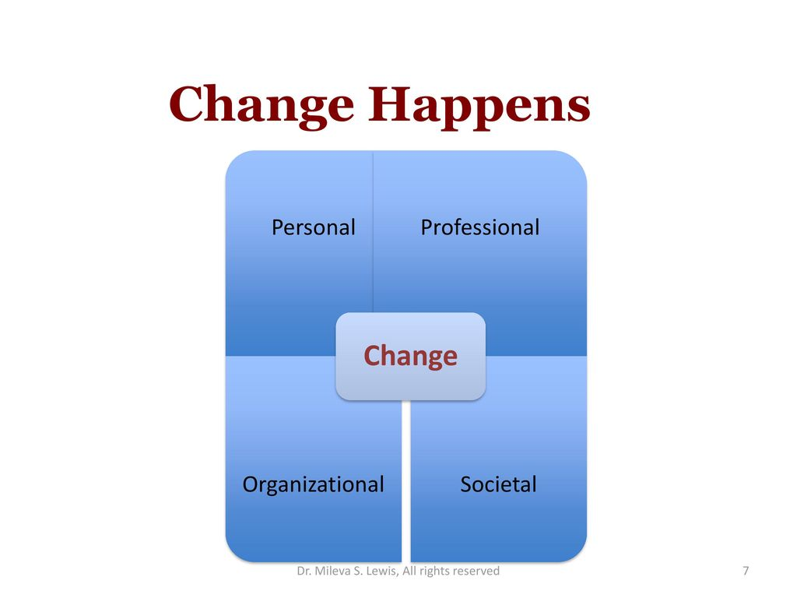

Slide 7
Why does health care need to change?
Evolving تطورneeds of Patients.
Demands متطلبات الرعاية on healthcare change due to various reasons:
Every year, new treatments help manage common diseases.
Each such development affects the entire healthcare system as much as it has a positive impact on patients.

Slide 8
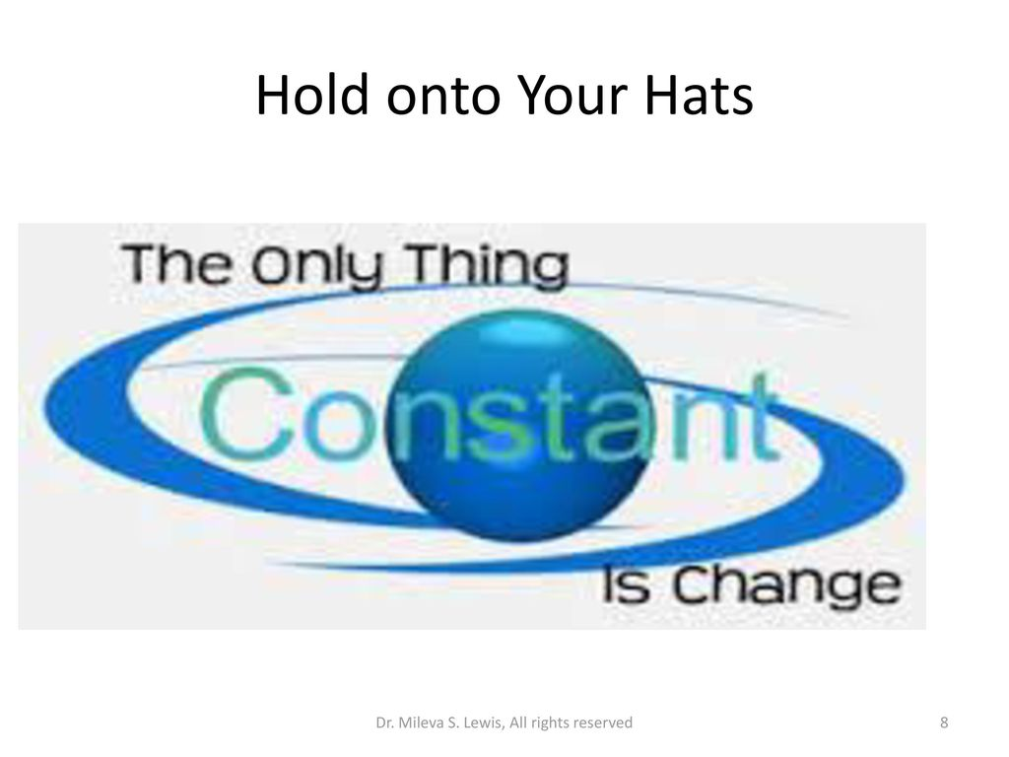

Slide 9
Nurses must constantly adapt to a variety of changes in the way they work, but their emotional responses can inhibit changes from being sustained in practice(burnout).
Implementing sustainable and meaningful change means supporting each individual to find value in new ways of working.

Slide 10
Test of change : at the beginning we have to combine our concepts مفاهيم of change together with our knowledge and experience about specific subject this can help for test for change.
After generating ideas, run plan – do- study- act
(PDSA) cycles to test a change or group of changes on small scale to see if they result in improvement, then we expand to a larger sample to be adopted widely.

Slide 11
Elements of change
There are three most important elements in changing a behavior:
1- Readiness to change : availability of resources and knowledge to successfully make a change.
2.Barriers to change : any thing prevent people from change.
3.Expect relapse : what might trigger a return to a former behavior.

Slide 12
Types of change (planned or un planned )
Planned change : Change is a planned process.
A planned action to make things different is defined change intervention.
Change agent is person (persons)who act as catalyst عامل مساعد and carry out the responsibility for managing the change process.

Slide 13
Planned changes occur when leaders in the organization recognize the needs for important change and organize an effective plan to achieve the planned objective.
Characteristics of planned change:
1-It is qualitative in nature , a change in the frequency is the quantitative change.

Slide 14
2.Every planned change has a direction, the change has basic objective and rationale العقلاني .
3.The means الطرق used for bring about change affecting the quality and direction of change
4.In any change process the adoption the variation rate is a wide معدل تقبل الافراد تختلف .

Slide 15
Steps in planned change
Recognize نميز the need for change
Develop the objectives of change
Select the change agent الشخص او المنظمة
Diagnose the situation ( SWOT analysis )نقاط الضعف والقوة .
Select the implementation method
Develop a plan
Implement the plan
8.Follow up متابعة the plan and evaluate تقييم the percentage of success or failure and identifying the causes.

Slide 16
Un planned change:
The unplanned change occur suddenly without a predetermined plan as incase of urgent situation or crisis to the organization ( health system ). The persons response in reactive way (رد فعل للموقف الجديد ) and not organized approach اسلوب غير منظم

Slide 17
Major barriers of change
1.Scarce (rare) قليلة resources
2.The magnitude of the change .
3.Instability of facility leadership
4.Competing التنافسdemands
5.Stakeholder المستفيدين من الخدمة resistance
6.Technical problems .

Slide 18
How to Overcome Resistance and Effectively Implement Change
1.Overcome opposition. Regardless of how well the organization to manage a change, there is always going to be resistance. ...
2.Effectively engage employees. Listen, listen, listen. ...
3.Implement change in several stages. ...
4.Communicate change effectively.

Slide 19
Facilitating strategies for supporting successful change:
1.organization-wide involvement .
2.leadership support
3.use of administrative authority السلطة .
4.adequate training .

Slide 20

Big Thanks

