Slide 1


"قالوا سبحانك لا علم لنا إلا ما علمتنا إنك أنت العليم الحكيم "
صدق الله العظيم
البقرة، آية 32

Slide 2
Introduction to Perspectives and professional issues in nursing
Assistant Prof. Dr / Samia Farouk Mahmoud, Community Health Nursing Department, Hilla University
College of Nursing

Slide 3
Course specification Preparatory
Total marks = 100
Semester Activities: (30 marks)
Written exam: (70 marks)
Semester summative evaluation
(30)
Final summative evaluation
(70)
Introduction to Research Methodology

Slide 4
outlines
Historical Evolution of Nursing.
Roles and Responsibilities of Professional Nurses.
Scope of Nursing Practice and Its Importance in Patient Care.

Slide 5
Learning Objectives
By the end of this lecture, participants will be able to:
Understand the historical evolution of nursing as a profession.
Discuss the roles and responsibilities of professional nurses in various healthcare settings.
Explore the scope of nursing practice and its importance in patient care.

Slide 6
Video about
Historical Evolution of Nursing

Slide 7
Historical Evolution of Nursing
1. Early Nursing Practices :
  Nursing roles in ancient civilizations (Iraq, Egypt, Greece, Rome).
  Care rooted in religion, family, and community support.

Slide 8
Question
Which of the following was a primary source of care in ancient civilizations like Iraq, Egypt, Greece, and Rome?
A) Formal nursing schools
B) Religious institutions and community support
C) Military hospitals
D) Secular hospitals

Slide 9
2-Middle Ages
  Care dominated by religious institutions and charity work.
  Women in religious and men in military orders provided care for the sick and wounded.

Slide 10
2. During the Middle Ages, who predominantly provided care for the sick and wounded?
A) Physicians
B) Religious orders, with women and men in military orders
C) Nurses trained in secular hospitals
D) Family members at home

Slide 11
3.Renaissance and Enlightenment:
  Secular hospitals began to emerge. Nursing remained informal and often lacked training.

Slide 12
3. What was the impact of the Renaissance and Enlightenment on nursing care?
A) Nursing became highly formalized and regulated
B) Secular hospitals emerged, but nursing remained informal and untrained
C) Religious orders took over all nursing duties
D) Nursing became more scientific and research-based

Slide 13
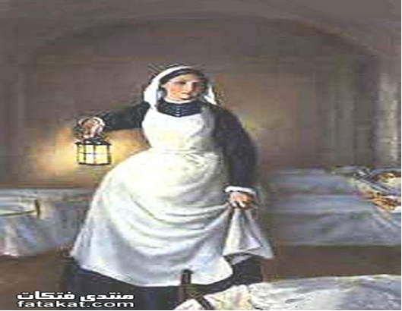
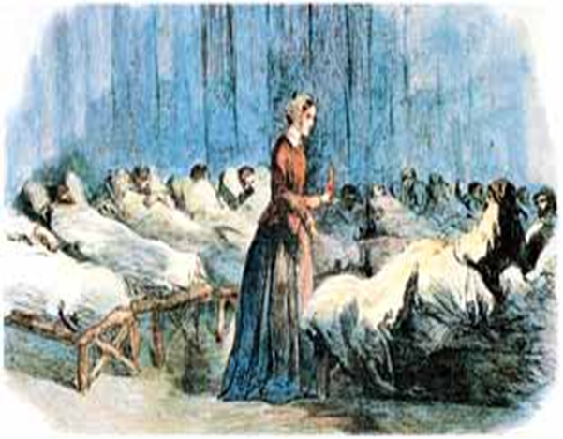
History of Ethics

Slide 14
Florence nightingale (1820-1910) the morals and values she gave to nursing have endured.
Florence nightingale saw nursing as a call to services, and she thought that those
Who became nurses should be people of good moral character.
She was passionate about the need to provide care to poor people and also about the
importance of a sanitary environment as seen in her work with soldiers in Crimean war (1854- 1856).

Slide 15
Florence Nightingale’s Impact:
  Modernized nursing during the Crimean War by improving sanitation and patient care outcomes.
  Established the first professional nursing school in 1860.
  Advocated for public health and statistical analysis in healthcare.

Slide 16
How did Florence Nightingale contribute to the modern nursing profession?
A) She established the first secular hospital
B) She modernized nursing during the Crimean War by improving sanitation and patient care
C) She focused only on military care
D) She limited nursing education to religious orders

Slide 17
4. 20th Century and Beyond•
  Nursing became a regulated profession with licensure and formal education.
  Specialized roles emerged, such as advanced practice nurses and researchers.
Global recognition of nursing’s essential role during health crises and pandemics

Slide 18
5. Which of the following developments occurred in the 20th century and beyond in nursing?
A) Nursing became less regulated with no formal education required
B) Specialized roles emerged, including advanced practice nurses and researchers
C) Nursing returned to being a purely religious vocation
D) Nursing was excluded from global health crises and pandemics

Slide 19
2. Roles and Responsibilities of Professional Nurses
Core Roles of a Nurse:
  1. Caregiver: Providing competent care to patients.
  (Caregiver):
  2. Educator: Teaching patients and families about health, and disease management.

Slide 20
True/false
A core role of a nurse is to provide competent care to patients.
Nurses are only responsible for providing direct care to patients and do not have roles in educating patients or their families.

Slide 21
Core Roles of a Nurse:
  3. Advocate: Representing patients' needs and ensuring ethical treatment.
  4. Researcher: Engaging in evidence-based practice to improve healthcare outcomes.

Slide 22
Core Roles of a Nurse:
  5. Leader: Managing teams, influencing policies, and driving change within healthcare systems.

Slide 23
True/ false
1. The role of a nurse as an advocate involves representing patients' needs and ensuring ethical treatment.
2. Nurses do not participate in research or evidence-based practice, as their role is primarily clinical and focused on direct patient care.

Slide 24
Responsibilities in Healthcare Settings:
  1. Delivering patient-centered care.

Slide 25
Responsibilities in Healthcare Settings:
  2 - Maintaining patient safety and quality standards.

Slide 26
Responsibilities in Healthcare Settings:
  3. Collaborating with interdisciplinary teams for holistic care.

Slide 27
3. Scope of Nursing Practice
1. Nurse Practice Acts: Laws that outline nursing roles and responsibilities, varying by region or country.

Slide 28
True/false
Nurse Practice Acts are laws that define nursing roles and responsibilities, and they are the same worldwide.
.

Slide 29
3. Scope of Nursing Practice
2. Practice Areas:
  Clinical care: Acute and long-term care settings.
  2. Community and public health nursing.
  Advanced practice roles: Nurse Practitioner (NP), Nurse Anesthetist, Nurse Midwife, etc.

Slide 30
True or False:
Clinical care is only provided in acute care settings, such as hospitals, and does not apply to long-term care settings.

Slide 31
References
Black, B. P. (2020). Professional Nursing: Concepts & Challenges (9th ed.). Elsevier.
Cherry, B., & Jacob, S. R. (2022). Contemporary Nursing: Issues, Trends, & Management (9th ed.). Elsevier.
Finkelman, A., & Kenner, C. (2021). Professional Nursing Concepts: Competencies for Quality Leadership (5th ed.). Jones & Bartlett Learning.
Hood, L. J. (2021). Leddy & Pepper's Professional Nursing (9th ed.). Wolters Kluwer.
American Nurses Association. (2020). The Code of Ethics for Nurses with Interpretive Statements. Journal of Nursing Regulation, 11(1), S1-S64.
Institute of Medicine. (2011). The Future of Nursing: Leading Change, Advancing Health. National Academies Press.

Slide 32
References
Black, B. P. (2020). Professional Nursing: Concepts & Challenges (9th ed.). Elsevier.
Cherry, B., & Jacob, S. R. (2022). Contemporary Nursing: Issues, Trends, & Management (9th ed.). Elsevier.
Finkelman, A., & Kenner, C. (2021). Professional Nursing Concepts: Competencies for Quality Leadership (5th ed.). Jones & Bartlett Learning.
Hood, L. J. (2021). Leddy & Pepper's Professional Nursing (9th ed.). Wolters Kluwer.
American Nurses Association. (2020). The Code of Ethics for Nurses with Interpretive Statements. Journal of Nursing Regulation, 11(1), S1-S64.
Institute of Medicine. (2011). The Future of Nursing: Leading Change, Advancing Health. National Academies Press.

Slide 33


