Slide 1
Model of Health
Dr. Samia Farouk Mahmoud
Assistant professor of community health nursing

Slide 2
Outlines:
Definition of health.
Meikirch model of health.
Health continuum: Wellness-Illness.
Role of nurse in achieving health:

Slide 3
Learning objectives:
By the end of this lecture the undergraduate students should be able to:
Define health.
Identify and draw the Meikirch model of health.
Describe and draw the health continuum: Wellness-Illness.
Apply the role of nurse in achieving health:

Slide 4
Introduction
Before discussing about health education, it is imperative to conceptualize what health itself means.
Health is a highly subjective concept.
Good health means different things to different people, and its meaning varies according to individual and community expectations.

Slide 5
Introduction
Many people consider themselves healthy if they are free of disease or disability.
However, people who have a disease or disability may also see themselves as being in good health if they are able to manage their condition so that it does not impact greatly on their quality of life.

Slide 6
Question
1: Why is it important to understand the concept of health?
A) To establish a fixed definition of health for everyone.
B) To highlight the importance of disease prevention.
C) To acknowledge the subjective nature of health and its varied interpretations.
D) To promote a universal approach to health education.

Slide 7
Question
3. How might individuals with diseases or disabilities view their health?
A) They always perceive themselves as unhealthy.
B) They focus exclusively on managing their conditions.
C) They may still consider themselves in good health if they can manage their condition's.
D) They believe that good health is unattainable بعيد المنال for them.

Slide 8
Definition of Health:
In 1948, World Health Organization (WHO) defined health in its constitution as “a state of complete physical, mental, and social well-being and not merely the absence of disease or infirmity”.

Slide 9
Conference on Health Promotion
was held in Ottawa, Canada. Health was defined more broadly,
health has been considered less as an abstract state and more as a means to an end.
Health is a resource for everyday life, not the object of living.

Slide 10
How did the Ottawa Charter redefine the concept of health?
a. As an abstract state
b. As an individual goal
c. As a resource for everyday life
d. As a luxury for the elite

Slide 11
Meikirch Model
Health is a dynamic state of wellbeing characterized by a physical, mental and social potential, which satisfies the demands of a life suitable with age, culture, and personal responsibility. If the potential is insufficient to satisfy these demands the state is disease.

Slide 12
Five components of Meikirch model:
Demands of life
Biologically given potential
Personally acquired potential
Social determinants of health
Environmental determinants of health
These five components are interacting with each other by ten complex interactions

Slide 13
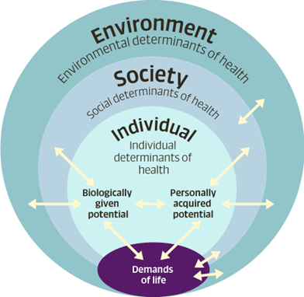

Slide 14
Complex Interactions
:
1: High demands of life (e.g., stressful work) may interact with personally acquired potential (e.g., coping skills) to influence overall well-being.
2: Social determinants (e.g., access to education) can interact with biologically given potential (e.g., genetic factors influencing cognitive abilities) to impact an individual's overall health.

Slide 15
According to Meikirch Model
In order to be healthy each human being has to fulfill all demands of life such as adequate nutrition, assurance of personal safety, hygiene, and social integration. For this purpose each human being has received abilities at birth and must also develop further abilities as life progresses.

Slide 16
According to Meikirch Model
These abilities have to serve also in our future. Therefore they are called potentials. If the biologically given and the personally acquired potentials together suffice to cover all the vital demands of life a person is healthy.

Slide 17
If they are insufficient she or he is diseased. Consequently, each individual has the responsibility to take good care of his or her biologically given potential and to continuously acquire new personal potential.

Slide 18
Potentials used to describe the abilities received at birth and developed throughout life.

Slide 19
What is the Meikirch Model's definition of health?
a. Absence of disease
b. A dynamic state of wellbeing characterized by physical, mental, and social potential
c. Physical fitness only
d. Mental and emotional stability

Slide 20
According to the Meikirch Model, what happens when the potential is insufficient to satisfy life demands?
a. Enhanced potential
b. State of health
c. Disease
d. Social integration
What is the term used to describe the abilities received at birth and developed throughout life according to the Meikirch Model?
a. Biological necessities
b. Personal responsibilities
c. Potentials
d. Social determinants

Slide 21
The Illness- Wellness Continuum:
Continuum means something that changes gradually without any clear points, and Health is a variable component which changes time to time to make adjustment with the internal or external variables.

Slide 22
The Illness- Wellness Continuum:
The Health illness continuum is a graphic representation of the wellness of an individual.
This concept was first proposed by John W. Travis.

Slide 23
The Illness- Wellness Continuum:
In this Travis model right side shows a high level of wellness i.e. achievement of optimum health and the left side shows premature death.

Slide 24
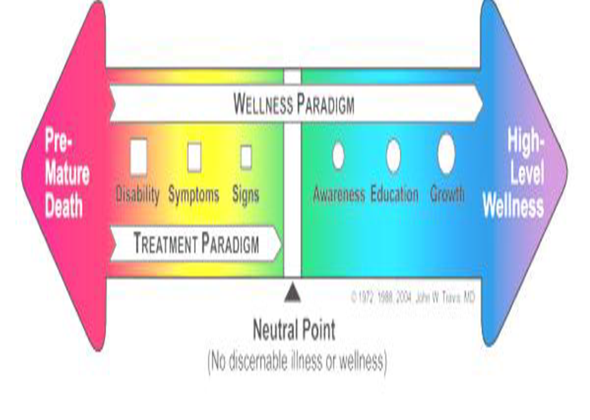

Slide 25
Travis explained that, treatment paradigm can only move health to a neutral point where all can see no sign of illness. After this neutral point, it depends on the individual how he can move himself to optimum health which is a high level of wellness.

Slide 26
To achieve high level of wellness individual need to pass through three stages like awareness, education and growth. Individuals attitude towards health also affect. If individual have positive attitude, he moves towards right side that means to achieving good health. But if individual have negative attitude he will move left side.

Slide 27
The Illness- Wellness Continuum:
For example, if a person has a fever, and he thinks he will be better in few days and continue the treatment person will have both mental wellness and physical wellness.
In case of a negative attitude, the individual will be in mental distress and there may be a delay in recovery from illness.

Slide 28
Question 1: What does the Illness-Wellness Continuum represent?
A) A fixed point indicating a person's level of health.
B) A gradual change in health over time
C) A measurement of physical health only
D) A graphical representation of illness only.
Question 2: Who first proposed the concept of the Illness-Wellness Continuum?
A) John W. Travis
B) Florence Nightingale
C) Albert Einstein
D) Marie Curie.

Slide 29
Role of nurse in achieving health:
Determine the clients' stage of health and position at health illness model.
Recognize the risk factors that are causing degradation in health of client, it may be genetics, or physiological.
Prevent the illness through awareness, educating the client.

Slide 30
Question
What is one of the roles of a nurse in achieving health?
a. Providing entertainment
b. Determining clients' stage of health
c. Cooking meals for clients
d. Fixing broken equipment

Slide 31
References
Institute for Work & Health. (2023). Primary, Secondary, and Tertiary Prevention. Retrieved from https://www.iwh.on.ca
World Health Organization. (2024). Health Promotion and Disease Prevention. Retrieved from https://www.who.int
Snelling, A. (2023). Introduction to Health Promotion (2nd ed.). Jossey-Bass.
Madanat, H., Arredondo, E. M., & Ayala, G. X. (2021). Introduction to Health Promotion & Behavioral Science in Public Health. Cengage Learning.
World Health Organization. (2024). Health Promotion. Retrieved from https://www.who.int/health-topics/health-promotion
Thompson, S. (2015). The Essential Guide to Public Health and Health Promotion. Routledge.
Naidoo, J., & Wills, J. (2016). Foundations for Health Promotion (4th ed.). Elsevier.

Slide 32
thanks

