Slide 1
Terminology lecture 4 Combining forms اشكال جمعية
Prof Hasan A Baiee

Slide 2
Word Parts Are the Key!
Four basic types of word parts are used to
create complex medical terms:
    Word roots
    Combining forms
    Suffixes
    Prefixes
(continues)

Slide 3
Combining Forms اشكال الجمع
Created تشكل by adding a vowel (usually the letter
“o”) to the end of a word root جذر الكلمة.
Used when connectingربط جذرين word roots or when the word root is joined to a suffix that beginsاو ربط جذر مع لاحق
with a consonant حرف ساكن .
(The combining form is a word root with the combining vowel letter attached).
(

Slide 4
Combining forms Combining(Linking) forms is formed when a word root is combined with a vowel. usually “o”, but occasionally “e” or “i”. i.e Combined form الشكل المرتبط = word root + o

Slide 5
Combining Forms
Examples:
  cardi/o = heart
  gastr/o = stomach
  neur/o = nerve
  Hepat/o= liver
(continues)

Slide 6
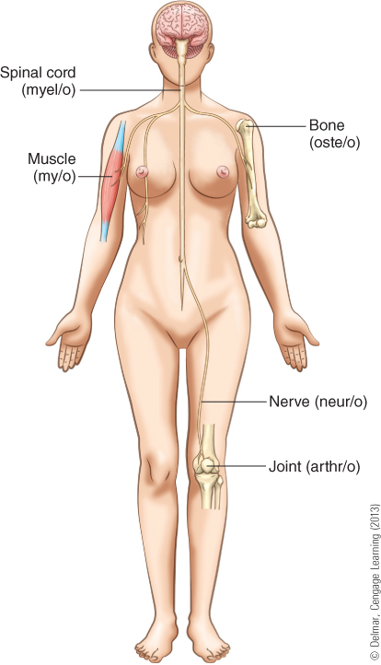
Combining Forms
© Cengage Learning

Slide 7
Rule قاعدة او حكم for combining word parts in medical terms
Most medical words have at least one word root, and some have several عدة جذور. Word roots are joined by a combining vowel .
When a word root is joined to a suffix, or to other root words to make a compound word, it requires the use of a combining vowel.

Slide 8
Purpose الغرضof combining form
A prefix can be used to modify the meaning of a word. The combining vowel is used to ease pronunciation تسهيل اللفظof the medical term.
A combining vowel is used to connect two word roots and to connect a word root and a suffix.

Slide 9
The root of a word (known as the word root) contains the basic meaning (definition) of the word often referring to a body part or system e.g. cardi (heart) , hepat/o, gastr/o, my /o(muscle)عضلة, arthr/o(joint) مفصل .

Slide 10
Word root+ vowel letters (e,a,o,i,u,y) + word root = compound word
Hydr/o therapy العلاج بالماء
Note : drop combining vowel when the suffix starts with vowel letter
Gastritis not gastroitis.

Slide 11
Combing form vowel rules
1. Vowel is used when the suffix begins with consonant الحرف الساكن
e,g, Encephalogram
2. The vowel is not used when the suffix begins with the vowel example : Gastritis not gastroitis.
3. A combing vowel can also be used when two or more word roots are joined together
Gastroenterology
Hem الدم o pneumo الرئة thorax الصدر

Slide 12
Derm/ dermato= skin
Dermatologist : is a specialist متخصص in diagnosis تشخيص and treatment معالجة of skin diseases الامراض الجلدية
Phlebotomist : one who specialize in drawing blood from a vein متخصص بسحب الدم من الوريد
Ologist: (suffix : one who studies ) cardi/o/ logist ) cardiologist
Ophthalmologist طبيب عيون اختصاص

Slide 13
Endocrinologist اختصاصي الغدد الصماء
Pathologist اختصاصي علم الامراض
Hematologist اختصاص امراض الدم
Neurologist اختصاصي امراض الجهاز العصبي

Slide 14
المصطلحات المهمة
Stethoscope سماعة طبية
Medical clinic عيادة طبية
Dose جرعة
Ointment مرهم

Slide 15
المصطلحات المهمة
Thermometer محرار طبي
Sphygmomanometer جهاز قياس ضغط الدم
Bleeding نزيف
Cure = recovered شفاء
Immune مناعة
Addiction ادمان

Slide 16
A patient with encephalitis is most likely to be treated by which of the following specialists?
(A) Endocrinologist
(B) Hematologist
(C) Neurologist
(D) Oncologist
(E) Radiologist

Slide 17
Quizzes
A cysto scope ناضور المثانة is an instrument used most commonly by a specialist in which of the following?
(A) Endocrinology
(B) Gastroenterology
(C) Gynecology
(D) Urology

Slide 18
Which of the following physicians specializes in treating patients with diseases of the liver?
(A) Hematologist
(B) Hepatologist
(C) Nephrologist
(D) Oncologist
(E) Rheumatologist

Slide 19
Which of the following is the chemical symbol for iron?
(A) F
(B) Fe
(C) Fr
(D) I
(E) Ir

Slide 20
Quizzes
Polydipsia, polyuria, good appetite with weight loss, and blurred vision are signs and symptoms of which of the following conditions?
(A) Diabetes mellitus
(B) Gout
(C) Hypothyroidism
(D)Hypertension

Slide 21

Big Thanks

