Slide 1
Medical Terminology Lecture 5
Professor Emeritus
Hasan A. Baiee
Consultant Public Health Physician

Slide 2
Learning objectives
Revision some words roots
Studying Pluralizing term صيغ الجمع

Slide 3
Some Word Roots Examples
“dent” means tooth سن example dentist طبيب اسنان
“dermat” means skinجلد example dermatologyعلم الامراض الجلدية
“pancreat” means pancreas البنكرياس
“hepat” means liver
“Nephr” means kidney
“Cyte” means cell

Slide 4
Pluralizing term صيغ الجمع
Rules
Add نضيف “s “ to words ending نهاية الكلمات in any vowel or consonant letters ( s , x, z, y)
Ex. Joint = joints مفاصل
Add es to words ending in( s , x or z ).
Ex. Reflexرد فعل = Reflexes ردود افعال
Suffix = suffixes لا واحق
Prefix = prefixes بادئات

Slide 5
Remove x and add ces to laten word ending in x
Ex. Appendix زائدة = appendices زوائد
Remove the y and add ies to the word ending with y preceded تسبق by consonant letter حرف ساكن ex. Mastectomy = رفع الثدي mastectomies

Slide 6
When the ending y is precededتسبق by vowel , the usual plural suffix is “s”
Ex. Boy = boys
add “e” to the ending of the word ending with “a”
Ex. Vertebra فقرة = vertebrae فقرات
Lamina الغضروف بين الفقرات = laminae الغضاريف بين الفقرات

Slide 7
Remove “on” from Greek or Latin words ending in “on” and add “ a”
Ex. Criterion صفة = Criteria صفات
Remove “um ” from Greek or Latin words ending in “um ” and add “ a”
Ex. Diverticulum انبعاج او تجويق = Diverticulaتجاويف
Atrium اذين = Atria جمع اذين not Atriums

Slide 8
Remove “us ” from Greek or Latin words ending in “us ” and add “ i”
Ex. Bacillus عصية = Bacilli
Change “sis” to “ses” in Latin words ending with sis
Ex: psychosis الذهان = psychoses

Slide 9
Levels of organization مستويات التنظيم in the human body
Cell خلية similar cells combine to form tissues انسجة
Two or more tissues combine to form an organ عضو
Two or more organs work together to form systemجهاز
All systems work together to support the organism الكائن

Slide 10
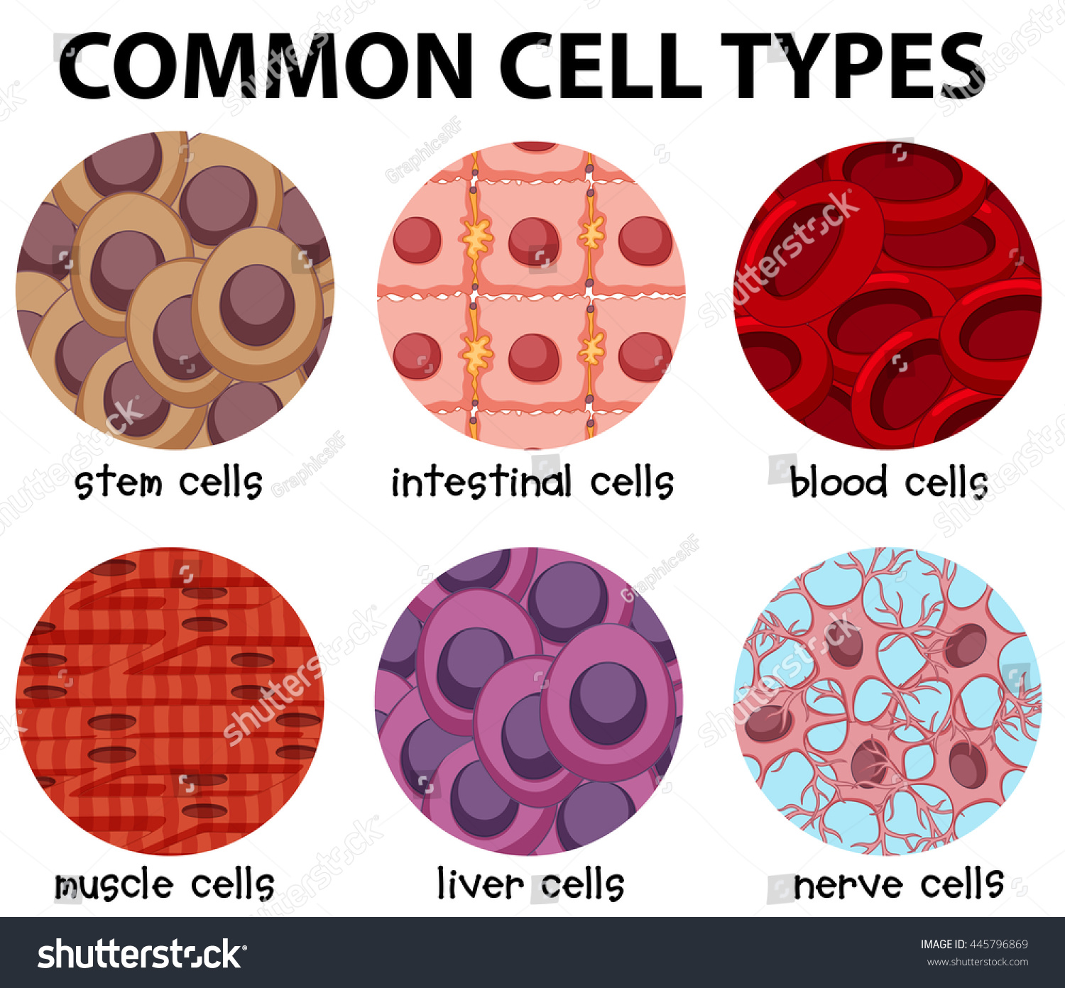
انواع خلايا شائعة لجسم الانسان

Slide 11
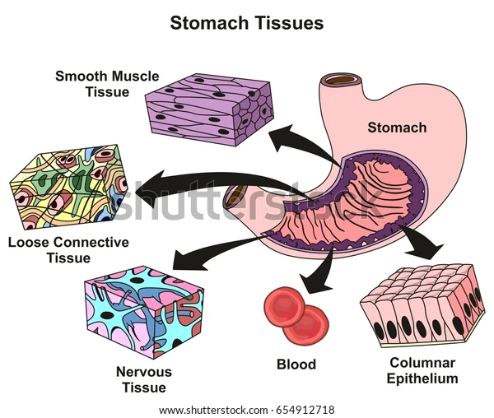

Slide 12
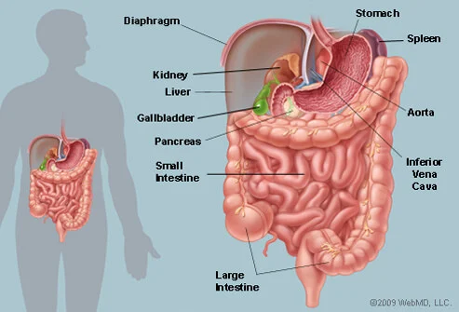

Slide 13
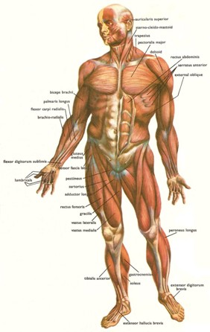

Slide 14
Cyt: Greek word means cell
Combining form cyt/o
Here we have a word (medical term) that contain the root cyt
cyt o logy = study off ]دراسة
Cytology علم دراسة الخلية
Cytopathoy = disease of the cell مرض في الخلية

Slide 15
Pathology علم الامراض
Cyt/o/ path/o logy = study of cell disease دراسة مرض الخلية
Cyt/o/ lysis = breakdown of cell تحلل او تكسر الخلية
Cyt/o/ toxic = toxic to cell تسمم الخلية
Cyt/o/ logist اخصائي = specialist in cytology متخصص في علم الخلية

Slide 16
Leuc ابيض / o/ cyte خلية white cells ( white cells )الخلية البيضاء
WBC ( White Blood Cell) خلية الدم البيضاء
Erthr احمر o اداة ربط cyte
The meaning of erythrocyte is red cell
Rbcs = red blood cells

Slide 17
A pigment cell الخلايا الصبغية
The cell that produces the pigment melanin صبغة الميلانين ( the black or brown color to the skin الصبغة السوداء او البني)
A fiber cell this cell produces the white collagen fibers الياف كولاجين that give supportدعم to the skin

Slide 18
Building words that refer to cell type :
A cell that contain melanin ( melanocyte ) الخلايا المولدة او المنتجة لصبغة الميلانين
A cell that produces fibers (fibrocyte) الخلايا المولدة للألياف

Slide 19
Singular and plural endings( quiz)
Question (1): A vertebra is a bone in the spine. What is the
plural of vertebra?
  vertebras
  vertebri
  Vertebrae
  Question( 2) the plural of boy is boys .
  True or False

Slide 20
Which of the following is the CORRECT spelling for the plural of bronchus?
(A) Bronchuses
(B) Bronchii
(C) Bronchi
(D) Bronchae
(E) Broncha

Slide 21
Which of the following is the plural form of the medical term that means chest?
(A) Alveoli
(B) Apices
(C) Calyces
(D) Pleurae
(E) Thoraces

Slide 22
Which of the following is correct spelling for the plural Bacillus bacteria that transmitted by unpasteurized milk ?
(A) Bacillae
(B) Bacilluses
(C) Bacilli
(D) Bacillusies

Slide 23


