Slide 1
Digestive System Terms (8)
Professor Hasan Alwan Baiee

Slide 2
2
Objectives: you will be able to:
•Name the parts of the digestive system and
discuss the function of each part
•Define combining forms used in building words that relate to the digestive system
•Identify the meaning of related abbreviations of digestive system

Slide 3
The Digestive System
Parts of the Alimentary Canal
Consists of the alimentary canal and several accessory organs.
Parts of the Alimentary Canal:
Mouth, pharynx, esophagus, stomach, small intestine, large intestine, anal canal

Slide 4
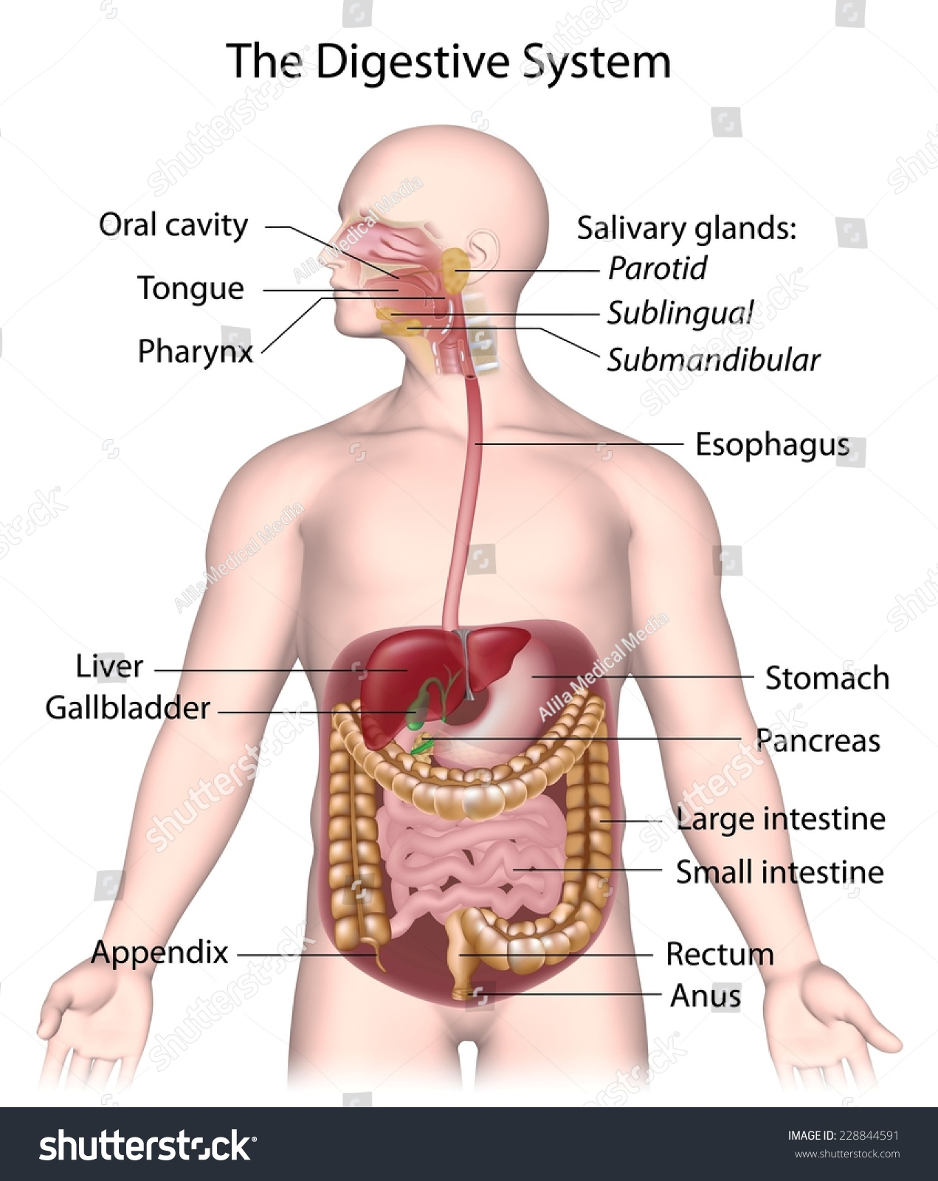

Slide 5


Combining Form
gluc(o)
glyc(o)
glucose
sugar
glycogen liver
glycogen(o)
hepat(o)
ile(o)
ileum
24

Slide 6


Combining Form
Meaning
anus, rectum pylorus rectum
saliva, salivary gland
salivary gland sigmoid colon fats
proct(o)
pylor(o) rect(o) sial(o)
sialaden(o) sigmoid(o) steat(o) stomat(o)
mouth
26

Slide 7

Abbreviation
Meaning
alanine transaminase
aspartic acid transaminase
ALT, AT
AST BE BM
EGD ERCP GERD GI
barium enema
bowel movement
esophagogastroduodenoscopy
endoscopic retrograde cholangiopancreatography
gastroesophageal reflux
disease
gastrointestinal
27

Slide 8
Meaning
inflammatory bowel disease irritable bowel syndrome
Abbreviation
IBD IBS NG NPO TPN UGI
nasogastric
nothing by mouth
total parenteral nutrition
upper gastrointestinal (series)

Slide 9

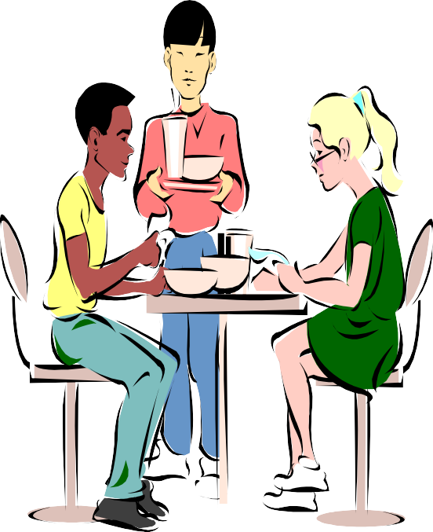
Eating Disorders
Anorexia
A morbid refusal to eat because the person wants to be dangerously thin
Bulimia
Obesity
Eating, then purposefully purging or vomiting to achieve weight loss
Excessive body weight that often results from overeating

Slide 10


Diseases of the Pharynx
Esophageal varices
twisted veins in the esophagus that are prone to hemorrhage and ulcers
Esophagitis
any inflammation of the esophagus
Gastroesophageal reflux
malfunctioning of the sphincter muscle at the bottom of the esophagus
Achalasia
failure of the sphincter muscle at the bottom of the
esophagus to relax during swallowing

Slide 11

Disorders of the Intestines
Duodenal ulcers
Ileus
A form of peptic ulcer thought to be bacterial in origin
An intestinal blockage
Colitis
Appendicitis
General term for inflammation
in the small intestine
Inflammation of the appendix, which lies on the side of the duodenum, and becomes inflamed if gastric substances leak into it from the duodenum
Ulcerative colitis
A chronic type of irritable bowel disease

Slide 12
Types of Endoscopes
esophagoscopy
gastroscopy
colonoscopy
proctoscopy
sigmoidoscopy
peritoneoscopy
X-rays and other Imaging Techniques
MRI
CAT scan
Barium swallow
Barium enema
Upper GI Series
Cholangiography
Cholecystography
Liver scan
Ultrasound

Slide 13



Procedures Requiring Removal
Term
glossectomy polypectomy appendectomy cholecystectomy gastrectomy colectomy hemorrhoidectomy
Part (s) Removed
tongue polyps appendix gallbladder stomach colon hemorrhoids
pancreatectomy
pancreas
43

Slide 14
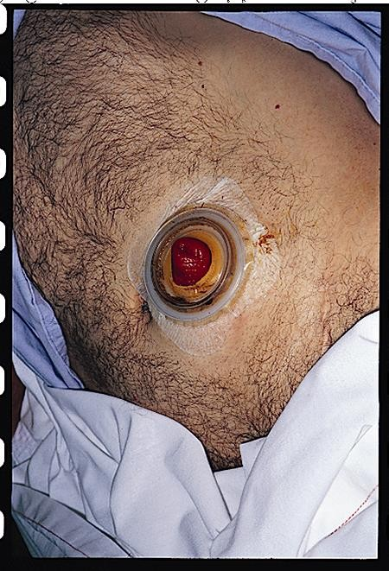
Openings may be made in the gastrointestinal tract for temporary or permanent alternatives to waste elimination.
ileostomy
-opening made in the ileum to allow fecal material to discharge into a bag outside the body
colostomy
-opening in the colon to create a place for waste to exit the body other than through the anus

Slide 15


Medications Used to Treat the Digestive System
Antacid
Antidiarrheal
Neutralizes stomach acid
(ex. Pepcid®)
Controls loose stools
(ex. Kaopectate®)
Antiemetic
Antispasmodic
Prevents regurgitation (ex. Tigan®)
Calms spasms of the GI tract
(ex. Robinul®)

Slide 16

Medications Used to Treat the Digestive System (cont’d)
Cathartic
Causes vomiting
Relieves constipation
Laxative
Relieves constipation

Slide 17

Which of the following structures is a part of the small intestine?
cecum
sigmoid colon
ileum
Answer: C. ileum

Slide 18
Which of the following is the site where digestion begins?
mouth
stomach
duodenum
Answer: A. mouth

Slide 19
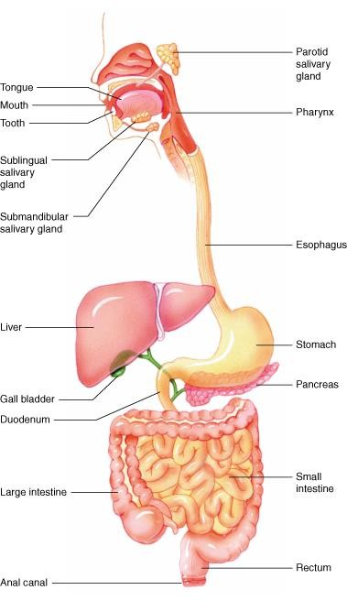
Locate the following structures on this diagram:
stomach, liver, gallbladder, large intestine, small intestines, anus, pancreas, duodenum and rectum
Answers:
7.
8.
9.
rectum
anal canal
large intestine
small intestine
duodenum
gall bladder
liver
stomach
pancreas
6.
5.
3.
4.
1.
2.
49

Slide 20
Mrs. Jones has recently had a cholecystectomy and she receives specific dietary instructions from her physician. Which of the following food types might she be instructed to avoid?
fatty foods
meats
sweets
Answer: A. fatty foods because she will have limited bile which is needed to breakdown the fats

Slide 21
James has been vomiting off and on for the past 8 hours. He goes to the local emergency room for treatment. Which of the following medications might he receive?
antiemetic
cathartic
antacid
Answer: A. antiemetic

