Slide 1
Cardiovasculer Disese part II
by Maysam Ali Ameen

Slide 2
II. Drug used in heart failure
Congestive heart failure occurs when there is an inability of the heart to maintain a cardiac out put sufficient to meet the requirements of the metabolising tissues.
Heart failure is usually caused by one of the following:
Ischaemic heart disease,
Hypertension,
Heart muscle disorders, and
Valvular heart disease.

Slide 3
A. Drugs with positive inotropic effect:-
Drugs with positive inotropic effect increase the force of contraction of the heart muscle. These include:
• Cardiac glycosides,
• Bipyridine derivatives,
• Sympathomimetics, and
• Methylxanthines

Slide 4
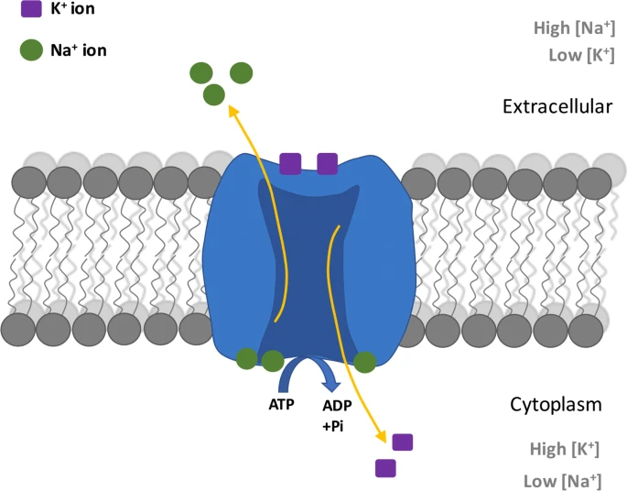
1\ Cardiac Glycosides
• Composed of steroid compounds that increase cardiac output and alter electrical functions.
• Commonly used are digoxin and digitoxin.
• Inotropic action mechanism: Inhibition of membrane-bound Na+ /K+ ATPase, causing increased intracellular sodium movement and accumulation.

Slide 5
• Decreased transmembrane exchange of sodium and calcium leads to increased intracellular calcium acting on contractile proteins.
• All glycosides have similar pharmacodynamic properties but differ in pharmacokinetic properties. Digitoxin is more lipid soluble and has longer half-life.
Therapeutic uses of cardiac glycosides include:
• Congestive heart failure
• Atrial fibrillation,
• Atrial flutter, and
• Paroxysmal atrial tachycardia.

Slide 6
2\ Bipyridine Derivatives :
• Possess positive inotropic and vasodilator effects.
• Mechanism of action: Inhibition of phophodiesterase, inactivating cyclic AMP.
• Increase in cAMP.
• Used in heart failure resistant to cardiac glycosides and vasodilators.

Slide 7
3\ Beta-Adrenergic Stimulants :
ex. dopamen and doputamin
• Increase myocardial contractility, increasing cardiac output.
• Positive chronotropic effect minimizes benefits, especially in ischaemic heart disease patients.
• Dobutamine's positive inotropic effect is greater than heart rate, reserved for acute failure or failure refractory to other oral agents.

Slide 8
B. Drugs without positive inotropic effect. These include:
• Diuretics, e.g. hydrochlorothiazide, furosemide
• Vasodilators, e.g. hydralazine, sodium nitroprusside
• Angiotensin converting enzyme inhibitors e.g. captopril, enalapril

Slide 9
Pharmacotherapy of Angina pectoris
Angina pectoris develops as a result of an imbalance between the oxygen supply and the oxygen demand of the myocardium.
It is a symptom of myocardial ischemia.
When the increase in coronary blood flow is unable to match the increased oxygen demand, angina develops.
It has become apparent that spasm of the coronary arteries is important in the production of angin

Slide 10
1\ Organic Nitrates: A Potent Vasodilator
• Used in therapy of angina pectoris for over 100 years.
• Mediates effects through direct relaxant action on smooth muscles.
• Mimics vasodilator action of endothelium derived relaxing factor (EDRF), nitric oxide.
• Action begins after 2-3 minutes when chewed or held under tongue.
• Action duration varies for different nitrates and pharmaceutical preparations.

Slide 11
• Adverse effects include flushing, weakness, dizziness, tachycardia, palpitation, vertigo, sweating, syncope localized burning, and contact dermatitis.
• Therapeutic uses include prophylaxis and treatment of angina pectoris, post myocardial infarction, coronary insufficiency, and acute LVF.

Slide 12
2\ Adrenergic Blocking Agents
• Exercise and emotional excitement cause angina by increasing heart rate, blood pressure, and myocardial contractility.
• Beta receptor blocking agents prevent angina by blocking these effects.
• Common agents include labetolol, atenololmetoprolol, propranolol LAMP .
• Adverse effects include lethargy, fatigue, rash, cold hands and feet, nausea, breathlessness, nightmares, and bronchospasm.
• Other therapeutic uses include hypertension, cardiac arrhythmias, post myocardial infarction, and pheochromocytoma.

Slide 13
3\Calcium Channel Blockers
• Interference with calcium entry into myocardial and vascular smooth muscle.
• Decreases intracellular calcium availability.
• Therapeutic uses include hypertension, acute coronary insufficiency, tachycardia.
• Adverse effects include flushing, nausea/vomiting, headache, ankle swelling, dizziness, constipation.

Slide 14
4.Miscellaneous drugs,e.g. Acetylsalicylic acid
Acetylsalicylic acid (aspirin) at low doses given intermittently decreases the synthesis of thromboxne A2 without drastically reducing prostacylin synthesis. Thus, at the doses of 75 mg per day it can produce antiplatelet activity and reduce the risk of myocardial infarction in anginal patients.

Slide 15
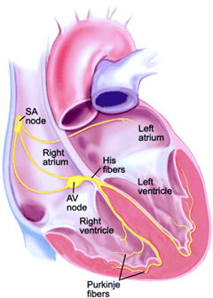

Slide 16
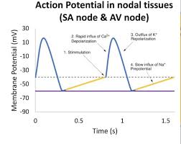

Slide 17
IV) Anti – arrhythmics
Electrophysiology of cardiac muscle: the pathophysiological mechanisms responsible for the genesis of cardiac arrhythmias are not clearly understood. However, it is generally accepted that cardiac arrhythmias arise as the result of either of
a) Disorders of impulse formation and/ or
b) Disorders of impulse conduction.
Antiarrhythmic drugs are used to prevent or correct cardiac arrhythmias (tachyarrhythmias).

Slide 18
Pharmacotherapy of cardiac arrhythmias
Drugs used in the treatment of cardiac arrhythmias are traditionally classified into:
Class (I): Sodium channel blockers which include quinidine, lidocaine, phenytion, flecainide, etc.
Class (II): Beta adrenergic blockers which include propranolol, atenolol, etc.
Class (III): Potassium channel blockers e.g. amiodarone, bretylium.
Class (IV): Calcium channel blockers e.g. verapamil, etc.
Class (V): Digitalis e.g.digoxin.

Slide 19
Class (I): Sodium channel blockers
Quinidine, a Class I drug, blocks sodium channels, increasing excitability threshold. It is well-absorbed orally but has low therapeutic ratio and adverse effects like SA block, cinchonism, severe headache, diplopia, and photophobia.
Lidocaine, a local anesthetic, blocks both open and inactivated sodium channels and decreases automaticity.

Slide 20
Class –II drugs: Beta-adrenergic receptor blockers
Propranolol: Myocardiac sympathetic beta receptor stimulation increases automaticity, enhances A.V. conduction velocity and shortens the refractory period. Propranolol can reverse these effects. Beta blockers may potentiate the negative inotropic action of other antiarrhythmics.
Therapeutic uses: This is useful in tachyarrhythmias, in pheochromocytoma and in thyrotoxicosis crisis.

Slide 21
Class – III: Potassium channel blockers
AMIODARONE: This drug is used in the treatment of refractory supraventriculat tachyarrhythmias and ventricular tachyarrhythmias.
It depresses sinus, atrial and A.V nodal function. The main adverse effects of this drug are anorexia, nausea, abdominal pain . Agents intended to increase the volume of blood in active circulation. peripheral neuropathy, A.V. block

Slide 22
Class IV drugs: Calcium channel blockers
Verapamil: this drug acts by blocking the movement of calcium ions through the channels. It is absolutely contraindicated in patients on beta blockers, quinidine or disopyramide. It is the drug of choice in case of paroxysmal supraventricular tachycardia for rapid conversion to sinus rhythm.

Slide 23
Class - V drugs: Digoxin
causes shortening of the atrial refractory period with small doses (vagal action) a prolongation with the larger doses (direct action). It prolongs the effective refractory period of A.V node directly and through the vagus. This action is of major importance in slowing the rapid ventricular rate in patients with atrial fibrillation

Slide 24
THANK YOU

