Slide 1
PHARMACOLOGY II lec 1
Antimicrobial Drugs
By : Dr. Maysam Ali Ameen

Slide 2
Antimicrobials
• Chemical agents used to treat bacterial, fungal, and viral infections.
• Antibiotics are substances produced by various microorganisms to suppress growth of other microorganisms.
• Antimicrobial drugs exhibit selective toxicity, harmful to parasites without host.
• Bactericidal action: Leads to the death of susceptible microbes.
• Bacteriostatic action: Inhibits microbial population growth and spread.

Slide 3
ANTIMICROBIAL DRUGS
Mechanisms of antimicrobial drug action:
1. Inhibition of cell wall synthesis
2. Cell membrane function inhibitors
3. Inhibition of protein synthesis
4. Inhibition of nucleic acid synthesis
5. Antimetabolites

Slide 4
1-Cell Wall Synthesis Inhibitors Group
• Includes beta-lactam antibiotics, vancomycin, bacitracine penicillins, cephalosporins, carbapenems, and monobactams.
• All have beta-lactam ring and carboxyl group, similar pharmacokinetics and action mechanisms.
• Water-soluble, primary renal elimination.

Slide 5
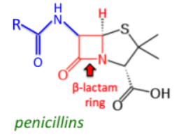
Penicillins
• Similar structure, pharmacological, and toxicological properties.
• Prototype penicillin G, derived from penicillium moulds.
• Classified into Natural Penicillins, Antistaphylococcal penicillins, and Extended-spectrum penicillins.
Mechanism of action
Inhibit bacterial growth by blocking transpeptidation reaction in cell wall synthesis.

Slide 6
Clinical use
Penicillin G and penicillin V are natural penicillins used for treating infections caused by streptococci, meningococci, enterococci, penicillin-susceptible pneumococci, and non-beta-lactamase-producing staphylococci.
Antistaphylococcal penicillins:
including methicillin, nafcillin, and isoxazolyl penicillins (Oxacillin, cloxacillin, and dicloxacillin), are used for infections caused by beta-lactamase-producing staphylococci, with oxacillin or nafcillin administered intravenously.

Slide 7
Extended Spectrum Penicillins Overview
• Aminopenicillins: Similar to penicillin G, but have greater activity against gram-negative bacteria.ampicillin, amoxicillin amoxicillin is better absorbed from the gut.
• Ampicillin IV: Used for serious infections caused by penicillin-susceptible organisms.
• Ureidopenicillins: Active against selected gram-negative bacilli, like Klebsiella pneumoniae. piperacillin ability to penetrate the gram-negative outer membrane

Slide 8
• Carboxypenicillins: Effective at lower doses, extend the ampicillin spectrum to include Pseudomonas aeruginosa and Enterobacter species .Carbenicillin
• Carboxypenicillins: Used in combination with aminoglycoside for pseudomonal infections due to P aeruginosa resistance.
• Methicillin, antibiotic formerly used in the treatment of bacterial infections caused by organisms of the genus Staphylococcus. Methicillin is a semisynthetic derivative of penicillin.

Slide 9
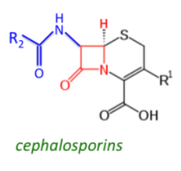
Cephalosporins
Cephalosporins are categorized into four generations based on their antimicrobial activity spectrum.
First-Generation Cephalosporins :
• Cefadroxil, cefazolin, cephalexin, cephalothin.
• Active against gram-positive cocci.
• Sensitive against Escherichia coli, Klebsiella pneumoniae,
• Inactivate against Pseudomonas aeruginosa.
Clinical used :Oral drugs are commonly used to treat urinary tract infections, minor staphylococcal lesions, and minor polymicrobial infections like cellulitis or soft tissue abscess.

Slide 10
Second Generation Cephalosporin Group
• Includes Cefuroxime.
• Heterogeneous with individual differences in activity, pharmacokinetics, and toxicity.
• Second-generation cephalosporins less active against gram-positive bacteria.
• Extended gram-negative coverage.
• Sensitive to Klebsiella and H influenzae.
• Can be given orally or parentrally.
Clinical Uses:
Sinusitis, otitis, or lower respiratory tract infections, mixed anaerobic infections.

Slide 11
Third-Generation Cephalosporins
• Members: cefotaxime, ceftazidime, ceftriaxone.
• Antimicrobial activity: cross blood-brain barrier and expand gram-negative coverage.
• Effective against Citrobacter, Serratia marcescens, Providencia, and beta-lactamase-producing Haemophilus and Neisseria strains.
• Can be given orally, IM, or IV.
• Cross blood brain barrier, inhibiting most pathogens, including gram-negative rods.

Slide 12
Clinical Uses:
• Gonorrhea (ceftriaxone, cefixime)
• Meningitis (pneumococci, meningococci, H influenzae)
• Penicillin-resistant pneumococci (ceftriaxone, cefotaxime)
• Sepsis

Slide 13
Fourth-generation cephalosporins (e.g.cefepime)
It is similar to third-generation agents; however, it is more resistant to hydrolysis by betalactamases. It has good activity against P aeruginosa
Fifth-generation cephalosporins
ceftaroline and ceftobiprole. Ceftaroline is also a broad-spectrum antimicrobial and thus can cover susceptible gram-positive and gram-negative organisms. However, what makes it unique from the rest of the cephalosporins is coverage against methicillin-resistant S aureus (MRSA).

Slide 14
Beta-Lactam Inhibitors
• Clavulanic acid, sulbactam, and tazobactam.
• No antimicrobial activity.
• Inhibit beta-lactamases irreversibly when combined with labile antibiotics.
• Examples: Timentin Ticarcillin and clavulanate Ampicillin and sulbactam [Unasyn], Amoxicillin and clavulanate [Augmentin]
, Unasyn, Augmentin.

Slide 15
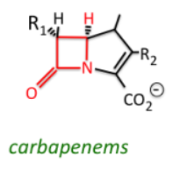
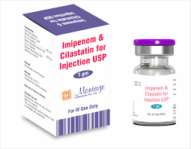
Carbapenems
• Incorporate imipenem and meropenem.
• Broad spectrum against most Gram-positive and negative bacteria.
• Imipenem inactivated by renal proteolytic enzyme.
• Must be combined with cilastatin.

Slide 16
Vancomycin
• Active against gram-positive bacteria, especially staphylococci.
• Inhibits cell wall synthesis.
• Poorly absorbed from intestinal tract.
• Administered orally for antibiotic-associated enterocolitis caused by Clostridium difficile.
• Parenteral doses must be intravenously.
• Widely distributed in body.
• Known to cause red man or red neck syndrome.

Slide 17
Bacitracin
• Active against gram-positive microorganisms.
• Inhibits cell wall formation.
• Nephrotoxic if systemically administered.
• Limited to topical use.
• Poorly absorbed.

Slide 18
THANK YOU

