Slide 1
PHARMACOLOGY II lec 4
Anticoagulants, Antiplatelets, and Thrombolytics
By : Dr. Maysam Ali Ameen

Slide 2
Introduction to Thromboembolic Disorders
Definition:
Thromboembolic disorders involve the formation of a thrombus (clot) that may obstruct blood flow, leading to severe complications.
If a clot detaches and moves, it becomes an embolus, which can cause stroke, myocardial infarction (MI), deep vein thrombosis (DVT), or pulmonary embolism (PE).

Slide 3
Pathophysiology of Thrombosis:
Arterial thrombosis: Forms due to platelet aggregation (e.g., in coronary artery disease → heart attack).
Venous thrombosis: Forms due to activation of clotting factors (e.g., in deep vein thrombosis).
Classes of Drugs Used in Thromboembolic Disorders:
Anticoagulants → Prevent new clot formation and stop clot growth.
Antiplatelet drugs → Prevent platelets from sticking together (important in arterial thrombosis).
Thrombolytic drugs → Dissolve pre-existing clots.

Slide 4
1. Anticoagulants
Function: Prevent clot formation by interfering with the coagulation cascade.
A. Parenteral Anticoagulants
1. Unfractionated Heparin (UFH)
Mechanism of Action:
  Binds to antithrombin III and enhances its activity.
  Inactivates thrombin (Factor IIa) and Factor Xa, preventing clot formation.

Slide 5
Indications:
  DVT, PE, MI, unstable angina.
  Used in pregnancy (does not cross the placenta).
Administration: IV or subcutaneous.
Monitoring:Activated Partial Thromboplastin Time (aPTT) (goal: 1.5–2.5x normal).
Side Effects: Bleeding, heparin-induced thrombocytopenia (HIT), osteoporosis (long-term use).
Antidote: Protamine sulfate (reverses heparin overdose).
Contraindications: Active bleeding, severe hypertension, recent surgery

Slide 6
2. Low Molecular Weight Heparins (LMWHs) (e.g., Enoxaparin, Dalteparin)
Mechanism:Inhibits Factor Xa more than thrombin
Advantages Over UFH:
  Longer half-life, no need for aPTT monitoring.
  Lower risk of HIT.
Uses:
  DVT prophylaxis in orthopedic surgery, cancer-associated thrombosis.
Antidote: Partial reversal with protamine sulfate.

Slide 7
3. Fondaparinux
Mechanism: Selective Factor Xa inhibitor.
Uses: Alternative for patients with HIT.
No specific antidote.

Slide 8
B. Oral Anticoagulants
1. Warfarin (Vitamin K Antagonist)
Mechanism: Inhibits Vitamin K epoxide reductase → prevents activation of clotting factors II, VII, IX, and X.
Uses: Long-term anticoagulation (e.g., atrial fibrillation, mechanical heart valves).
Monitoring: International Normalized Ratio (INR) (goal: 2–3; for mechanical heart valves, 2.5–3.5).

Slide 9
Antidote: Vitamin K (phytonadione), fresh frozen plasma (FFP).
Interactions:
  Increased INR (↑ bleeding risk): Antibiotics, amiodarone, NSAIDs.
  Decreased INR (↓ effect): Green leafy vegetables, rifampin.

Slide 10
2. Direct Oral Anticoagulants (DOACs)
Direct Thrombin Inhibitors: Dabigatran (Reversal agent: Idarucizumab).
Factor Xa Inhibitors: Rivaroxaban, Apixaban, Edoxaban (Reversal agent: Andexanet alfa).
Advantages over Warfarin:
  No INR monitoring required.
  Fewer drug and food interactions.

Slide 11
2. Antiplatelet Drugs
Function: Prevent platelet aggregation → used mainly in arterial thrombosis (e.g., MI, stroke).
a\ Aspirin (Acetylsalicylic Acid)
Mechanism:
  Irreversible COX-1 inhibition → ↓ thromboxane A2 → ↓ platelet aggregation.
Uses:
  MI prevention, stroke prevention, post-stent placement.
Side Effects:
  GI bleeding, peptic ulcers, Reye’s syndrome (children).

Slide 12
4. P2Y12 Inhibitors (Clopidogrel, Prasugrel, Ticagrelor)
Mechanism:
  Block ADP receptors → inhibit platelet activation.
Uses:
  Acute coronary syndrome, post-PCI (stent placement).
5. Glycoprotein IIb/IIIa Inhibitors (Abciximab, Eptifibatide, Tirofiban)
Mechanism:
  Block final step of platelet aggregation.
Uses:
  Used during percutaneous coronary intervention (PCI).

Slide 13
3. Thrombolytic (Fibrinolytic) Drugs
Function: Dissolve existing clots by converting plasminogen to plasmin, which degrades fibrin.
Examples:
Alteplase (tPA) (Tissue Plasminogen Activator).
Streptokinase.
Indications:
Acute MI (within 12 hours).
Ischemic stroke (within 3–4.5 hours).
Massive PE with hemodynamic instability.

Slide 14
Contraindications (Absolute):
🚫 Recent hemorrhagic stroke.
🚫 Active bleeding.
🚫 Severe hypertension (SBP >180 mmHg).
Side Effects:
Major bleeding (intracranial hemorrhage risk).
Allergic reactions (streptokinase).

Slide 15
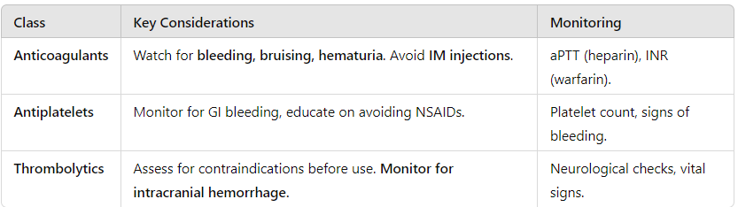
Nursing Considerations & Patient Education

Slide 16
Thank you

