Slide 1
PHARMACOLOGY II lec 2
Drug Therapy Across Different Life Stages: Pregnancy, Pediatrics, and Geriatrics
By : Dr. Maysam Ali Ameen

Slide 2
Drug Therapy During Pregnancy and Breastfeeding
Placental Transfer: Most drugs can cross the placenta to some extent, potentially affecting the fetus.
Teratogenicity: Certain drugs can cause congenital malformations, especially during the first trimester (organogenesis phase).
Pharmacokinetic Changes: Pregnancy alters absorption, distribution (increased blood volume), metabolism, and excretion, affecting drug levels.
Breastfeeding: Drugs can be excreted in breast milk, posing risks to the infant.

Slide 3
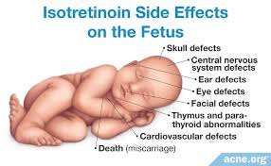
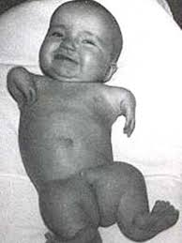
Safe Practices:
Avoid teratogenic drugs (e.g., isotretinoin, thalidomide).
Use the lowest effective dose and shortest duration possible.
FDA Pregnancy Categories (now replaced by detailed labeling) guide the safety of medications.
Monitor for neonatal withdrawal if drugs like opioids or SSRIs are used.

Slide 4
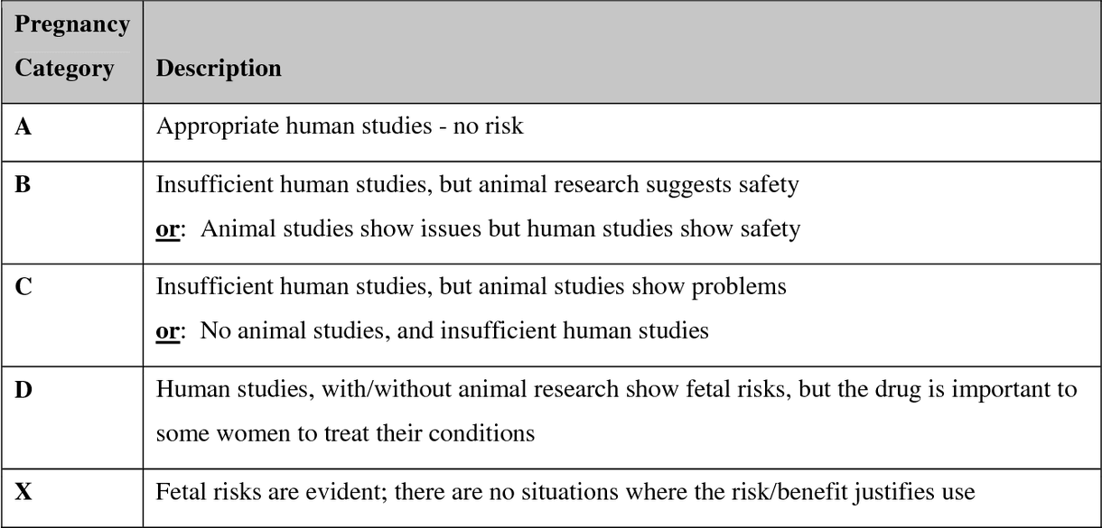

Slide 5
Common Concerns:
Antibiotics: Penicillins and cephalosporins are generally safe; tetracyclines should be avoided (risk of teeth discoloration).
Antiepileptics: Use with caution; folic acid supplementation is recommended to reduce neural tube defects.
Pain Management: Acetaminophen is preferred over NSAIDs (risk of premature ductus arteriosus closure).

Slide 6
Breastfeeding and Medication
• Drug transfer into breast milk
• Infant exposure calculation
• Safe medications during lactation
• Medications requiring temporary cessation
• Monitoring infant for adverse effects

Slide 7

Breastfeeding and Medication Exposure in Infants
• Over half of women use medications during breastfeeding, exposing infants to medication exposure.
• Adverse drug reactions may occur in infants, but are rarely reported.
• Disposition of maternal drugs in breast milk is described by relative infant dose (RID).

Slide 8
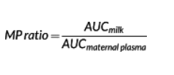
• Most drugs show RID values of <10%, indicating drug concentrations in infant serum do not reach therapeutic levels in adults.
• RID is a function of milk-to-(maternal) plasma drug concentration ratio (MP ratio) and maternal drug clearance.
• Some drugs show an MP ratio of <1 but an RID as high as 50–70%, while morphine shows an MP ratio of 2 but an RID in the range of 5%.

Slide 9
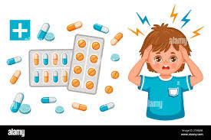
Drug Therapy for Pediatric Patients:
Key Considerations:
Immature Organ Function: Liver enzymes and renal clearance are underdeveloped, affecting drug metabolism and excretion.
Dosing Adjustments: Doses are often weight-based (mg/kg) or based on body surface area.
Blood-Brain Barrier: Less developed in neonates, increasing CNS drug penetration and potential toxicity.

Slide 10
Developmental Pharmacology
Age-related differences in drug absorption
Distribution variations in children
Metabolic pathway development
Excretion considerations
Body surface area calculations

Slide 11
Pediatric Dosing Principles
Weight-based dosing formulas
Surface area calculations
Age-specific considerations
Maximum/minimum dose limits
Dose frequency adjustments

Slide 12
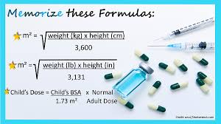
How do I calculate BSA for pediatrics?
Measure the child's weight (in kilograms – kg).
Check the child's height or length (in centimeters – cm).
Multiply the weight and height.
Divide the result by 3600.
Find the square root of that number.

Slide 13
Safe Practices:
Use pediatric-specific formulations the design and development of novel dosage forms, which should be adjustable for age, palatable, easy to administer, and, at the same time, safer and effective when available.
Adjust dosing based on age, weight, and developmental stage.
Monitor for growth and developmental side effects.
Administration techniques

Slide 14
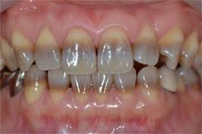
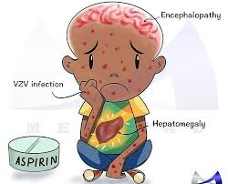
Common Concerns:
Antibiotics: Avoid sulfonamides in neonates (risk of kernicterus Kernicterus is a complication of severe jaundice.);
tetracyclines in children under 8 (teeth discoloration).
Pain Management: Acetaminophen and ibuprofen are safe; avoid aspirin (risk of Reye’s syndrome).
Vaccination Timing: Certain immunizations may be delayed if using immunosuppressive drugs.

Slide 15
Drug Therapy for Geriatric Patients:
Key Considerations:
Altered Pharmacokinetics: Reduced renal and hepatic function affects drug clearance. Increased fat stores can prolong the half-life of lipophilic drugs.
Polypharmacy: Older adults often take multiple medications, increasing the risk of drug-drug interactions and adverse effects.
Increased Sensitivity: Enhanced sensitivity to certain drugs, like CNS depressants (e.g., benzodiazepines).

Slide 16
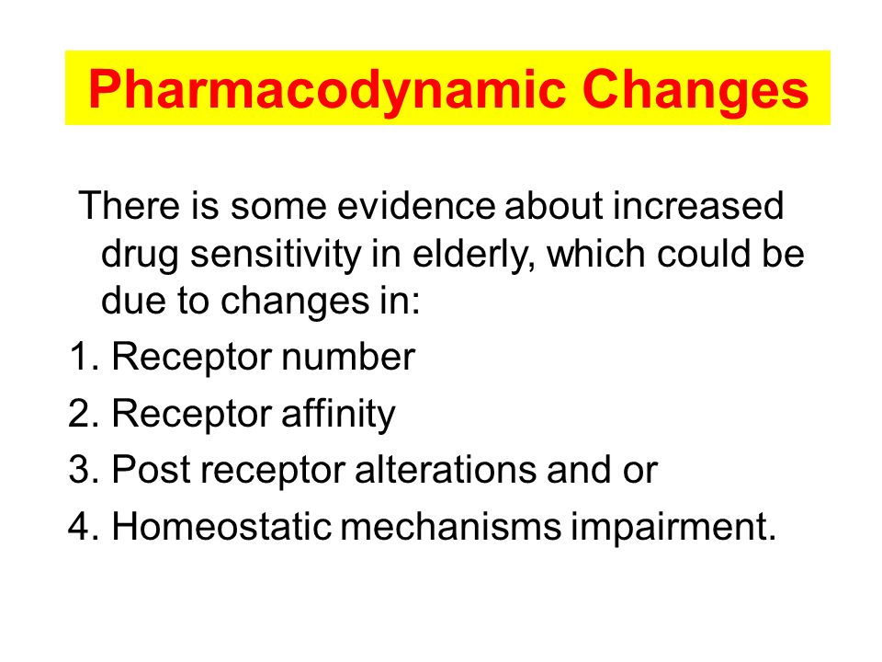

Slide 17
Safe Practices:
Follow the "start low, go slow" approach—initiate treatment with low doses and titrate slowly.
Use tools like the Beers Criteria lists of medicines that may be hazardous under certain situationsto identify potentially inappropriate medications in older adults.
Regularly review medications to minimize polypharmacy and check for renal function (e.g., CrCl or eGFR) before prescribing.

Slide 18
Common Concerns:
Antihypertensives: Increased risk of orthostatic hypotension; monitor closely.
CNS Drugs: Higher risk of sedation, falls, and cognitive impairment with benzodiazepines, antipsychotics, and anticholinergics.
NSAIDs: Increased risk of GI bleeding and renal dysfunction.

Slide 19
THANK YOU

